Slide 1

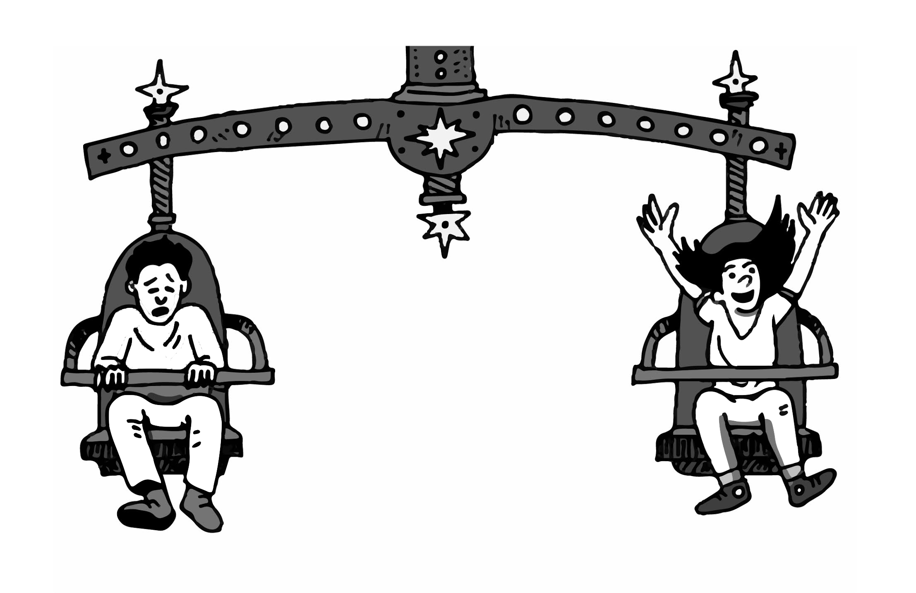
Twist-O-Matic Challenges
ANSWER KEY
Name:________________________
How is your body similar to a car?
CHALLENGE #1
The Twist-O-Matic needs to spin exactly 5 times on its own. So...
How many times do you need to turn the Twist-O-Matic with the THIN rubber band?
How many times do you need to turn the Twist-O-Matic with the THICK rubber band?
Would you use THIN or THICK rubber bands to make the most exciting ride? Why?
5 times
5 times
I would use thick rubber bands because the ride spins faster than when I used the thin rubber bands. The thick rubber band stores more energy than the thin rubber band.
CHALLENGE #2
Sadly, you can’t use THICK rubber bands. Do some experiments and describe what you did to make a fun, fast Twist-O-Matic ride using the THIN rubber band. (It’s okay if the ride spins around more than 5 times.)
Why do you think your experiment was successful in terms of energy?
I turned the Twist-O-Matic with the thin rubber band more than 5 times. (Note: This is one method, students could propose other methods that also solve the problem. Anything that adds more energy to the system will work.)
My experiment was successful because turning the rubber band more times adds more energy to the ride. The more energy it has, the faster it spins.
CHALLENGE #3
How will you make your real ride go—where will the stored energy come from?
Draw your ideas in the box. (If you need more room, use the back of the page.)
Student answers will vary, but should show some way of storing energy that was discussed in the lesson. Examples include using gasoline, batteries, electricity/electrical outlets, food, gigantic springs, or rubber bands.

