Slide 1

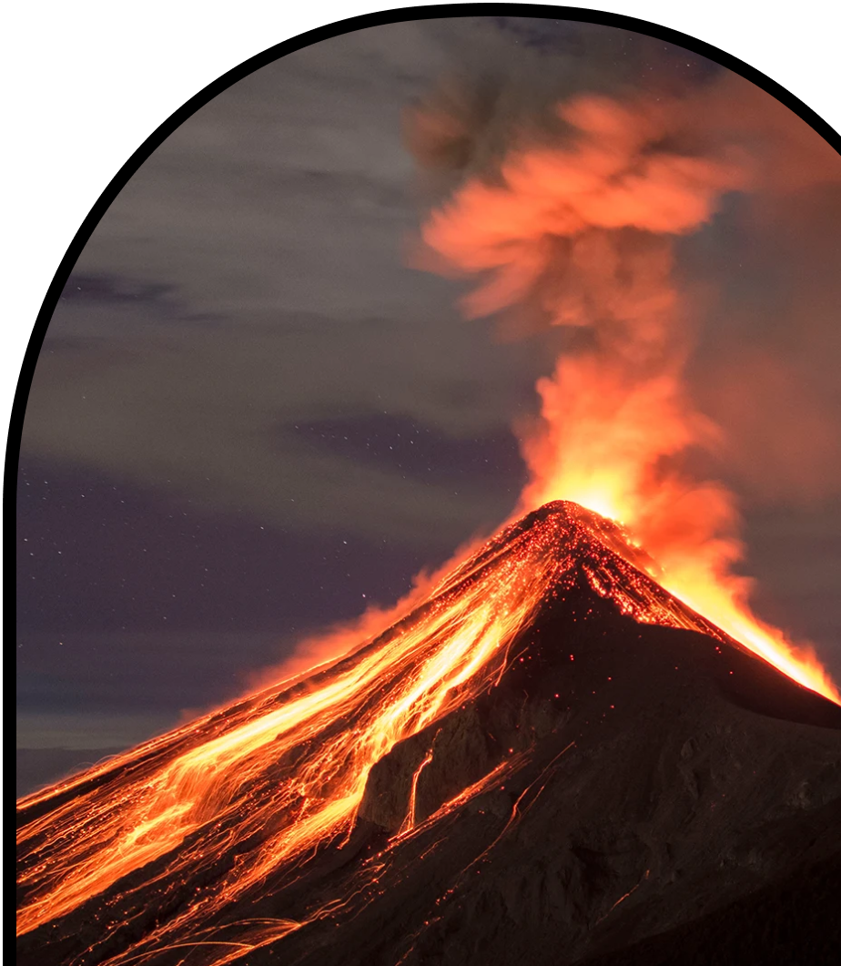
Anchor Layer Teacher Guide
A curriculum companion for Anchor Layer users
Grade 4
Earth’s Features & Processes
Unit Web Link • Pacing Guide • Other Units

Slide 2
Earth’s Features & Processes • Grade 4
Anchor Layer Teacher Guide
Unit Summary
In this unit, students investigate features and processes of the Earth’s surface. Students explore the rapid process of volcanic eruptions! In contrast, students also explore the gradual Earth processes of weathering and erosion. Students apply their knowledge and design solutions to mitigate the impacts of these processes on humans. Assessments
Performance Expectations | Science & Engineering Practices | Disciplinary Core Ideas | Crosscutting Concepts
• 4-ESS1-1. Identify evidence from patterns in rock formations and fossils in rock layers to support an explanation for changes in a landscape over time. • 4-ESS2-1. Make observations and/or measurements to provide evidence of the effects of weathering or the rate of erosion by water, ice, wind, or vegetation • 4-ESS2-2. Analyze and interpret data from maps to describe patterns of Earth’s features. • 4-ESS3-2. Generate and compare multiple solutions to reduce the impacts of natural Earth processes on humans. • 3-5-ETS1-2. Generate and compare multiple possible solutions to a problem based on how well each is likely to meet the criteria and constraints of the problem | • Analyzing and Interpreting Data • Engaging in Argument from Evidence • Constructing Explanations and Designing Solutions • Planning and Carrying Out Investigations • Constructing Explanations and Designing Solutions • Developing and Using Models | • ETS1.B: Designing Solutions to Engineering Problems • ESS1.C: The History of Planet Earth • ESS2.A: Earth Materials and Systems • ESS2.B: Plate Tectonics and Large-Scale System Interactions • ESS2.E: Biogeology • Ess3.B: Natural Hazards •ETS1.B: Designing Solutions to Engineering Problems | • Patterns • Cause and Effect
Earth’s Features & Processes Lesson Flow on Next Page
‹#›

Slide 3
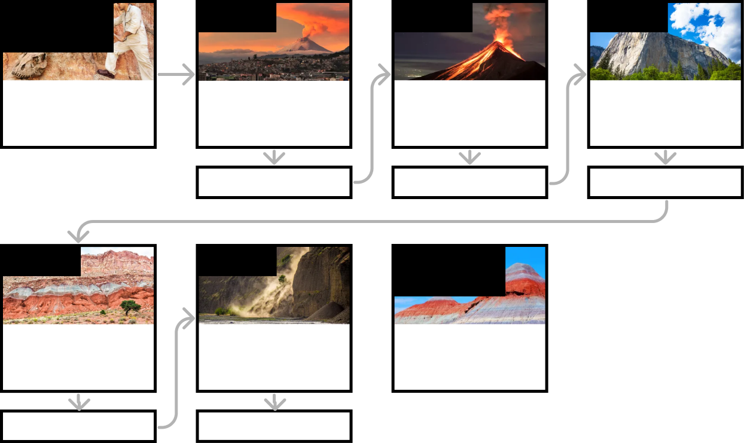
Earth’s Features & Processes • Grade 4
Anchor Layer Teacher Guide
Earth’s Features & Processes Lesson Flow
Anchor Phenomenon
Lesson 1
Lesson 2
Lesson 3
Fossils and Constructing Explanations
Fossil Finds
Volcanoes & Patterns of Earth’s Features
Could a volcano pop up where you live?
Volcanoes & Rock Cycle
Why do some volcanoes explode?
Weathering & Erosion
Will a mountain last forever?
Anchor Connection
Anchor Connection
Anchor Connection
Lesson 4
Lesson 5
Performance Task
Sedimentary Rock & Fossils
What did your town look like 100 million years ago?
Erosion, Natural Hazards, & Engineering
How could you survive a landslide?
Rocks & Earth’s Surface
How can you figure out where a rock came from?
Anchor Connection
Anchor Connection
‹#›

Slide 4
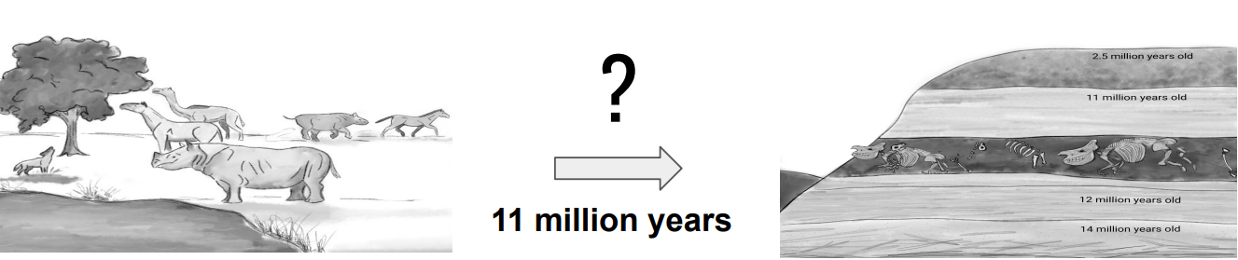
Earth’s Features & Processes • Grade 4
Anchor Layer Teacher Guide
Anchor Phenomenon Background
How did the land at the Ashfall Fossil Beds change over time?
11 million years ago, a volcano in Idaho (over 1,000 miles from Nebraska) erupted. The volcano had thick lava that was explosive and spewed ash for miles. The ash traveled to Nebraska, and slowly, the animals at the Ashfall Fossil Beds site suffocated. The smaller animals that had less lung capacity died first, and after a few weeks, the larger animals died.
A layer of ash settled over the bodies of the animals immediately following their death. Over time, nearby mountain ranges weathered and were broken down into sand, clay, gravel, and small rocks. This sediment was carried by rivers running through the Ashfall Fossil Beds and deposited on top of the fossil layer.
In 1971, a heavy rainfall occurred, washing away land. This exposed the first fossil of a baby rhino’s skull on the side of a ravine on a farm in Nebraska.
Paleontologists have uncovered over 100 fully intact skeletons of prehistoric animals that died from the volcanic eruption 11 million years ago. The Ashfall Fossil Beds site is an active dig site that is open to visitors.
‹#›

Slide 5
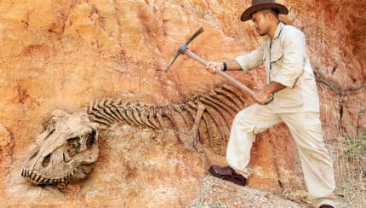
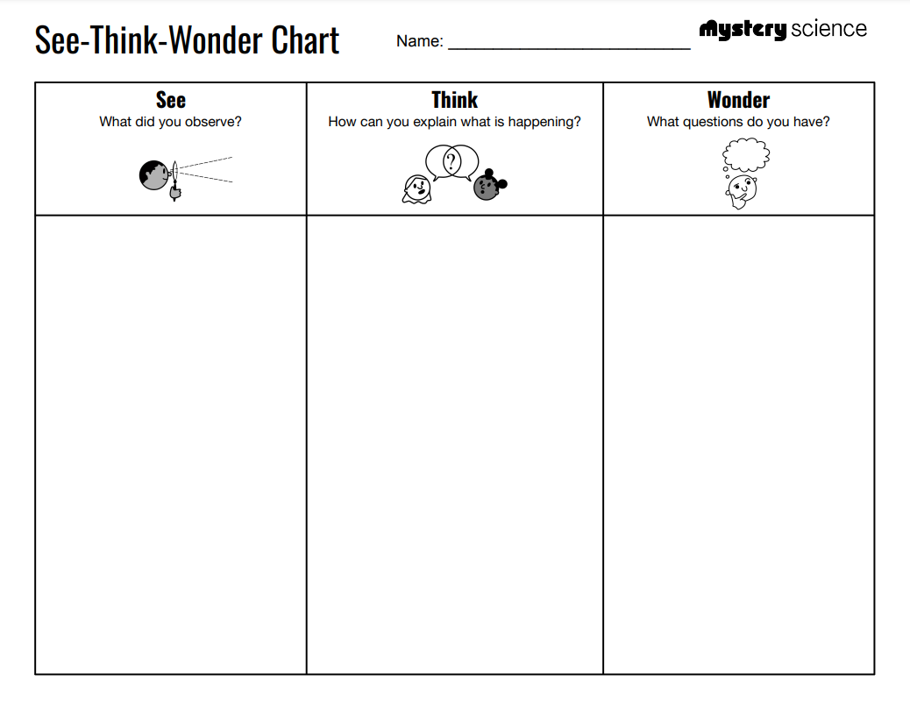
Earth’s Features & Processes • Grade 4
Anchor Layer Teacher Guide
Anchor Phenomenon: Fossil Finds
Fossils and Constructing Explanations
Anchor Phenomenon Lesson Overview
Note: This lesson is part of this unit’s Anchor Layer. If you have the Anchor Layer turned on, we recommend teaching all lessons in the remainder of this unit in order.
The anchor phenomenon for this unit is the Ashfall Fossil Beds. Students generate observations and questions about the phenomenon and create an initial explanation to explain what killed the prehistoric animals, how their bones ended up underground, and what changes happened to the land that uncovered their fossils.
Anchor Phenomenon 10 mins
Guided Inquiry 20 mins
Hands-On Activity 30 mins
Student Work Samples & Notes
It is important to encourage students to recognize that even if they don't know the perfect answer yet, they are going to learn a lot throughout the unit and have an opportunity to change or add to their first explanation.
The fossils are all intact
The fossils are laying down
The fossils are close to each other
There are different types of skeletons
The fossils are in a white/grey substance
Ideas about how the animals died will vary.
Some possibilities include: meteor, starvation, they died with the dinosaurs, covered in volcano lava
The fossils were covered by layers of earth
How did the animals die?
How long ago did the animals die?
How many animals are there?
How did they all die at the same time?
Why are the skeletons all in one piece?
‹#›

Slide 6
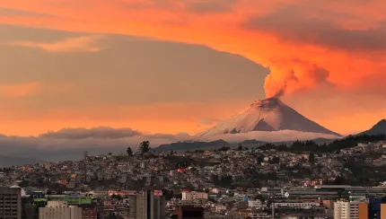
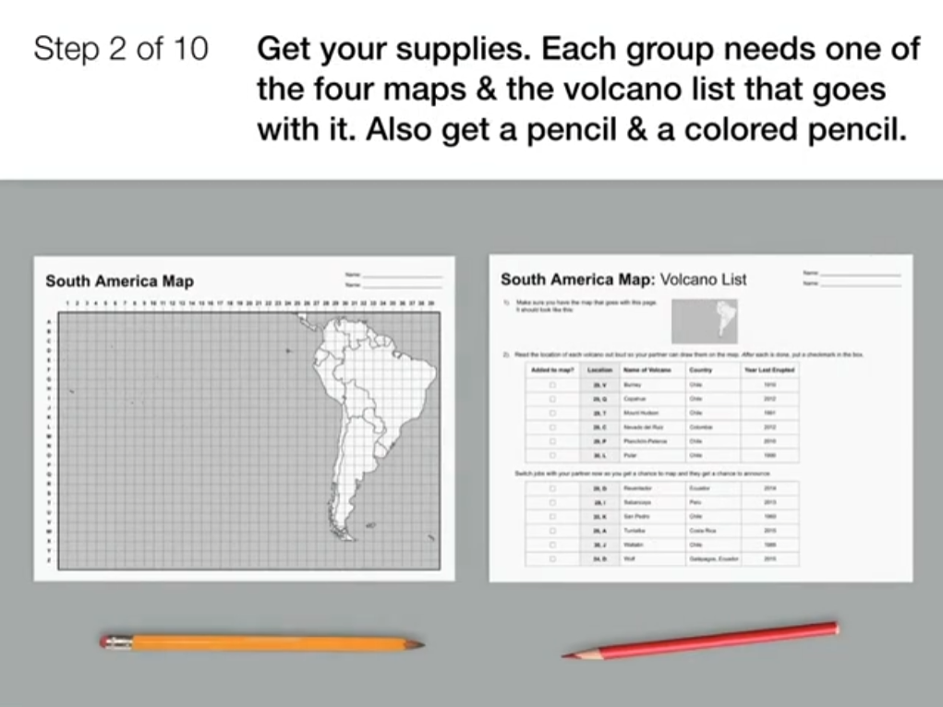
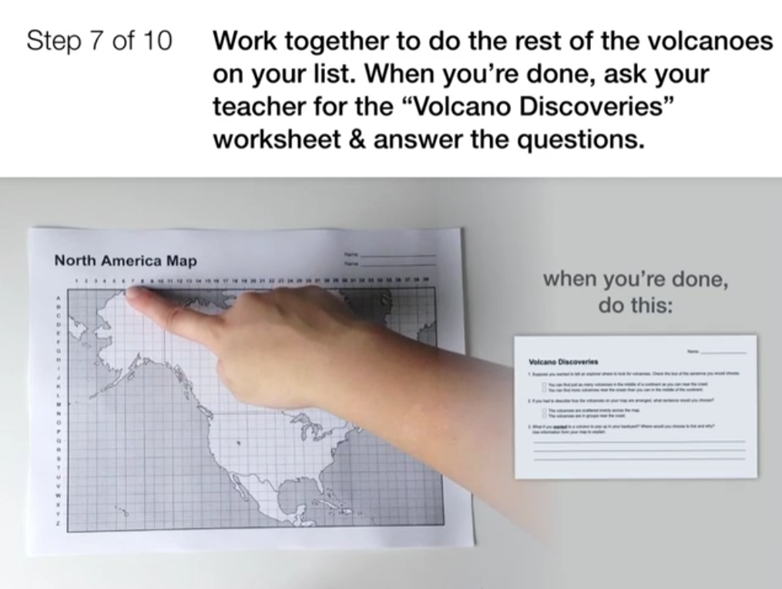
Earth’s Features & Processes • Grade 4
Anchor Layer Teacher Guide
Lesson 1: Could a volcano pop up where you live? (pg 1 of 2)
Volcanoes & Patterns of Earth’s Features
Overview
In this lesson, students explore the past and present pattern of where volcanoes exist on the earth.
In the activity, Mapping Volcanoes, students plot volcano locations on a world map and look for patterns. Students analyze these maps to discover that volcanoes form a “Ring of Fire” around the Pacific Ocean.
Anchor Connection on Next Page
Exploration 7 mins
Hands-On Activity 40 mins
Wrap-up 8 mins
Anchor Connection 30 mins
Assessment 25 mins
Activity Notes
We suggest students work in pairs. Each pair of students will work on one quarter of the Volcano Map. At the end of the activity, four pairs of students will bring their maps together to form one complete Volcano Map.
You will need enough wall space to display the completed maps. There will be one map for every 8 students, so a class of 32 students will have 4 completed maps. Each complete map measures approximately 22” x 17”.
Display Maps (Optional): At the end of the activity, you may want to display the completed Volcano Maps. Depending on the wall surface, attach the maps using tape or push pins.
‹#›

Slide 7
Earth’s Features & Processes • Grade 4
Anchor Layer Teacher Guide
Lesson 1: Could a volcano pop up where you live? (pg 2 of 2)
Volcanoes & Patterns of Earth’s Features
Anchor Connection
The Ashfall Fossil Beds site is far from where any volcanoes are found today. Students consider if a volcano could be responsible for the death of the prehistoric animals.
In the lesson 1 Anchor Connection, students map the location of 6 prehistoric volcanoes. They evaluate distance of the volcanoes from the Ashfall Fossil Beds in Nebraska.
Students revisit the explanation that they worked on during the Anchor Phenomenon. They should understand that there were prehistoric volcanoes located in North America, but they are not near the Ashfall Fossil Beds.
Students can update their explanations by adding new evidence and thinking:
Question 1: How did the prehistoric rhinos and other animals die?
The animals weren’t near a volcano at the Ashfall Fossil Beds site. Maybe they weren’t killed by a volcano?
Question 2: Why did it take 11 million years to find the fossils of the animals?
The earth can change over time.
Question 3: How were the fossils eventually found?
--
Connecting Storyline Question
How could the volcanoes have killed the rhinos even if they are far away?
Exploration 7 mins
Hands-On Activity 40 mins
Wrap-up 8 mins
Anchor Connection 30 mins
Assessment 25 mins
‹#›

Slide 8
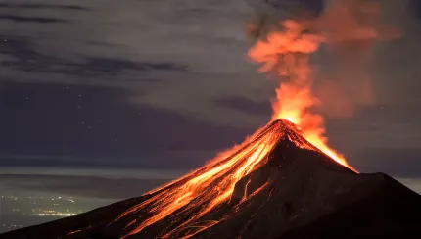

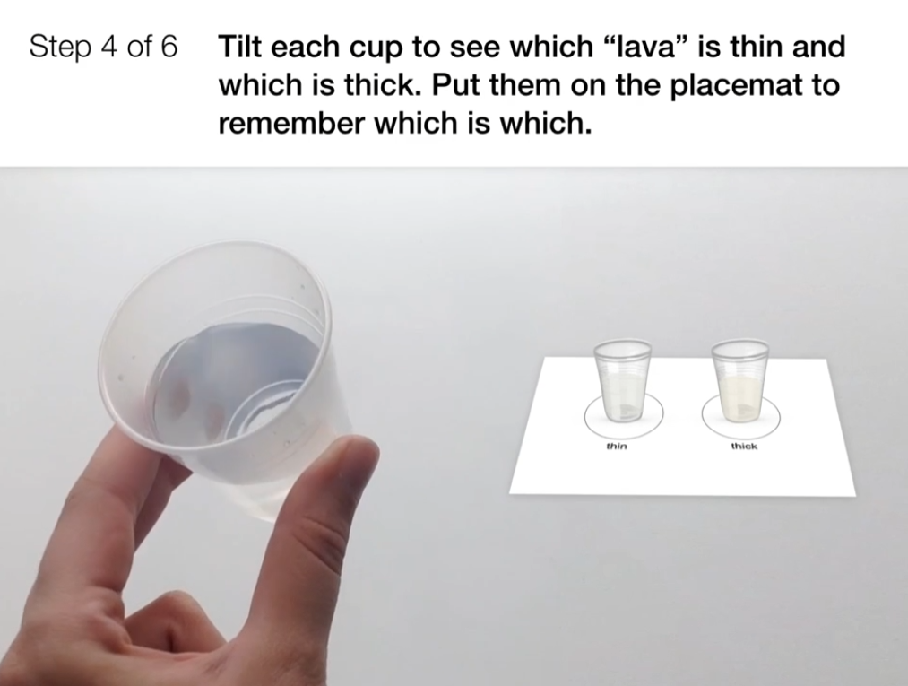
Earth’s Features & Processes • Grade 4
Anchor Layer Teacher Guide
Lesson 2: Why do some volcanoes explode? (pg 1 of 2)
Volcanoes & Rock Cycle
Overview
In this lesson, students will investigate how differences in lava types explain differences in the shape and eruption patterns among volcanoes.
In the activity, Bubble Trouble, students compare two different types of "lava" -- thin and thick. They use this information to figure out why volcanoes have different shapes and how the type of lava explains why some volcanoes explode.
Anchor Connection on Next Page
Exploration 15 mins
Hands-On Activity 35 mins
Wrap-up 5 mins
Anchor Connection 30 mins
Assessment 25 mins
Activity Notes
You will need access to water for this activity. We suggest students work in pairs.
To prepare the “lava,” you will need water, flour, a 1-gallon Ziploc bag (or large mixing bowl), measuring cups, scissors, and (optionally) red food coloring. For thin lava, use plain water. You can optionally add a drop or two of red food coloring to make it look more like lava. To make thick lava, mix up the flour with water and (optionally) red food coloring. See the lesson page for more detailed prep instructions.
Fill half of the cups about halfway with the “thin lava.” Fill the other half of the cups about halfway with the “thick lava.”
‹#›

Slide 9
Earth’s Features & Processes • Grade 4
Anchor Layer Teacher Guide
Lesson 2: Why do some volcanoes explode? (pg 2 of 2)
Volcanoes & Rock Cycle
Anchor Connection
Students update their Ashfall Fossil Beds Evidence Chart to show which of the prehistoric volcanoes had thick lava. The ash from a thick lava volcano could have traveled the distance to Nebraska.
In the lesson 2 Anchor Connection, students evaluate the list of prehistoric volcanoes, considering the type of lava the volcano had and how long ago it erupted. They determine which volcano may have caused the death of the animals.
Students revisit the explanationthat they worked on during the Anchor Phenomenon. They should understand that the volcanoes closest to the Ashfall Fossil Beds site erupted thick lava. These eruptions create huge explosions and the ash could have made it all the way to Nebraska.
Students can update their explanations by adding new evidence and thinking:
Question 1: How did the prehistoric rhinos and other animals die?
The animals could have been killed by the ash of a thick lava volcano.
Question 2: Why did it take 11 million years to find the fossils of the animals?
--
Question 3: How were the fossils eventually found?
--
Connecting Storyline Question
If ash fell on top of the rhinos, how did the bones end up so far underground, underneath other rocks?
Exploration 15 mins
Hands-On Activity 35 mins
Wrap-up 5 mins
Anchor Connection 30 mins
Assessment 25 mins
‹#›

Slide 10
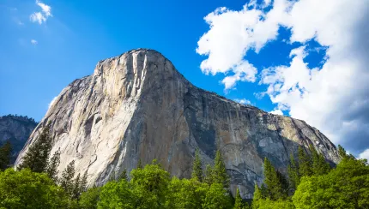

Earth’s Features & Processes • Grade 4
Anchor Layer Teacher Guide
Lesson 3: Will a mountain last forever? (pg 1 of 2)
Weathering & Erosion
Overview
In this lesson, students will explore how solid rock breaks apart into smaller pieces through a process called weathering (including root-wedging and ice-wedging).
In the activity, Sugar Shake, students use sugar cubes as a model for rocks. They perform an experiment with this model to understand the process of weathering and how this process explains why rocks at the tops of mountains are jagged, while those at the bottom are rounded.
Anchor Connection on Next Page
Exploration 20 mins
Hands-On Activity 45 mins
Anchor Connection 30 mins
Assessment 25 mins
Activity Notes
We suggest students work in pairs.
Each pair of students will experiment with 5 sugar cubes. You may want to count out 5 sugar cubes and place each on a paper plate prior to class for easier distribution.
‹#›

Slide 11
Earth’s Features & Processes • Grade 4
Anchor Layer Teacher Guide
Lesson 3: Will a mountain last forever? (pg 2 of 2)
Weathering & Erosion
Anchor Connection
The fossils at the Ashfall Fossil Beds were found in a layer of ash. Below and above the ash layer were layers of sand, gravel, and clay. The sediment was carried from weathered mountains by the river and deposited at the fossil site over time.
In the lesson 3 Anchor Connection, students analyze the the fossil layers at the Ashfall Fossil Beds and the location of mountains and rivers nearby to predict why the fossils were covered for so long.
Students revisit the explanation that they worked on during the Anchor Phenomenon. They should understand that pieces of rock fall down nearby mountains and are smoothed as they tumble. Over time these rocks, along with sediments, were carried by a river to the Ashfall Fossil Beds site, piling on top of the rhino fossils.
Students can update their explanations by adding new evidence and thinking:
Question 1: How did the prehistoric rhinos and other animals die?
--
Question 2: Why did it take 11 million years to find the fossils of the animals?
The layers below and above the ash layer are made of sediment carried from mountains by the river and deposited over time. This buried the fossils.
Question 3: How were the fossils eventually found?
--
Connecting Storyline Question
How did the fossils end up inside of solid rock?
Exploration 20 mins
Hands-On Activity 45 mins
Anchor Connection 30 mins
Assessment 25 mins
‹#›

Slide 12
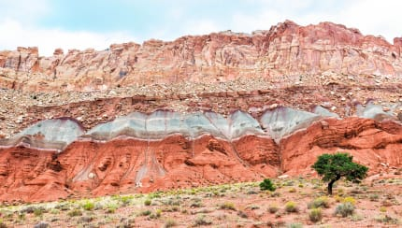
Earth’s Features & Processes • Grade 4
Anchor Layer Teacher Guide
Lesson 4: What did your town look like 100 million years ago?
Sedimentary Rock & Fossils (pg 1 of 2)
Overview
In this lesson, students gather evidence to describe how environments on Earth have changed over time. Students explore how the process of sedimentary rock formation preserves a record of those past environments.
In the activity, Canyon Explorer, students observe fossils found within a model canyon. The characteristics of those fossils provide evidence to support the explanation that the landscape has changed numerous times.
Teacher Background
Colossal Canyon is a model, but if you and your students are curious, each layer roughly corresponds to a real geologic time period. If you want to learn more, be sure to check out our Extension with links to help you explore rocks and fossils throughout the National Park System in the United States.
Layer 6: Tertiary Period 65-2 million years ago
Layer 5: Cretaceous Period 145-65 million years ago
Layer 4: Triassic & Jurassic Periods 250-145 million years ago
Layer 3: Permian Period 300-250 million years ago
Layer 2: Carboniferous Period 350-300 million years ago
Layer 1: Devonian Period 400-350 million years ago
Anchor Connection on Next Page
Exploration 20 mins
Hands-On Activity 35 mins
Wrap-up 15 mins
Anchor Connection 15 mins
Assessment 25 mins
Activity Notes
We suggest students work in pairs. If you have limited time, you can divide this lesson into two sessions. We have marked a natural stopping point after the construction of the model canyon.
‹#›

Slide 13
Earth’s Features & Processes • Grade 4
Anchor Layer Teacher Guide
Lesson 4: What did your town look like 100 million years ago?
Sedimentary Rock & Fossils (pg 2 of 2)
Anchor Connection
When sediment collects in an area, it can bury and protect objects for millions of years. This is how we find fossils of plants and animals from the deep past.
In the lesson 4 Anchor Connection, students consider that most living things quickly break down after they die. The animals at the Ashfall Fossil Beds were completely buried. While this is what killed the animals, it is also what preserved their remains so that we can observe them 11 million years later.
Students revisit the explanation that they worked on during the Anchor Phenomenon. They should understand that as sedimentary rock forms, it can trap and preserve the remains of living things. This is why we can still see ancient fossils in the Ashfall Beds.
Students can update their explanations by adding new evidence and thinking:
Question 1: How did the prehistoric rhinos and other animals die?
–
Question 2: Why did it take 11 million years to find the fossils of the animals?
Once the fossils were buried, the layers of sand and rock above them grew taller and taller. Those layers protected the fossils.
Question 3: How were the fossils eventually found?
–
Connecting Storyline Question
How did the rhino fossils become exposed after being buried for so long?
Exploration 20 mins
Hands-On Activity 35 mins
Wrap-up 15 mins
Anchor Connection 15 mins
Assessment 25 mins
‹#›

Slide 14
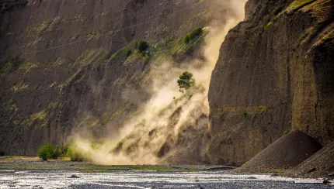

Earth’s Features & Processes • Grade 4
Anchor Layer Teacher Guide
Lesson 5: How could you survive a landslide? (pg 1 of 2)
Erosion, Natural Hazards, & Engineering
Overview
In this lesson, students will learn about the types, causes, and dangers of landslides.
In the activity, Slide City, students are faced with the engineering problems of protecting a house from a landslide and preventing a landslide from happening. They use a brainstorming technique to design creative solutions.
Anchor Connection on Next Page
Exploration 13 mins
Hands-On Activity 30 mins
Wrap-up 2 mins
Anchor Connection 30 mins
Assessment 25 mins
Activity Notes
You will need a large wall or board space where you can put up student Post-it notes.
To prepare for this brainstorming activity, we suggest teachers watch this short video demonstration of brainstorming.
‹#›

Slide 15
Earth’s Features & Processes • Grade 4
Anchor Layer Teacher Guide
Lesson 5: How could you survive a landslide? (pg 2 of 2)
Erosion, Natural Hazards, & Engineering
Anchor Connection
When sloped areas of earth become full of water (after a heavy rain) it often causes the earth to slide/move. This is called a landslide.
In the lesson 5 Anchor Connection, students consider that the weather conditions--heavy rain--caused the earth to slide. This exposed the original fossil after 11 million years of being buried.
Students revisit the explanation that they worked on during the Anchor Phenomenon. They should understand that years of heavy rain could have eroded the earth on the hillside of the farm, eventually exposing the rhino jaw fossil.
Students can update their explanations by adding new evidence and thinking:
Question 1: How did the prehistoric rhinos and other animals die?
--
Question 2: Why did it take 11 million years to find the fossils of the animals?
--
Question 3: How were the fossils eventually found?
Rain washed the earth away, exposing the fossils that had been buried for 11 million years.
Connecting Storyline Question
How can we figure out where a rock comes from?
Exploration 13 mins
Hands-On Activity 30 mins
Wrap-up 2 mins
Anchor Connection 30 mins
Assessment 25 mins
‹#›

Slide 16
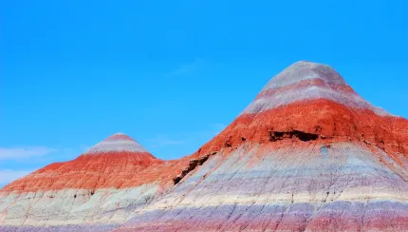
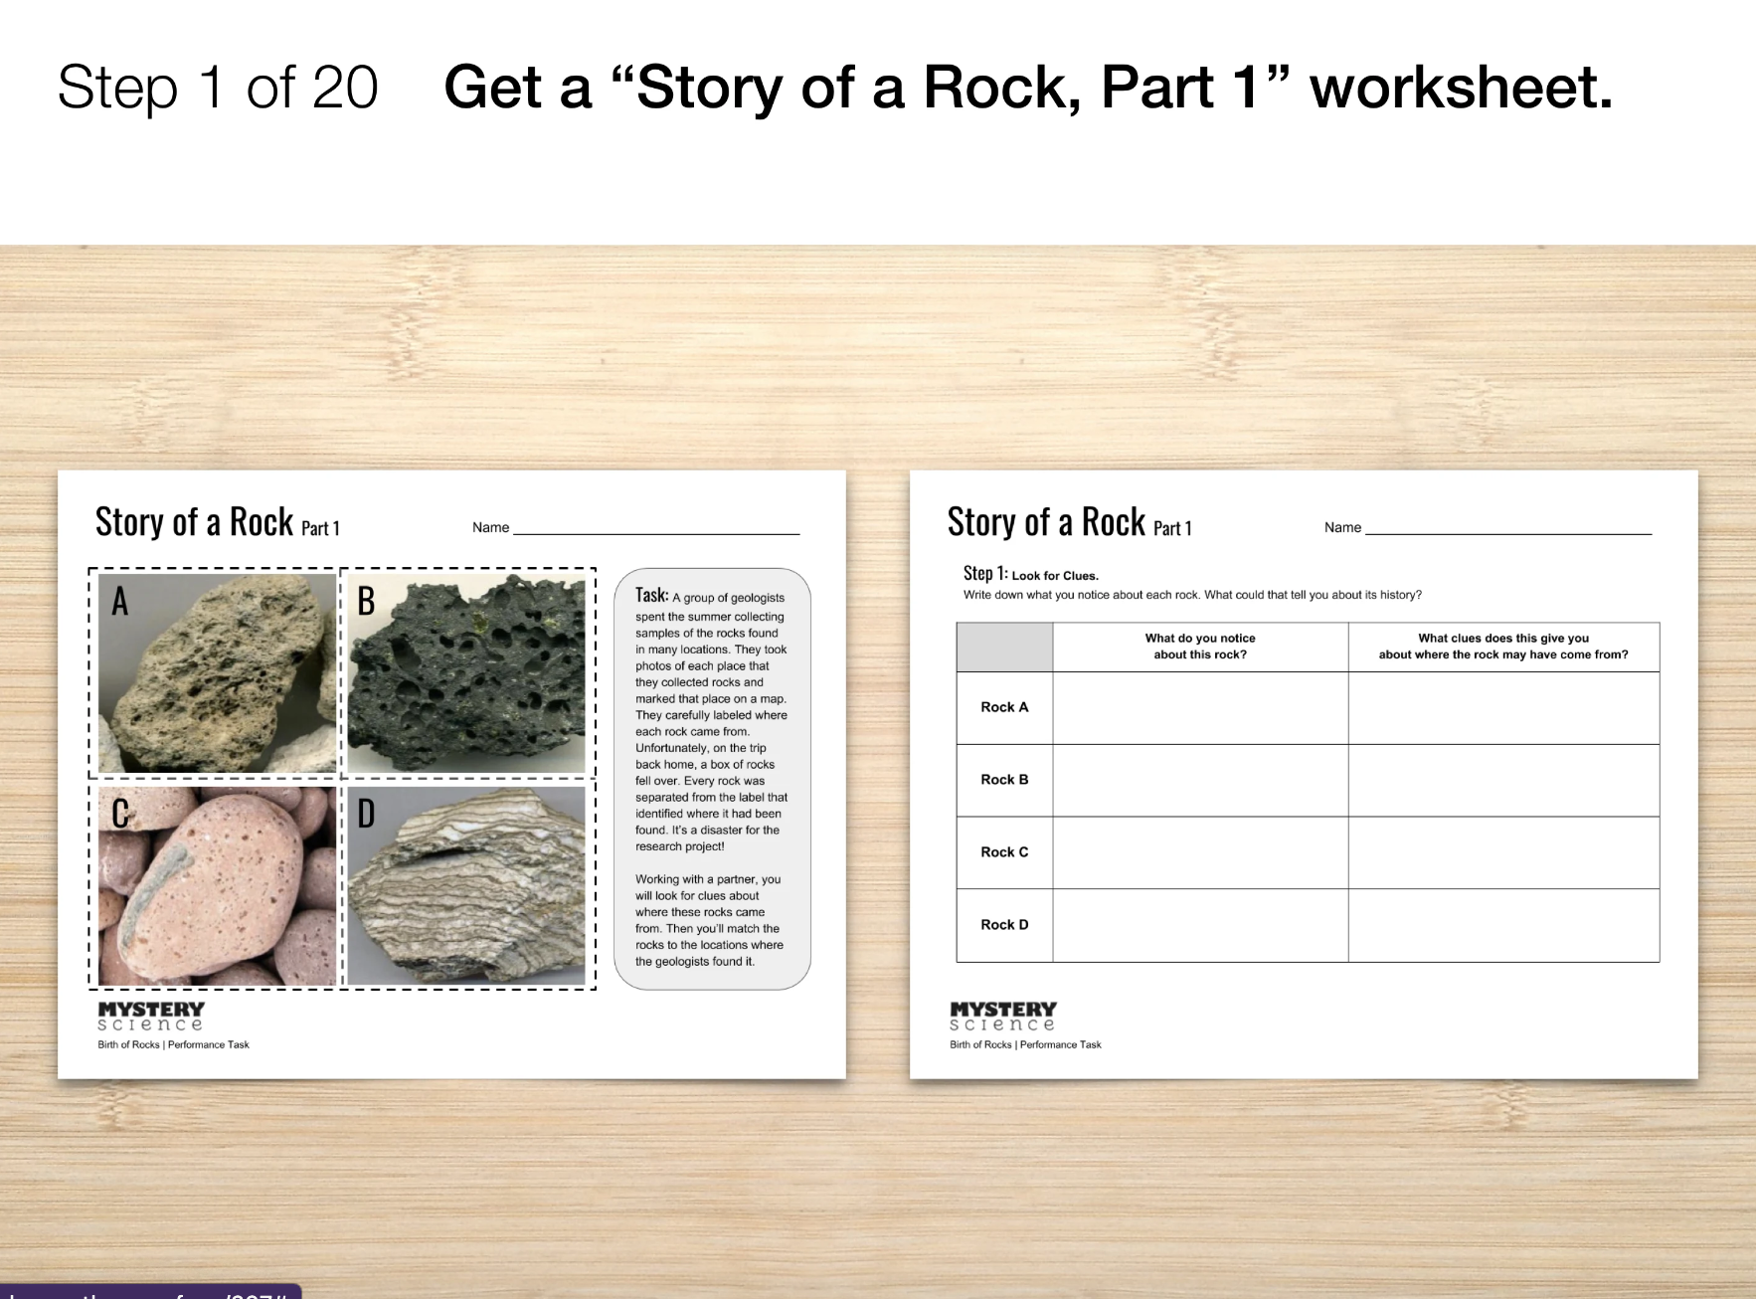
Earth’s Features & Processes • Grade 4
Anchor Layer Teacher Guide
Performance Task: How can you figure out where a rock came from?
Rocks & Earth’s Surface
Overview
In this performance task, students use their knowledge of how rocks form and how the earth changes over time to help geologists solve a puzzle. They analyze maps and photos from four locations to figure out which rocks were found in each place. Then, they support their claims with evidence. If you have time to extend the performance task, there is an optional writing extension in the last step.
Unit Review 20 mins
Hands-On Activity 120 mins
Performance Task Notes
Each student will need:
One Story of a Rock worksheet (Part 1 and 2).
One Story of a Rock Rubric
The Story of a Rock Answer Key will help you support students throughout the unit. Students are not expected to have these answers until the end of the unit.
Crosscutting Concepts
Patterns: Patterns can be used as evidence to make predictions and support explanations. Patterns in the Ashfall Fossil Beds give clues to how the earth’s surface has changed over time.
Cause & Effect: Cause and effect relationships are used to explain change. Weathering and erosion cause the earth’s surface to change over time.
‹#›

