Slide 1

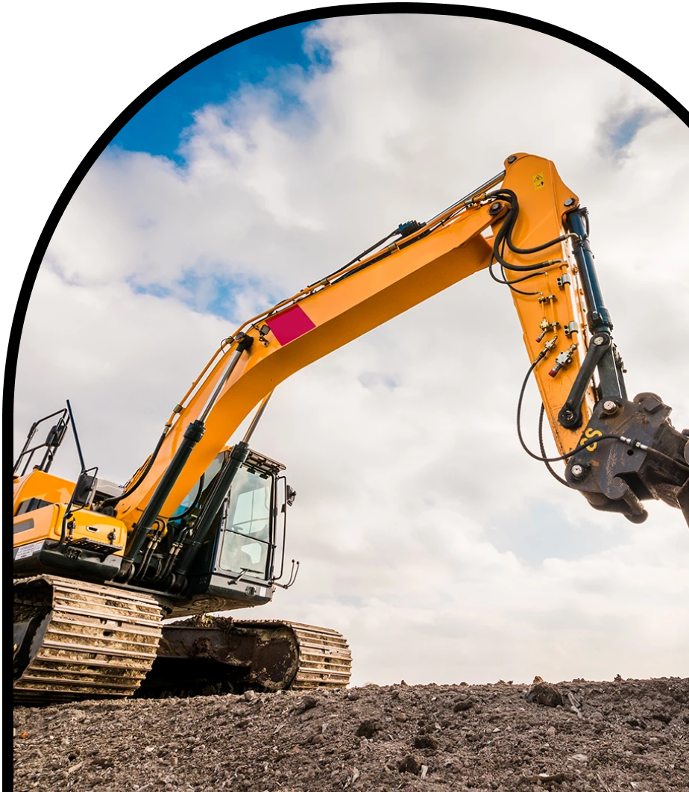
Anchor Layer Teacher Guide
A curriculum companion for Anchor Layer users
Grade K
Pushes & Pulls
Unit Web Link • Pacing Guide • Other Units

Slide 2
Pushes & Pulls • Grade K
Anchor Layer Teacher Guide
Unit Summary
In this unit, students are introduced to pushes and pulls and how those affect the motion of objects. Students observe and investigate the effects of what happens when the strength or direction of those pushes and pulls are changed.
Performance Expectations | Science & Engineering Practices | Disciplinary Core Ideas | Crosscutting Concepts
• K-PS2-1. Plan & conduct an investigation to compare the effects of different strengths or different directions of pushes and pulls on the motion of an object. • K-PS2-2. Analyze data to determine if a design solution works as intended to change the speed or direction of an object with a push or a pull. • K-2-ETS1-1. Ask questions, make observations, and gather information about a situation people want to change to define a simple problem that can be solved through the development of a new or improved object or tool. • K-2-ETS1-2. Develop a simple sketch, drawing, or physical model to illustrate how the shape of an object helps it function as needed to solve a given problem. • K-2-ETS1-3. Analyze data from tests of two objects designed to solve the same problem to compare the strengths and weaknesses of how each performs. | • Analyzing and Interpreting Data • Developing and Using Models • Engaging in Argument from Evidence • Obtaining, Evaluating, and Communicating Information | • LS1.C. Organization for Matter and Energy Flow in Organisms • ESS3.A. Natural Resources • ESS2.E. Biogeology | • Systems and System Models • Patterns
Pushes & Pulls Lesson Flow on Next Page
‹#›

Slide 3
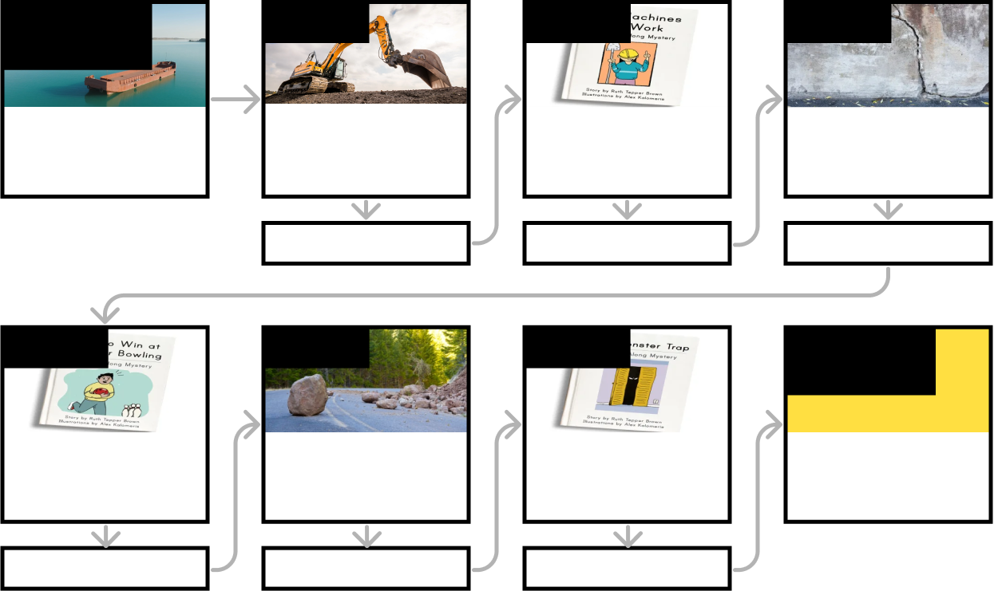
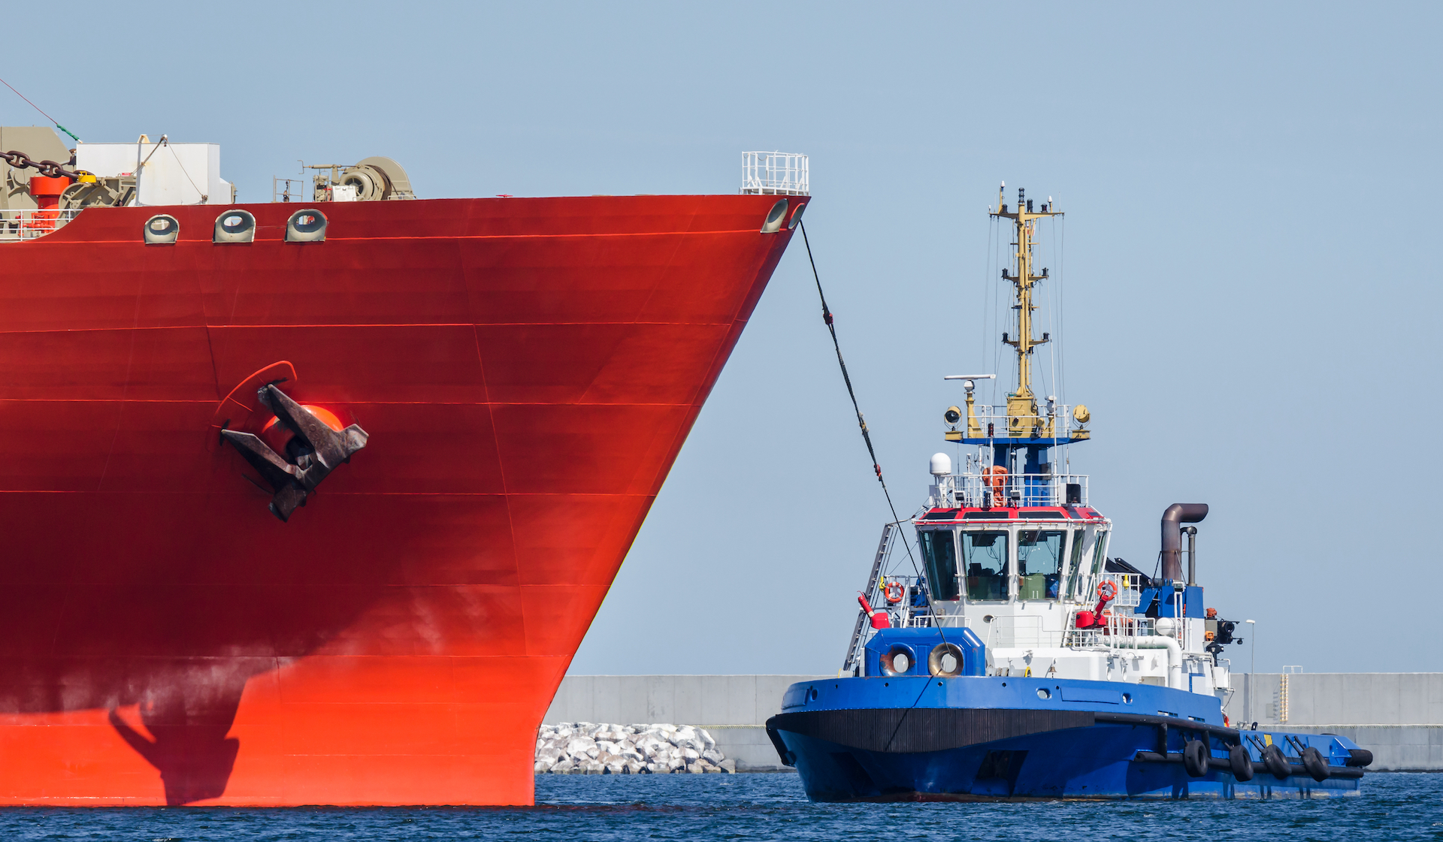
Pushes & Pulls • Grade K
Anchor Layer Teacher Guide
Anchor Phenomenon
Lesson 1
Lesson 2
Lesson 3
Pushes & Pulls
Big Barges
Pushes & Pulls
What’s the biggest excavator?
Pushes, Pulls, & “Work Words”
Why do builders need so many big machines?
Motion, Speed, & Strength
How can you knock down a wall made of concrete?
Anchor Connection
Anchor Connection
Anchor Connection
Lesson 4
Lesson 5
Lesson 6
Performance Task
Speed & Direction of Force
How can you knock down the most pins?
Direction of Motion & Engineering
How can we protect a mountain from falling rocks?
Forces & Engineering
How could you invent a trap?
Pushes & Pulls
What do tugboats do?
Anchor Connection
Anchor Connection
Anchor Connection
‹#›

Slide 4
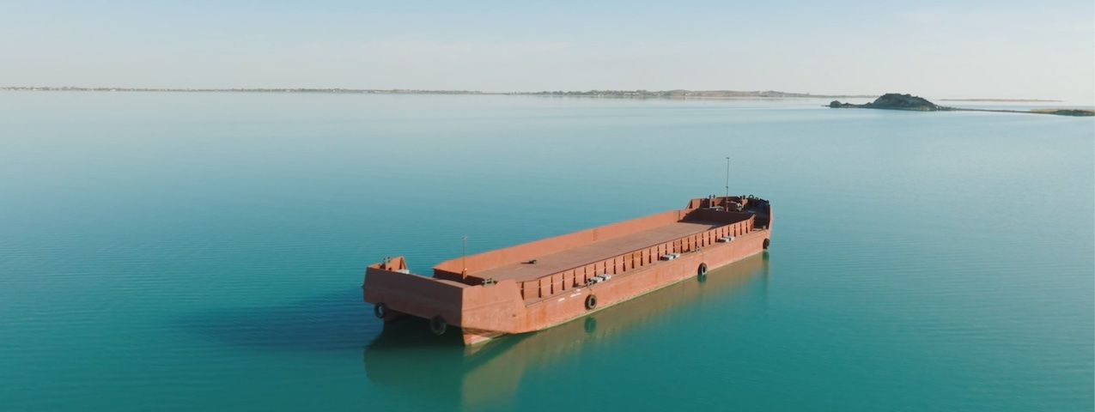
Pushes & Pulls • Grade K
Anchor Layer Teacher Guide
Anchor Phenomenon Background
How do barges help us move things?
Whenever people engage in physical work, they see many examples of pushes and pulls that make different things happen. By understanding these pushes and pulls, people have been able to design and build machines that allow us to do jobs that we couldn’t do any other way.
One of the most common examples of work that people want to do is simply moving something from one place to another. Whether its carrying the groceries from outside to inside, moving furniture across a room, or carrying a basket to a picnic, people like to move things around. People have invented bigger and bigger machines that help us to move more and more things.
Barges are very simple inventions that help us move incredible amounts of things. The most basic barges are just large, empty boats that may not even have the ability to move on their own. Some have flat surfaces atop which objects can rest. Others have deep holds that can contain things such as rocks, sand, or grain.
This Anchor Layer focuses on these basic barges, because they give students the ability to directly observe how other machines work alongside the barges. Tugboats push and pull directly on the barges to move them and to hold them still. Cranes and dump trucks lift huge amounts of cargo onto and off of barges. There are other types of barges that are self-powered, but they don’t make it as easy to observe how objects interact with one another.
‹#›

Slide 5
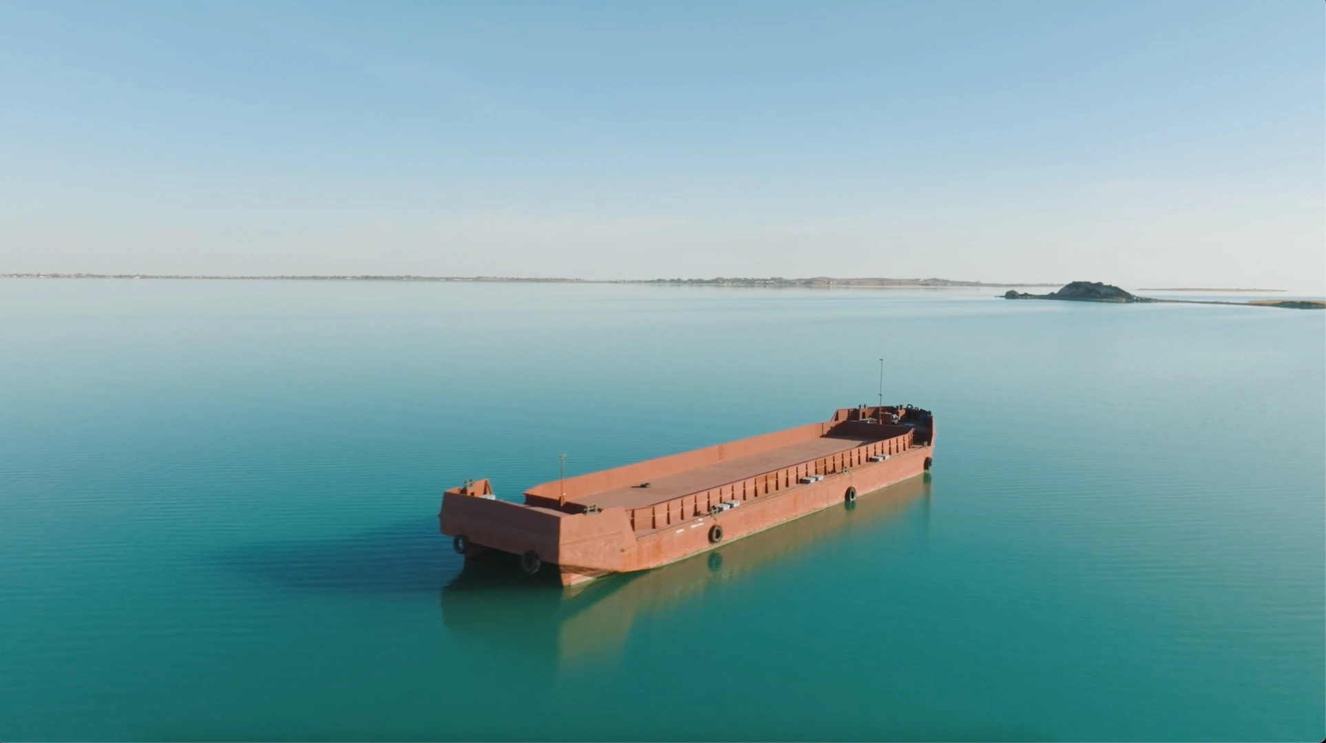
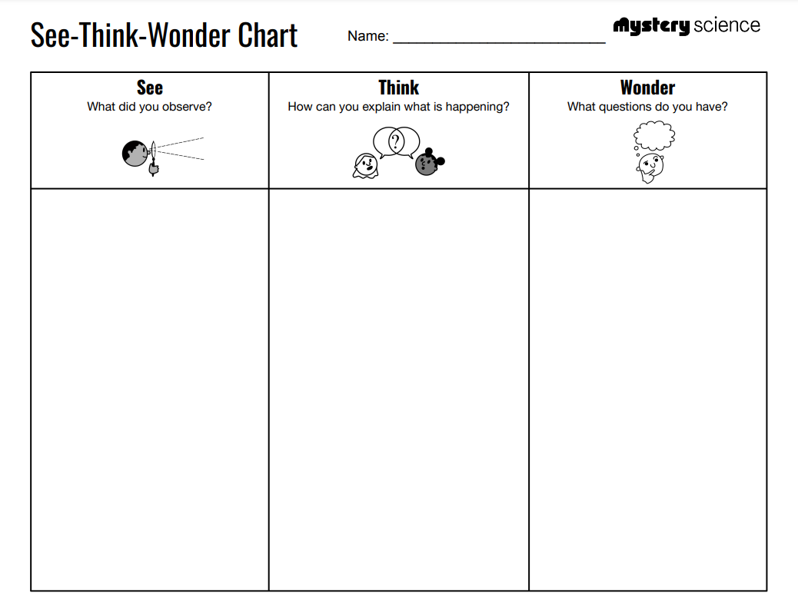
Pushes & Pulls • Grade K
Anchor Layer Teacher Guide
Anchor Phenomenon: Big Barges
Pushes & Pulls
Anchor Phenomenon Lesson Overview
Note: This lesson is part of this unit’s Anchor Layer. If you have the Anchor Layer turned on, we recommend teaching all of the lessons in this unit in order.
The anchor phenomena for this unit are barges! Student investigate how pushes and pulls affect the motion of barges, and how other machines allow us to use barges to move huge amounts of objects.
During the introduction, students generate observations and questions about the phenomenon and create a list of possible explanations for the phenomenon.
Anchor Phenomenon 15 mins
Guided Inquiry 20 mins
Student Work Samples & Notes
Students will gather clues during and after each lesson in this unit to help them improve their understanding and explanations. It is important to encourage students to recognize that even if they don't know the perfect answer yet, they are going to learn a lot throughout the unit and will have an opportunity to revisit the phenomenon over time.
A long rope tied to the barge
A tugboat
The tugboat moving and pulling on the rope
I think people use barges to move big things
I think that anything can go on a barge, as long as it fits
What else goes on barges?
Can barges move in other directions?
Where do barges go?
‹#›

Slide 6
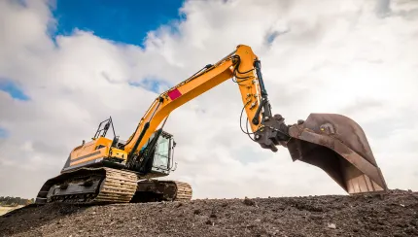
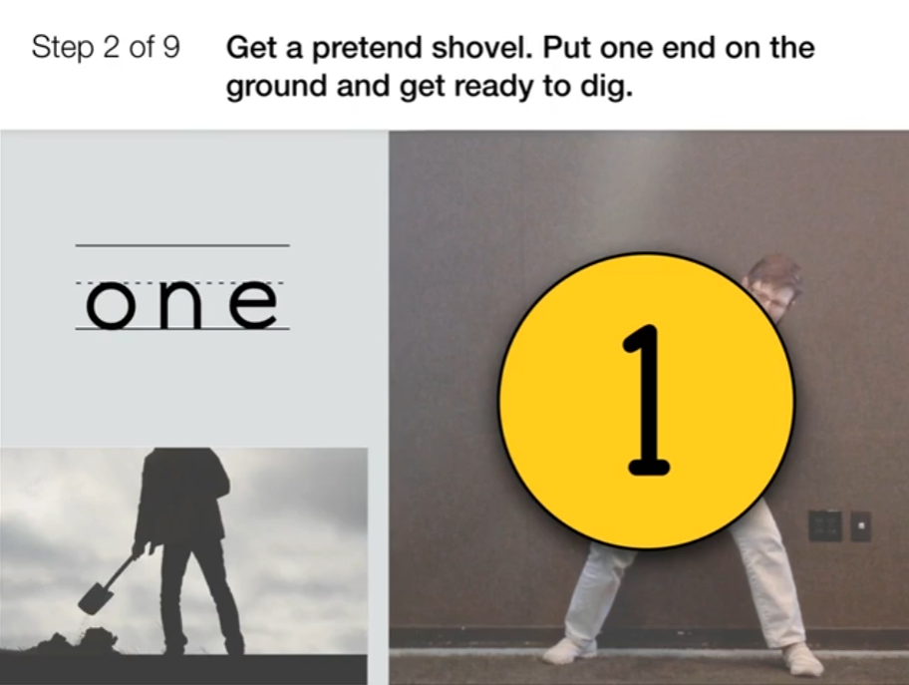
Pushes & Pulls • Grade K
Anchor Layer Teacher Guide
Lesson 1: What's the biggest excavator?
Pushes & Pulls
Overview
In this lesson, students discover that there are pushes and pulls involved in any kind of work, including the work done by machines.
In the activity, Be a Digging Machine, students pretend to use shovels and excavators to dig a hole for a swimming pool.
Anchor Connection
In this lesson, students learn that work words can be used to describe what machines and people do when working. These work words describe different kinds of pushes and pulls. Digging machines, such as excavators and cranes, can help to load materials onto barges. Students observe a variety of work words in action!
Students revisit the See-Think-Wonder chart that they worked on during the Anchor Phenomenon. They should understand that digging machines use pushes and pulls to help lift and dump different kinds of cargo onto barges. Then, they can be moved to new places.
Connecting Storyline Question
How else are barges loaded?
Exploration 15 mins
Hands-On Activity 15 mins
Anchor Connection 10 mins
Assessment 20 mins
Activity Notes
This activity does not require supplies. Make sure students have enough space to move around as they dig like a digging machine. No other preparation needed.
‹#›

Slide 7

Pushes & Pulls • Grade K
Anchor Layer Teacher Guide
Lesson 2: Why do builders need so many big machines?
Pushes, Pulls, & “Work Words” (pg 1 of 2)
Overview
In this Read-Along lesson, Vivian watches a house being built and wonders why the builders need so many big machines.
The lesson includes a short exercise where students act out the “work words” of their favorite machine. You can extend the lesson with the optional activity, Forces at Work, where students watch videos of construction equipment and practice using work words to describe what the machines are doing.
Digital Book (W/Audio) 25 mins
Hands-On Activity 20 mins
Anchor Connection 10 mins
Assessment 20 mins
Activity Notes
This activity does not require supplies. As an optional activity, we include videos of three construction machines, like the ones Vivian saw in the story. The videos include songs about the construction machines and what they do.
We suggest you preview the videos. When you show them to your students, you may want students to act out what the machines do. After watching the videos, ask your students to describe what each machine does and identify the "work words" involved.
Anchor Connection on Next Page
‹#›

Slide 8
Pushes & Pulls • Grade K
Anchor Layer Teacher Guide
Lesson 2: Why do builders need so many big machines?
Pushes, Pulls, & “Work Words” (pg 2 of 2)
Anchor Connection
In this lesson, students observe various large machines at work. Dump trucks are an example of a machine that can do many different things. In the anchor connection, students observe a dump truck loading rocks onto a barge.
Students revisit the See-Think-Wonder chart that they worked on during the Anchor Phenomenon. They should understand that dump trucks use pushes and pulls to help load and unload barges, just like digging machines do.
Connecting Storyline Question
How else do barges move?
Digital Book (W/Audio) 25 mins
Hands-On Activity 20 mins
Anchor Connection 10 mins
Assessment 20 mins
‹#›

Slide 9

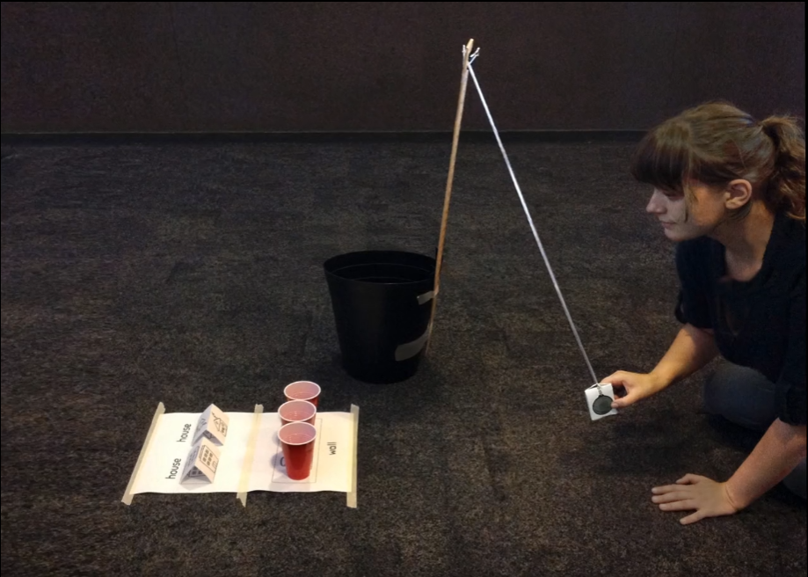
Pushes & Pulls • Grade K
Anchor Layer Teacher Guide
Lesson 3: How can you knock down a wall made of concrete?
Motion, Speed, & Strength (pg 1 of 2)
Overview
In this lesson, students change the strength and direction of a wrecking ball’s push in order to solve a tricky problem.
The activity, Don't Crush That House, is a game in which students experiment with the force of a paper wrecking ball in order to knock down a wall of cups. The challenge is: they can’t knock down the paper houses!
Exploration 10 mins
Hands-On Activity 20 mins
Anchor Connection 10 mins
Assessment 20 mins
Activity Notes
Your students will play the Wrecking Ball game in groups, taking turns. To help you determine how many game stations to set up, we suggest splitting your class into groups of 4.
Before class, get all the Game Station pieces ready for your students. See the lesson page for more prep details.
Anchor Connection on Next Page
‹#›

Slide 10
Pushes & Pulls • Grade K
Anchor Layer Teacher Guide
Lesson 3: How can you knock down a wall made of concrete?
Motion, Speed, & Strength (pg 2 of 2)
Anchor Connection
In this lesson, students experiment with pushes and pulls. Barges are a great example of a place where students can directly observe a tugboat pulling a barge from the front with a rope, or directly pushing a barge from behind.
Students revisit the See-Think-Wonder chart that they worked on during the Anchor Phenomenon. They should understand that tugboats can either push or pull on barges to make them move. The tugboat goes behind the barge if it is pushing, and in front if it is pulling.
Connecting Storyline Question
Can tugboats hold a barge still?
Exploration 10 mins
Hands-On Activity 20 mins
Anchor Connection 10 mins
Assessment 20 mins
‹#›

Slide 11

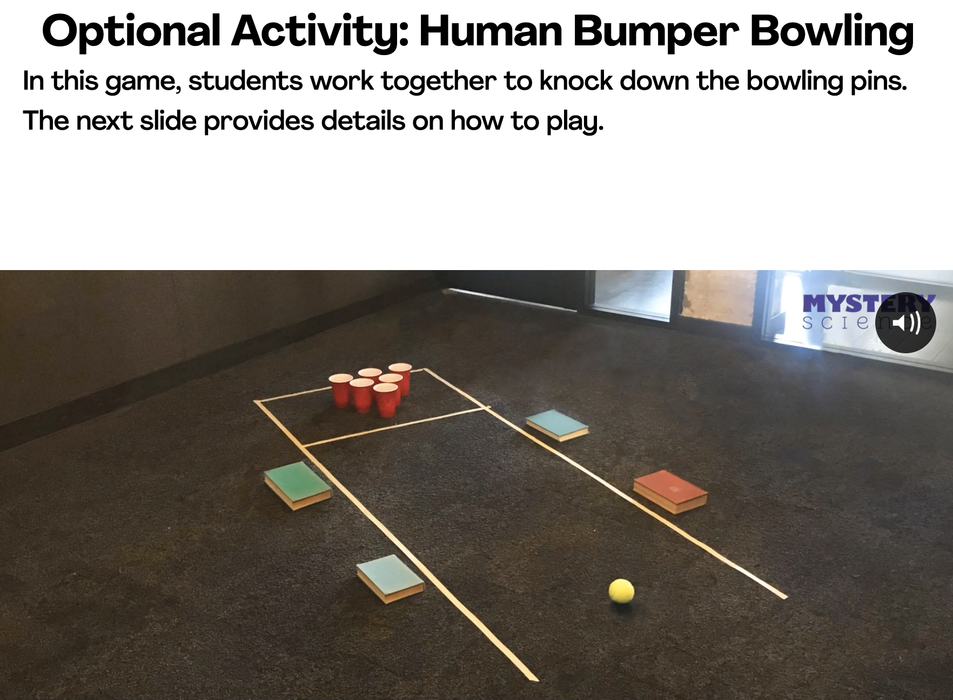
Pushes & Pulls • Grade K
Anchor Layer Teacher Guide
Lesson 4: How can you knock down the most pins?
Speed & Direction of Force (pg 1 of 2)
Overview
In this Read-Along lesson, Daniel worries he won’t do well at a friend’s Bumper Bowling party…until he figures out an unexpected way to win.
The lesson includes a short exercise where students act out bowling. If you want to extend the lesson, you can try this optional activity, Human Bumper Bowling, where students make a model bumper bowling alley and work together to knock down pins.
Digital Book (W/Audio) 25 mins
Hands-On Activity 20 mins
Anchor Connection 10 mins
Assessment 20 mins
Activity Notes
We suggest having students work in groups of four to six.
This activity requires enough floor space to set up “bowling alleys.” Decide how many you’ll set up and where you’ll put them. Using masking tape, mark off alleys that are 10 feet long and 2½ feet wide. Mark a box at the end to set the pins in. Leave room between your bowling alleys for students to sit on the floor.
Anchor Connection on Next Page
‹#›

Slide 12
Pushes & Pulls • Grade K
Anchor Layer Teacher Guide
Lesson 4: How can you knock down the most pins?
Speed & Direction of Force (pg 2 of 2)
Anchor Connection
In this lesson, students learn how to use pushes and pulls to control the motion of an object. Pushes and pulls can also be used to hold an object still. Tugboats do both with barges: sometimes they make barges move, sometimes they hold barges still.
Students revisit the See-Think-Wonder chart that they worked on during the Anchor Phenomenon. They should understand that tugboats can push barges up against other stationary objects. This keeps them from moving around when loading or unloading.
Connecting Storyline Question
Why don't barges get damaged when tugboats push on them?
Digital Book (W/Audio) 25 mins
Hands-On Activity 20 mins
Anchor Connection 10 mins
Assessment 20 mins
‹#›

Slide 13
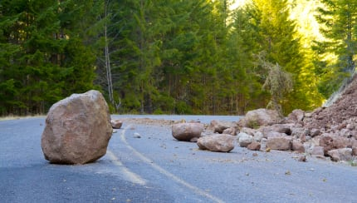
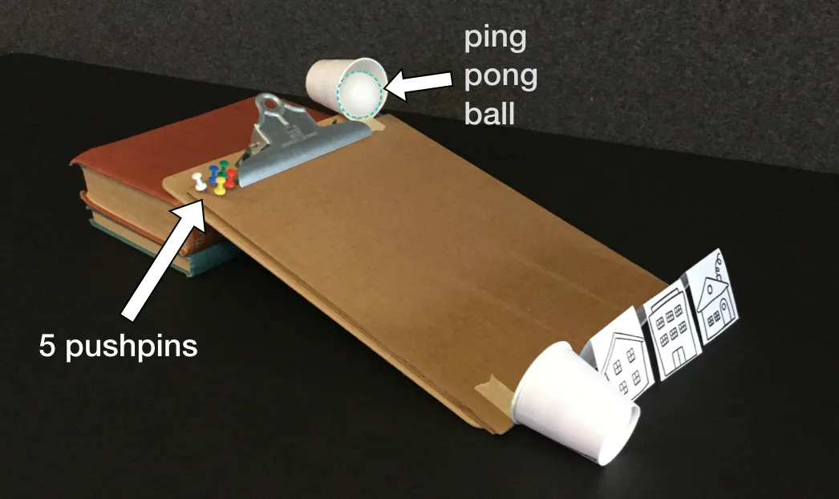
Pushes & Pulls • Grade K
Anchor Layer Teacher Guide
Lesson 5: How can we protect a mountain from falling rocks?
Direction of Motion & Engineering (pg 1 of 2)
Overview
In this lesson, students investigate how pushes can change the speed and direction of falling objects.
In the activity, Boulder Bounce, students play a game where they design a solution that protects a model town called Tiny Town from a bouncing-ball “boulder.”
Anchor Connection on Next Page
Exploration 17 mins
Hands-On Activity 20 mins
Wrap-Up 3 mins
Anchor Connection 10 mins
Assessment 20 mins
Activity Notes
We suggest students work in pairs.
We suggest one game station for every pair of students, but you can set up as many stations as you think might be practical for your classroom.
Set up game stations before class. See the lesson page for more in-depth prep details.
‹#›

Slide 14
Pushes & Pulls • Grade K
Anchor Layer Teacher Guide
Lesson 5: How can we protect a mountain from falling rocks?
Direction of Motion & Engineering (pg 2 of 2)
Anchor Connection
In this lesson, students observe how the motion of an object can change when it bumps into something else. Tugboats can bump into barges and push them, and tires are frequently seen around tugboats to soften those bumps.
Students revisit the See-Think-Wonder chart that they worked on during the Anchor Phenomenon. They should understand that tugboats are covered in flexible materials, such as tires, that help to cushion impacts when pushing on barges.
Connecting Storyline Question
Are there different kinds of barges?
Exploration 17 mins
Hands-On Activity 20 mins
Wrap-Up 3 mins
Anchor Connection 10 mins
Assessment 20 mins
‹#›

Slide 15

Pushes & Pulls • Grade K
Anchor Layer Teacher Guide
Lesson 6: How could you invent a trap?
Forces & Engineering (pg 1 of 2)
Overview
In this Read-Along lesson, twins Mimi and Lulu try different ways to catch a mysterious nighttime visitor…until they hit on just the right solution.
The lesson includes a short exercise where students imagine how to design a good monster trap, and then pretend to be sneaky monsters. You can extend the lesson with the optional activity, Be an Inventor, where students draw their own inventions for machines that do chores.
Anchor Connection on Next Page
Digital Book (W/Audio) 20 mins
Hands-On Activity 25 mins
Anchor Connection 10 mins
Assessment 20 mins
Activity Notes
As an optional activity, we suggest you have your students explore what it takes to be an inventor. Have them watch the mini-lesson "How do you become a great inventor?" to start them thinking about the inventions all around us.
Then each student will think about and act out a chore they do. You may have to remind them of possible chores, such as making their bed, feeding the cat, walking the dog, setting the table, or picking up their toys. After acting out a chore, students will think up a machine that could help with this chore and draw their machine. Finally, students will share their drawing with a partner and explain how their machine works.
‹#›

Slide 16
Pushes & Pulls • Grade K
Anchor Layer Teacher Guide
Lesson 6: How could you invent a trap?
Forces & Engineering (pg 2 of 2)
Anchor Connection
In this lesson, students learn how we can design a variety of solutions to different problems. Barges have a variety of designs that solve different problems, too!
Students revisit the See-Think-Wonder chart that they worked on during the Anchor Phenomenon. They should understand that there are many types of barges. Two of the most common types have either a large, flat top or a deep hold. They do different jobs.
Connecting Storyline Question
How can we change which way a barge is moving?
Digital Book (W/Audio) 20 mins
Hands-On Activity 25 mins
Anchor Connection 10 mins
Assessment 20 mins
‹#›

Slide 17

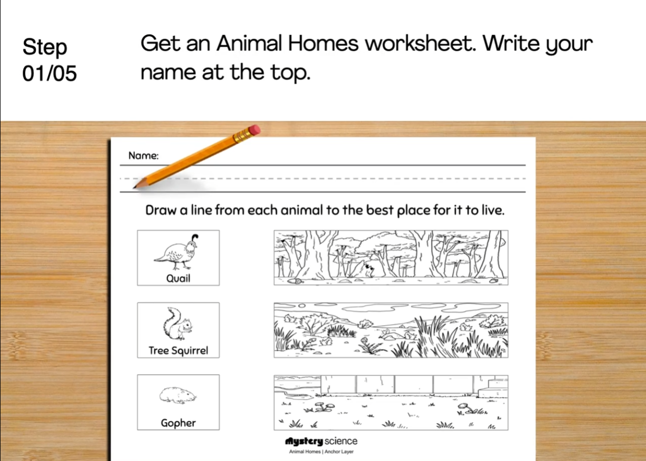
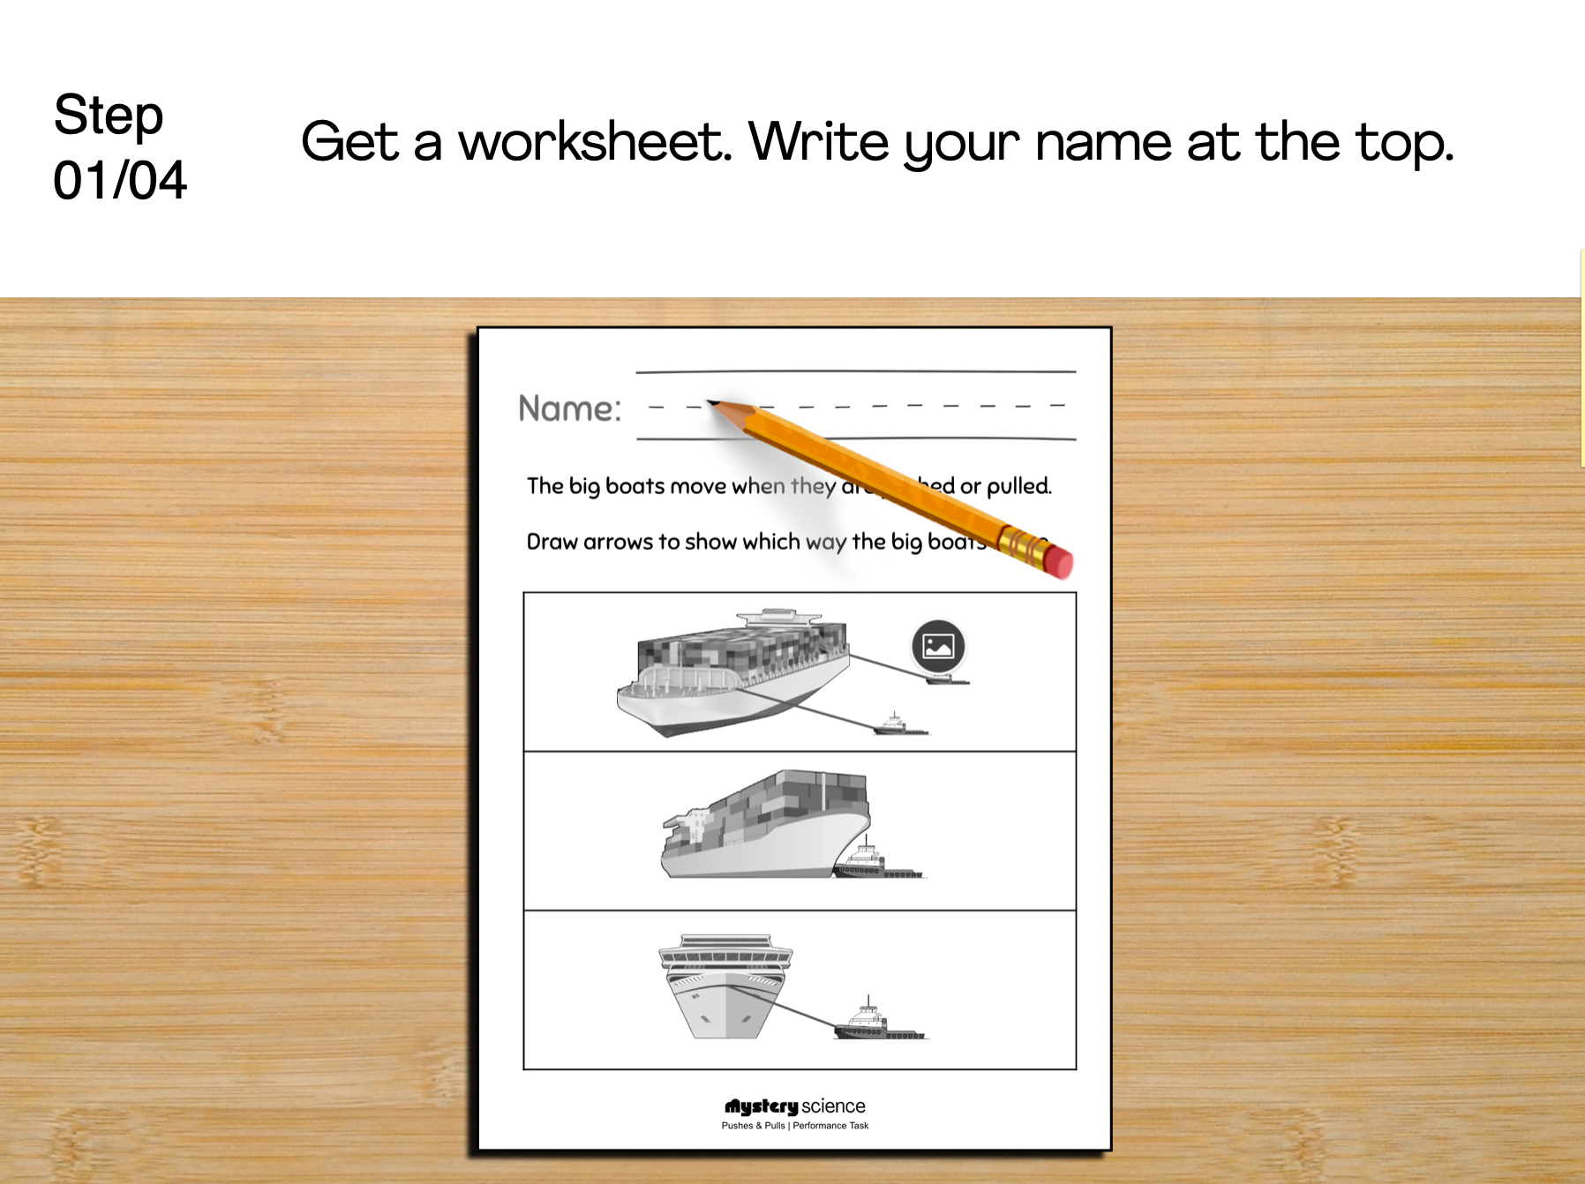
Pushes & Pulls • Grade K
Anchor Layer Teacher Guide
Performance Task: What do tugboats do?
Pushes & Pulls
Overview
In this performance task, students make observations of tugboats in order to determine if they successfully move other boats in the intended way.
After a brief review of the unit, students record the effects that tugboats have in a variety of situations and then use what they learned to help guide a big boat out to sea.
Unit Review 10 mins
Hands-On Activity 30 mins
Performance Task Notes
Students can work as a class, in small groups, or individually. Each student will need one copy of the worksheet.
With your students, begin the lesson. It begins with a brief unit review. Then, move through the activity. The activity includes a step-by-step guide and discussion questions throughout.
Crosscutting Concepts
Cause & Effect: Pushes and pulls cause many different things to move every day. This cause and effect relationship is one of the most important things for students to understand as they develop an understanding of the physical world around them. By observing how objects start moving, stop moving, or change directions when they are pushed or pulled, students build a foundation to explain more complex interactions in later grades.
‹#›

