Slide 1
Agents of change
What’s my role and what can I do? > SEL > Agents of change

Slide 2
What makes a good field agent?

Slide 3
Stealth
Knowledge
Skills
Understanding the target

Slide 4
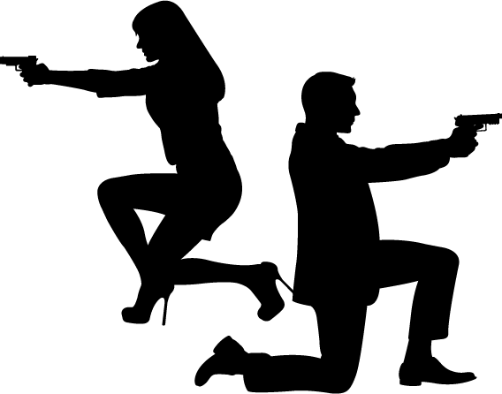
What skills might they need to be successful?

Slide 5
Understanding where and when to engage
Timing
Focus
Language
Communication skills
Understanding the situation
Escape routes
Self-defence
Resilience
Courage

Slide 6
These skills can help you tackle online hate too!

Slide 7
www.hackinghate.eu
#SELMA_eu

