Slide 1

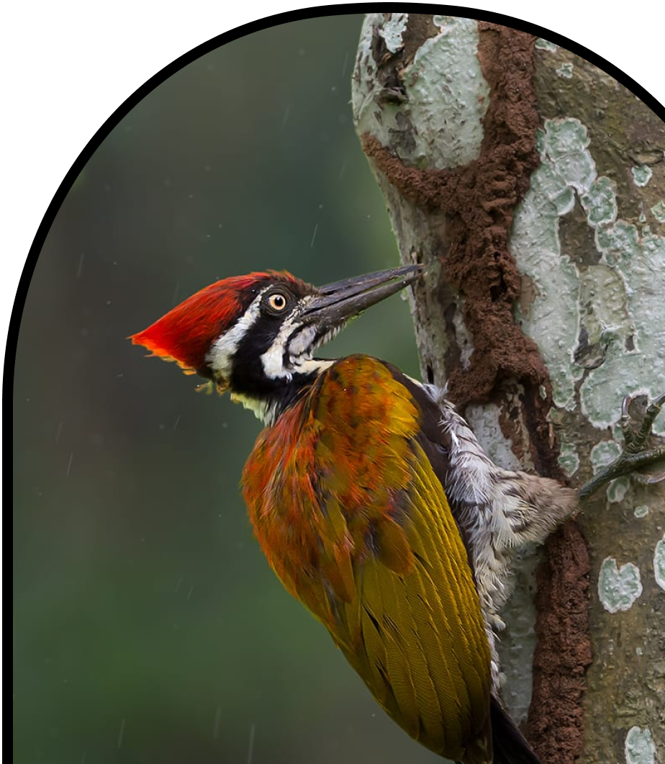
Anchor Layer Teacher Guide
A curriculum companion for Anchor Layer users
Grade K
Animal Needs
Unit Web Link • Pacing Guide • Other Units

Slide 2
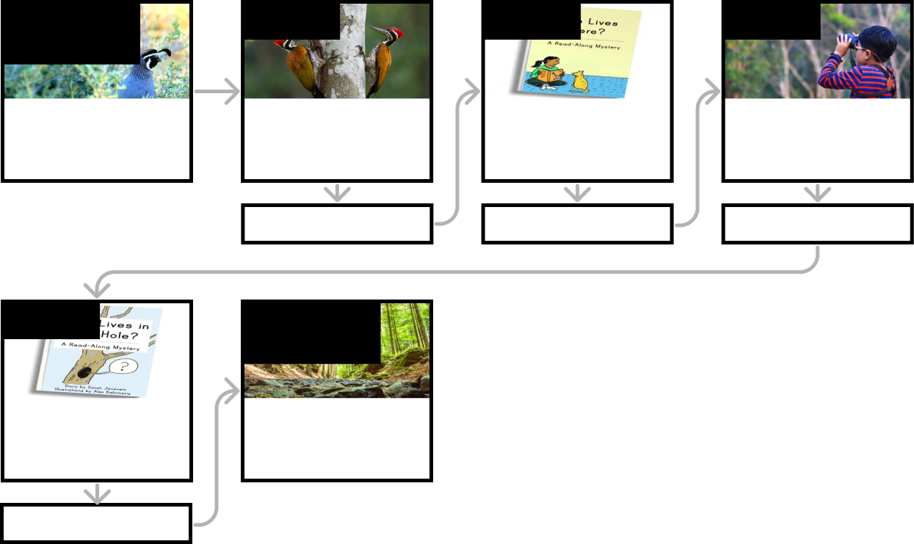
Animal Needs • Grade K
Anchor Layer Teacher Guide
Unit Summary
In this unit, students use observations to understand the basic needs of animals. Students explore how animals need things to eat and a safe place to live, and also how animals can change their environments to meet those needs.
Performance Expectations | Science & Engineering Practices | Disciplinary Core Ideas | Crosscutting Concepts
• K-LS1-1. Use observations to describe patterns of what plants and animals (including humans) need to survive. • K-ESS3-1 Use a model to represent the relationship between the needs of different plants and animals (including humans) and the places they live. • K-ESS2-2. Construct an argument supported by evidence for how plants and animals (including humans) can change the environment to meet their needs | • Analyzing and Interpreting Data • Developing and Using Models • Engaging in Argument from Evidence • Obtaining, Evaluating, and Communicating Information | • LS1.C. Organization for Matter and Energy Flow in Organisms • ESS3.A. Natural Resources • ESS2.E. Biogeology | • Systems and System Models • Patterns
Anchor Phenomenon
Lesson 1
Lesson 2
Lesson 3
Animal Needs
Animal Homes
Animal Needs: Food
Why do woodpeckers peck wood?
Animal Needs: Shelter
Where do animals live?
Animal Needs: Safety
How can you find animals in the woods?
Anchor Connection
Anchor Connection
Anchor Connection
Lesson 4
Performance Task
Animals & Changing the Environment
How do animals make
their homes in the forest?
Animal Needs
Why do different animals live in different places?
Anchor Connection
‹#›

Slide 3
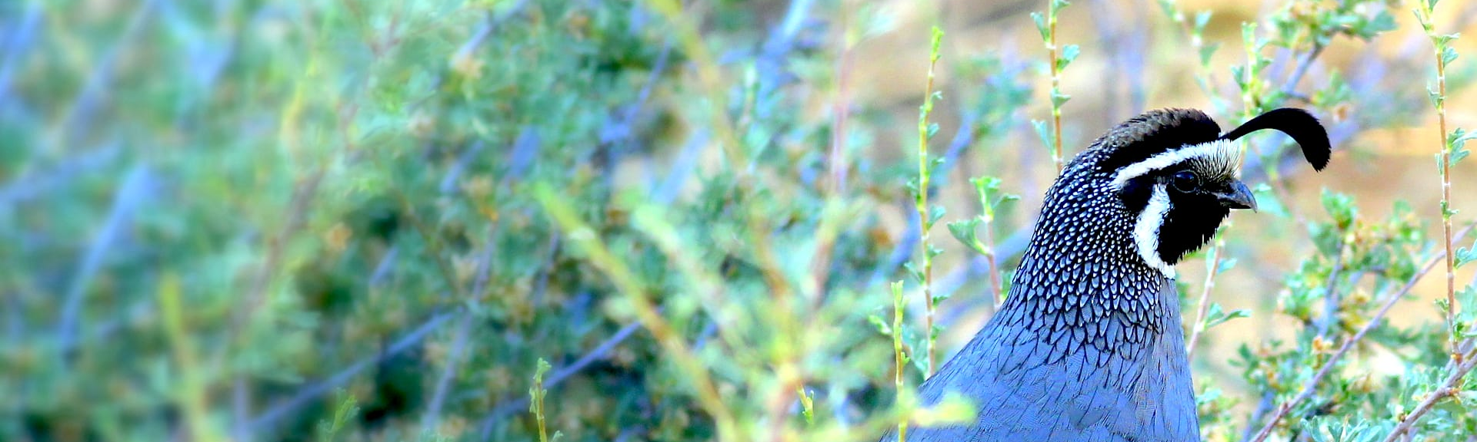
Animal Needs • Grade K
Anchor Layer Teacher Guide
Anchor Phenomenon Background
Why do different animals live where they do?
While animals come in all shapes and sizes, they have many important things in common. For example, all animals interact with their environment. They rely upon their environment for things such as food, water, shelter, and temperature regulation.
Animals also change their environment, sometimes significantly. This happens in a wide range of places. Some animals build burrows deep underground, while other animals build nests at the tops of the tallest trees.
While many kindergartners do not yet view humans as a kind of animal, they can understand that all of these same things are true of humans. Humans interact with their environment. Humans rely upon their environment for food, water, shelter, and temperature regulation. And, importantly, humans change their environment, sometimes significantly.
Because animals interact so closely with their environment, they form a system with their environment. Animals cannot exist separately from their environment and survive. In order to fully understand any animal, including humans, we must also understand their environment.
‹#›

Slide 4
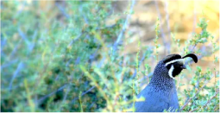
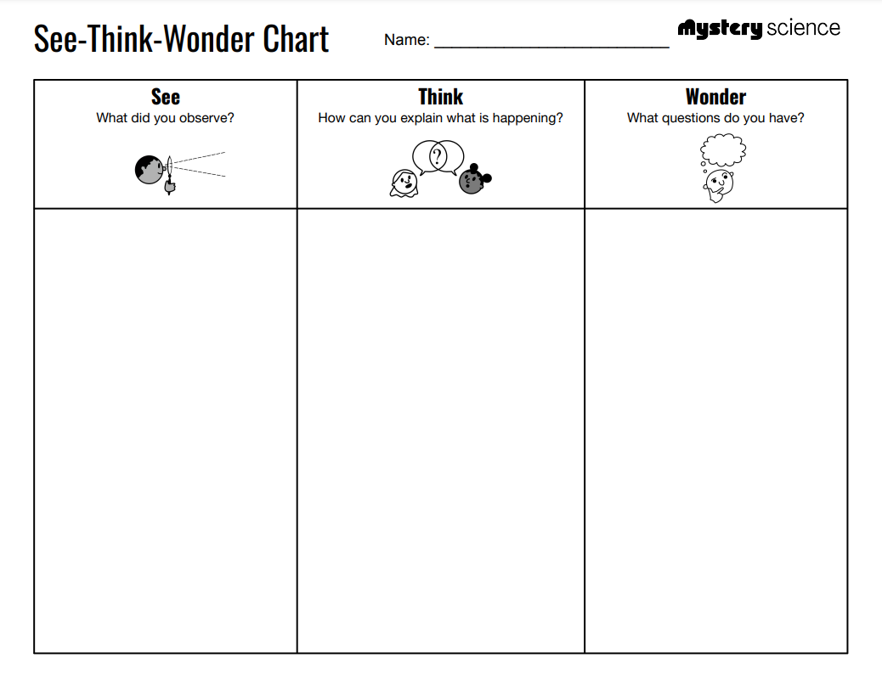
Animal Needs • Grade K
Anchor Layer Teacher Guide
Anchor Phenomenon: Animal Homes
Animal Needs
Anchor Phenomenon Lesson Overview
Note: This lesson is part of this unit’s Anchor Layer. If you have the Anchor Layer turned on, we recommend teaching all of the lessons in this unit in order.
The anchor phenomenon for this unit is a small collection of animals that live in very different places and do very different things. Yet they all have in common that they rely upon the place in which they live to meet their needs.
During the introduction, students generate observations and questions about the phenomenon and create a list of possible explanations for the phenomenon in a guided See-Think-Wonder activity. Students will use these initial ideas to track how their understanding grows throughout the unit. We recommend that you record your student's ideas in a single See-Think-Wonder chart for your class.
Anchor Phenomenon 10 mins
Guided Inquiry 15 mins
Student Work Samples & Notes
Students will gather clues during and after each lesson in this unit to help them improve their understanding and explanations. It is important to encourage students to recognize that even if they don't know the perfect answer yet, they are going to learn a lot throughout the unit and will have an opportunity to revisit the phenomenon over time.
The bird is scratching the ground
The squirrel is climbing a tree
The animal is hiding underground
The animal is eating seeds
I think the bird is looking for food
I think the squirrel is carrying sticks
I think the animal underground is hiding
What kind of animal is underground?
Why is the bird scratching the ground?
What is the squirrel doing?
‹#›

Slide 5
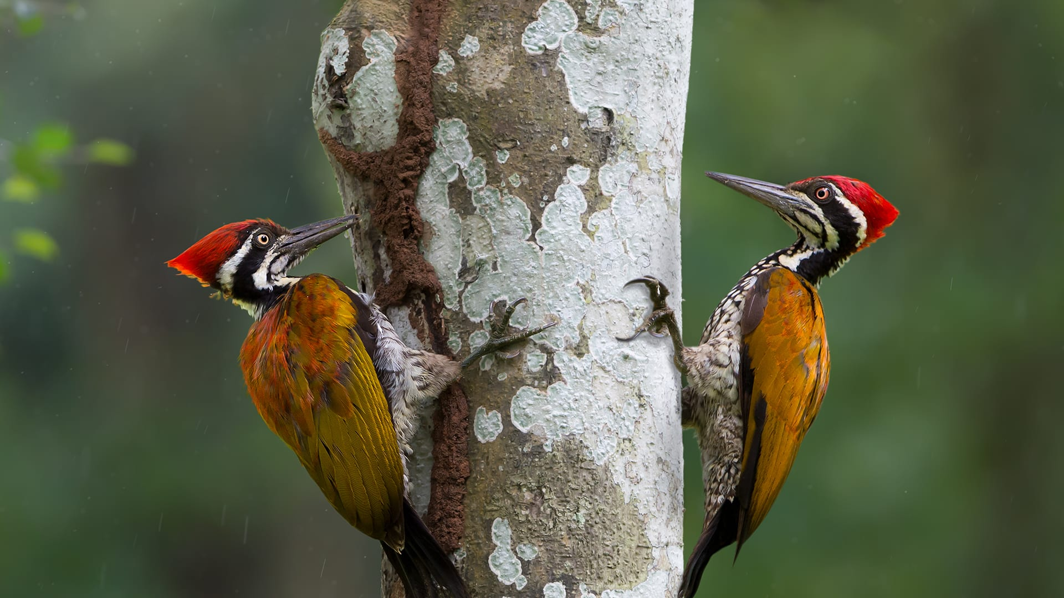
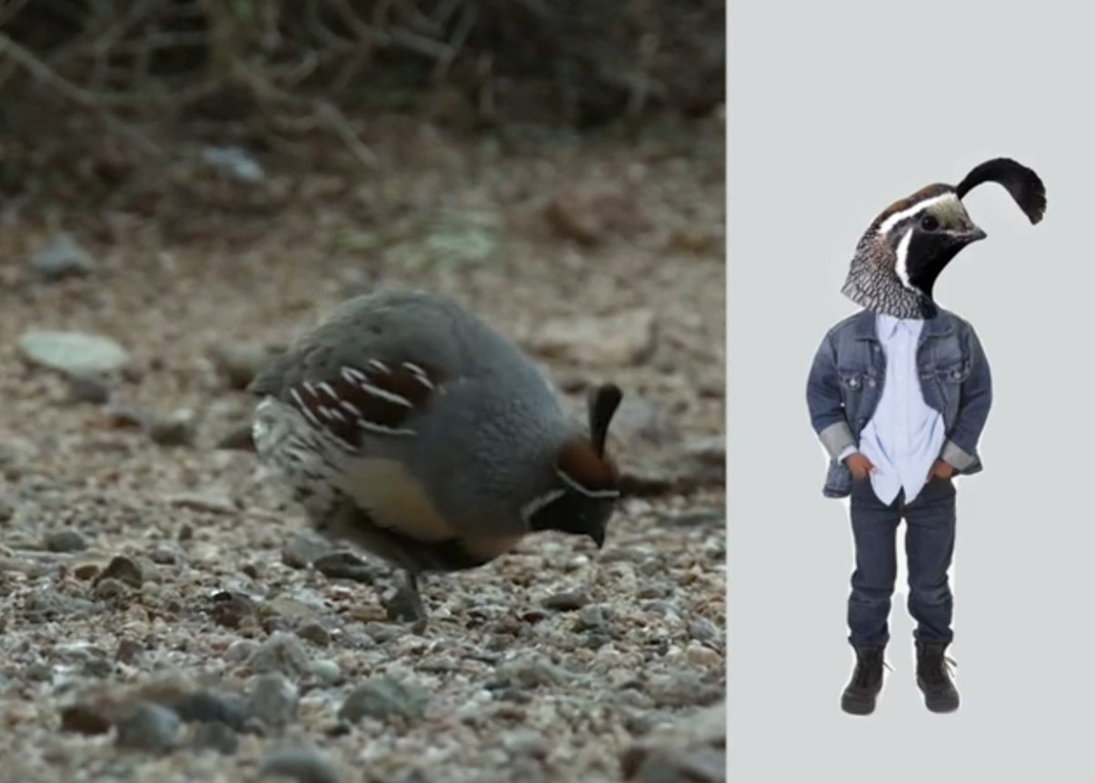
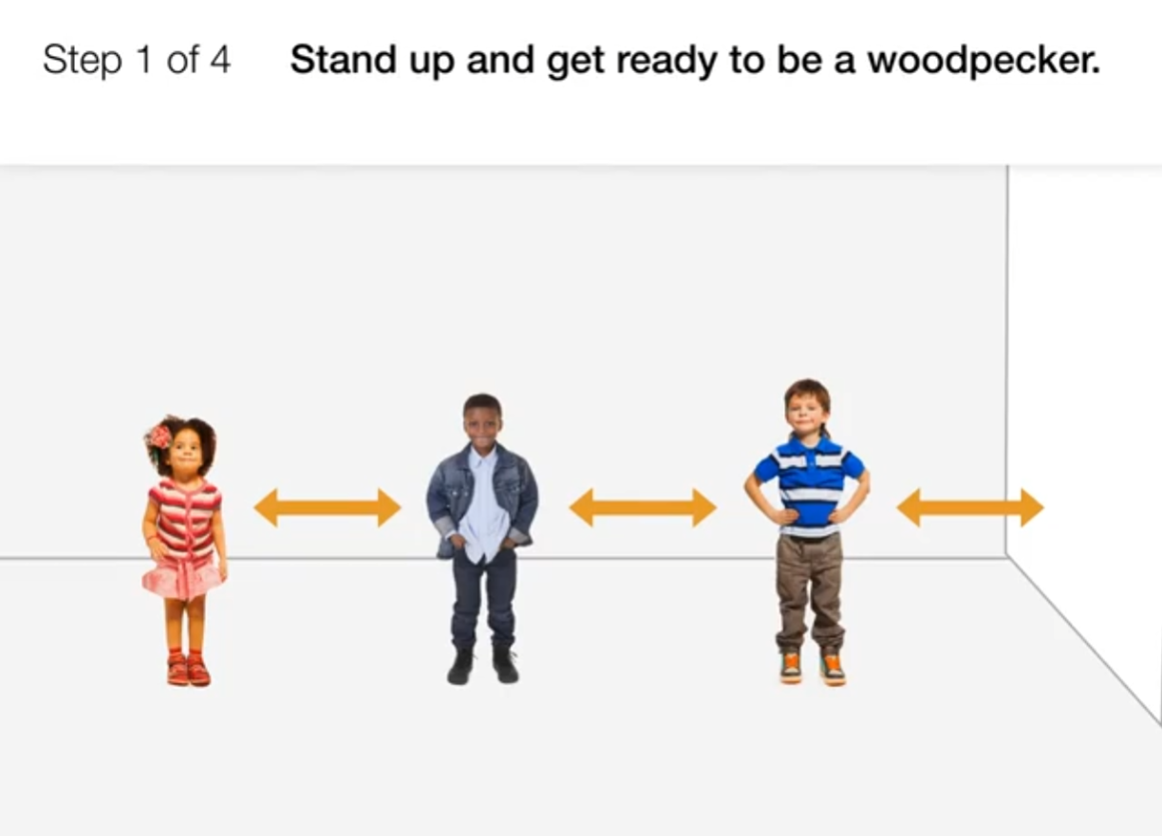
Animal Needs • Grade K
Anchor Layer Teacher Guide
Lesson 1: Why do woodpeckers peck wood? (pg 1 of 2)
Animal Needs: Food
Overview
In this lesson, students observe animal behaviors and work to discover a pattern: all animals seek food in order to survive.
The activity, Eat Like an Animal, includes physical movement in which students act out animal behaviors, pretending to be quail scratching in the dirt, raccoons wading in the water, and woodpeckers pecking a log.
Anchor Connection on Next Page
Exploration 8 mins
Hands-On Activity 25 mins
Wrap-Up 7 mins
Anchor Connection 15 mins
Assessment 15 mins
Activity Notes
This activity does not require supplies.
Make sure students have enough space to move around as they pretend to be different animals in the forest.
Since there’s so little prep for this activity, we recommend you also do one of the activities in the Extensions section. To understand what animals need, it’s important that children have a chance to observe them. You can provide that opportunity by attracting birds with a bird feeder, taking your class on a nature walk or field trip, or having your students observe animals through videos.
‹#›

Slide 6
Animal Needs • Grade K
Anchor Layer Teacher Guide
Lesson 1: Why do woodpeckers peck wood? (pg 2 of 2)
Animal Needs: Food
Anchor Connection
In this lesson, students gathered observations of animals that are attempting to find food. Quail live on the ground, so they have to find food on the ground.
Students revisit the See-Think-Wonder chart that they worked on during the Anchor Phenomenon. They should understand all animals require food to survive. No matter where an animal lives, it must be able to find food.
Connecting Storyline Question
Why do different animals live in different places?
Exploration 8 mins
Hands-On Activity 25 mins
Wrap-Up 7 mins
Anchor Connection 15 mins
Assessment 15 mins
‹#›

Slide 7

Animal Needs • Grade K
Anchor Layer Teacher Guide
Lesson 2: Where do animals live?
Animal Needs: Shelter
Overview
In this Read-Along lesson, Sofia wonders where animals live and goes for a walk in the woods to find out.
The lesson includes a short exercise where students pretend to be squirrels and learn about their habitats.
Anchor Connection
In this lesson, students gathered observations of the different ways in which animals find or make places to hide. Squirrels make nests up in trees, while quail hide in plants that grow low to the ground.
Students will revisit the See-Think-Wonder chart that they initially worked on during the Anchor Phenomenon. They should understand that different animals seek very different types of places to live. Some live up in trees, some live on the ground, and some live underground.
Connecting Storyline Question
How do animals stay safe where they live?
Digital Book (W/Audio) 25 mins
Hands-On Activity 20 mins
Anchor Connection 15 mins
Assessment 15 mins
Activity Notes
This activity does not require supplies.
As an optional activity, we suggest having your students view a one-minute video of animals at home and then discuss what they noticed. Preview it on the Nature Nuggets site here.
Here are some possible questions for discussion:
What animals did you see in the video?
Where do the animals live? How do you know?
If the animals could talk, what would you ask them?
‹#›

Slide 8
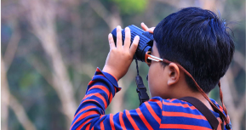
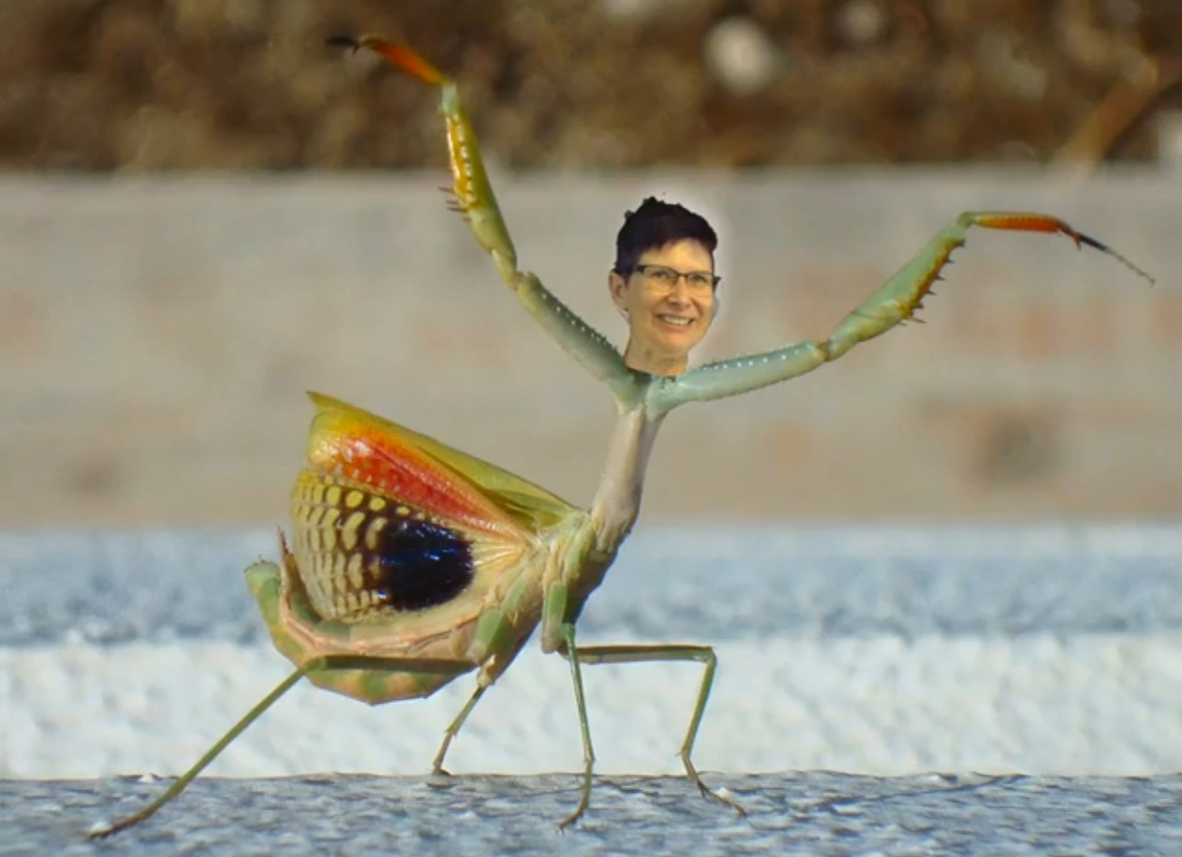
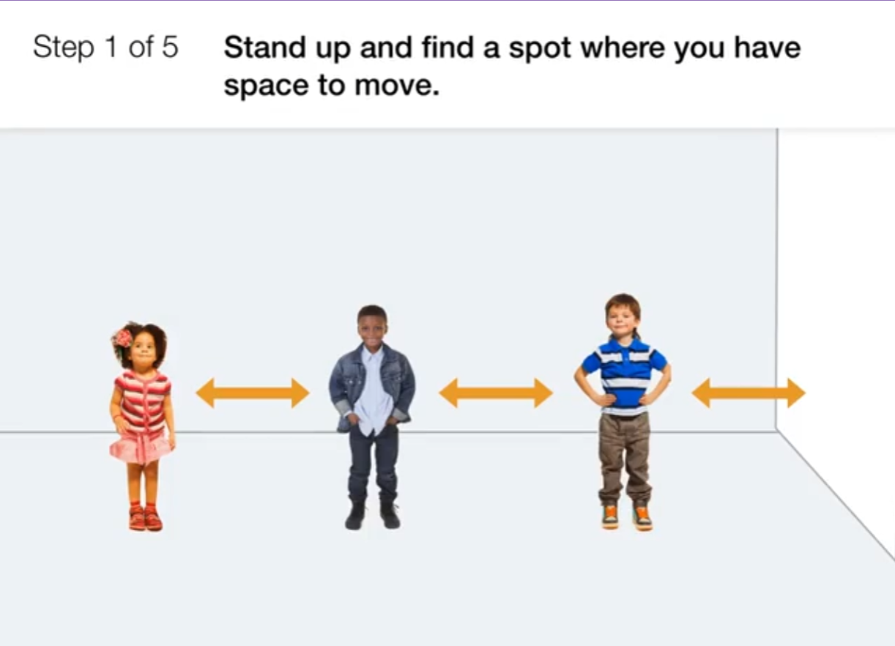
Animal Needs • Grade K
Anchor Layer Teacher Guide
Lesson 3: How can you find animals in the woods? (pg 1 of 2)
Animal Needs: Safety
Overview
In this lesson, students observe different animal behaviors and work to discover another pattern: all animals seek safety in order to survive.
The activity, Gopher in a Hole, includes physical movement in which students pretend to be snails hiding in their shells, praying mantises scaring away predators, and gophers popping out of holes.
Anchor Connection on Next Page
Exploration 8 mins
Hands-On Activity 25 mins
Wrap-Up 7 mins
Anchor Connection 15 mins
Assessment 15 mins
Activity Notes
This activity does not require supplies.
Make sure students have enough space to move around as they pretend to be different animals.
Since there’s so little prep for this activity, we recommend you plan on doing one of the activities in the Extensions. To understand how animals seek safety, it’s important that children have a chance to observe them. You can provide that opportunity by keeping pet snails, exploring a grassy lawn, going for a nature walk, or watching videos to learn what animals make their homes in a hole in a tree.
‹#›

Slide 9
Animal Needs • Grade K
Anchor Layer Teacher Guide
Lesson 3: How can you find animals in the woods? (pg 2 of 2)
Animal Needs: Safety
Anchor Connection
In this lesson, students gathered observations of the behaviors that animals exhibit that keep them safe. Many animals hide as a means to stay safe. Quail hide on the ground, squirrels hide in trees, and gophers hide underground.
Students will revisit the See-Think-Wonder chart that they initially worked on during the Anchor Phenomenon. They should understand that in addition to food, many animals also require some form of shelter. Some animals find their shelters, others make shelters.
Connecting Storyline Question
How do animals make their homes?
Exploration 8 mins
Hands-On Activity 25 mins
Wrap-Up 7 mins
Anchor Connection 15 mins
Assessment 15 mins
‹#›

Slide 10

Animal Needs • Grade K
Anchor Layer Teacher Guide
Lesson 4: How do animals make their homes in the forest?
Animals & Changing the Environment
Overview
In this Read-Along lesson, Desiree notices all the holes in the trees around her house—and sets out to discover how they got there, & why they matter.
The lesson includes a short exercise where students listen for animal sounds and pretend to be woodpeckers.
Anchor Connection
In this lesson, students gathered observations of animals working to meet their needs. All animals rely upon the place in which they live to meet their needs for food. All animals also need space to live. Some animals change their environment to make space to live, while other animals use the environment as it is.
Students will revisit the See-Think-Wonder chart that they initially worked on during the Anchor Phenomenon. They should understand that in addition to food, many animals also require some form of shelter. Some animals find their shelters, others make shelters.
Connecting Storyline Question
What’s the best place for different kinds of animals?
Digital Book W/Audio 20 mins
Hands-On Activity 25 mins
Anchor Connection 15 mins
Assessment 15 mins
Activity Notes
This activity does not require supplies. As an optional activity, we suggest you go on a nature walk. It doesn't have to be far from your classroom or home. You can find animal homes in a playground, a grassy lawn, a city park, or a small yard. Look for ant hills, spiderwebs, birds in the trees, and insects in the grass. We suggest bringing a notebook so that you can make a list of the animals that everyone sees.
‹#›

Slide 11
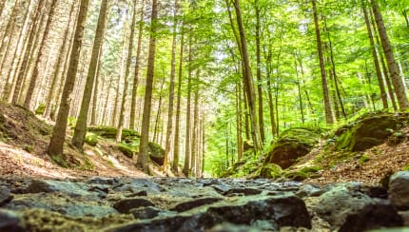
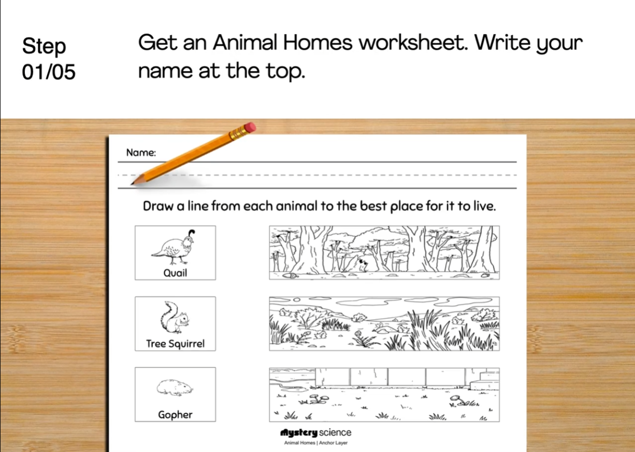
Animal Needs • Grade K
Anchor Layer Teacher Guide
Performance Task: Why do different animals live in different places?
Animal Needs
Overview
In this performance task, students use a simple model to identify the relationships between the needs of animals & the places in which they live.
After a review of the animals they observed throughout the unit, students use observations of three new places to determine which of those places best meet the needs of each animal.
Unit Review 10 mins
Hands-On Activity 30 mins
Performance Task Notes
Students can work as a class, in small groups, or individually. Each student will need one copy of the Animal Homes worksheet.
With your students, begin the lesson. It begins with a brief unit review. Then, move through the activity. The activity includes a step-by-step guide and discussion questions throughout.
Crosscutting Concepts
Systems and System Models: All living things interact with and rely on their environment. Animals rely on their environment for food sources and for space to live. In turn, many animals change their environment by doing things such as building nests or digging tunnels underground. All animals must live in environments in which their needs are met, either by changing that environment or by interacting with it in its natural state.
‹#›

