Slide 1

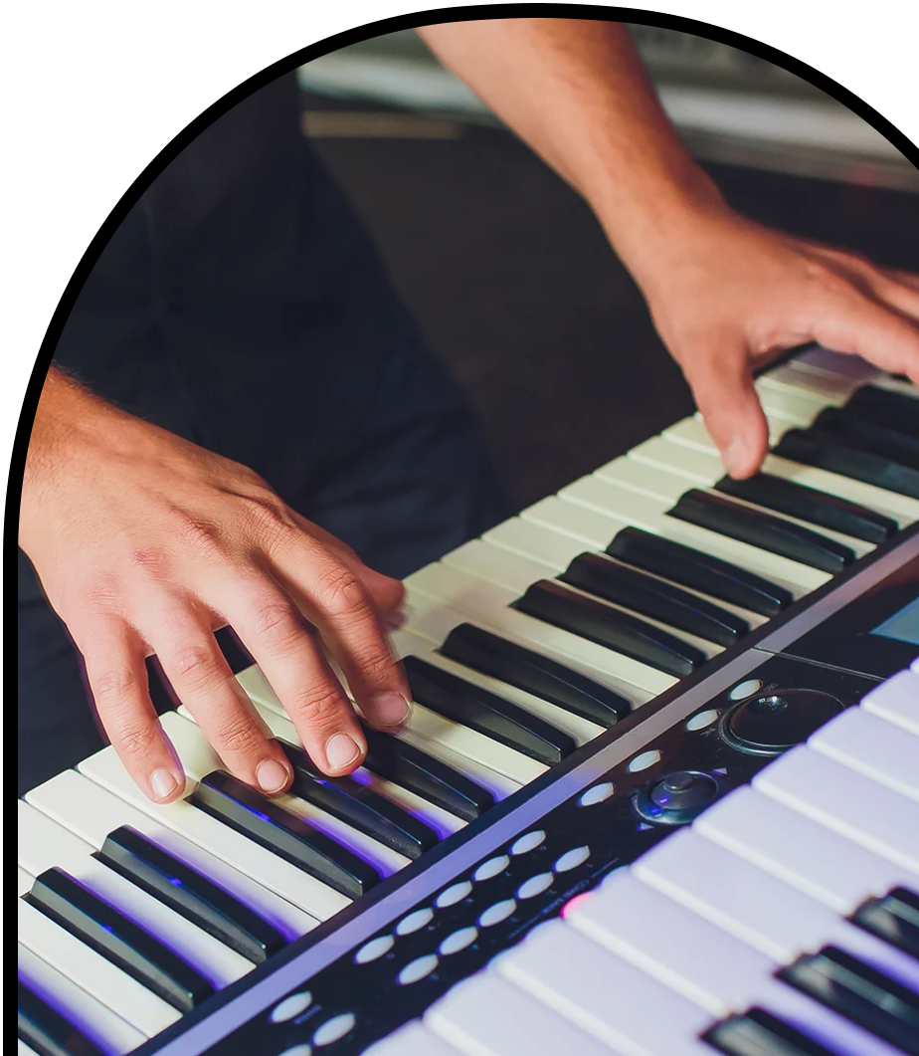
Anchor Layer Teacher Guide
A curriculum companion for Anchor Layer users
Grade 4
Sound, Waves, & Communication
Unit Web Link • Pacing Guide • Other Units

Slide 2
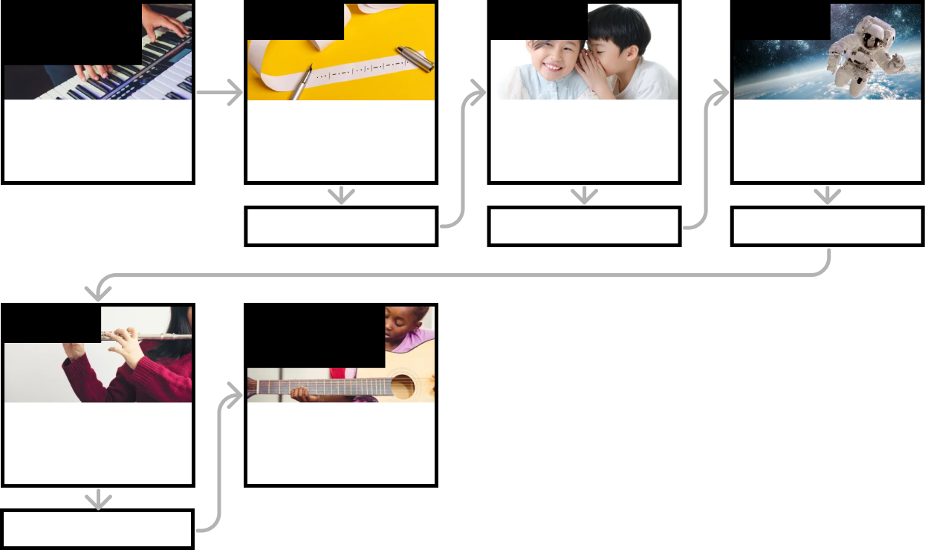
Sound, Waves, & Communication • Grade 4
Anchor Layer Teacher Guide
Unit Summary
In this unit, students investigate the science of sound. Students construct physical devices to feel the vibrations that allow us to communicate across distances. Students also use digital devices to visualize the characteristics of different sound waves that cause us to hear different things. Assessments
Performance Expectations | Science & Engineering Practices | Disciplinary Core Ideas | Crosscutting Concepts
• 4-PS4-1. Develop a model of waves to describe patterns in terms of amplitude and wavelength and that waves can cause objects to move. • 4-PS4-3. Generate and compare multiple solutions that use patterns to transfer information. • 3-5-ETS1-2. Generate and compare multiple possible solutions to a problem based on how well each is likely to meet the criteria and constraints of the problem. • 3-5-ETS1-3. Plan and carry out fair tests in which variables are controlled and failure points are considered to identify aspects of a model or prototype that can be improved. | • Planning and Carrying Out Investigations • Developing and Using Models • Constructing Explanations and Designing Solutions | • PS4.A: Wave Properties • PS4.C: Information Technologies and Instrumentation • ETS1.B: Developing Possible Solutions • ETS1.C: Optimizing the Design Solution | • Patterns
Anchor Phenomenon
Lesson 1
Lesson 2
Lesson 3
Sound Waves & Conceptual Modeling
Seeing Sound
Pattern Transfer & Technology
How do you send a secret code?
Sound, Vibration, & Engineering
How far can a whisper travel?
Sound & Vibrations
What would happen if you screamed into outer space?
Anchor Connection
Anchor Connection
Anchor Connection
Lesson 4
Performance Task
Sound Waves & Wavelength Why are some sounds high and some sounds low?
Sound Waves & Engineering
How can you make sound waves visible?
Anchor Connection
‹#›

Slide 3
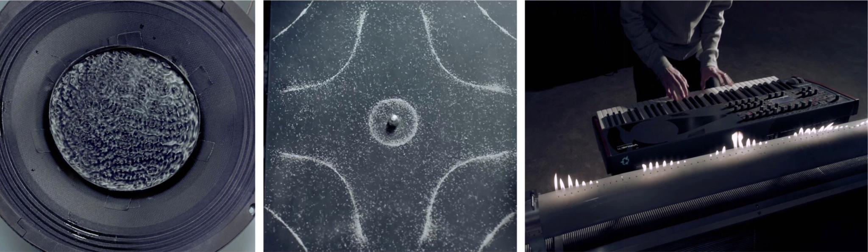
Sound, Waves, & Communication • Grade 4
Anchor Layer Teacher Guide
Anchor Phenomenon Background
How can invisible sounds cause the patterns we can see in the music video?
All sounds are vibrations. Normally, we hear those vibrations but don’t see or feel them. This unit’s activities give students the opportunity to observe how sound waves feel and look.
All sound vibrations require something to travel through called a medium. The majority of sound vibrations are loud enough to be heard when they travel through gases (like air), but are usually not loud enough to be felt or seen when they vibrate other media, such as liquids and solids. By the end of this unit, students will have gathered evidence of these vibrations traveling through a wide variety of media: from strings, to windshields, balloons, flames, & more.
This is an excellent example of the Crosscutting Concepts of patterns as well as cause and effect. A single cause (sound vibrations) can lead to a variety of effects (not only sounds, but also the patterns in the speaker dish, the salt on the metal plate, and the flames coming out of the Ruben’s Tube).
These effects exhibit predictable patterns in their response to the sounds.
Metal Plate: The metal plate is held in place by a bolt in the center and covered in grains of salt. The edges of the plate are free to vibrate. As the sound vibrations travel through the metal plate, they bounce the grains of salt into patterns based on how the plate is shaking!
Speaker Dish: The dish is filled with a liquid and sitting directly on a speaker. As the speaker vibrates with the music, the vibrations cause tiny waves that travel back and forth through liquid.
Ruben’s Tube: The tube has a series of holes in the top, and it is constantly being fed by a supply of flammable gas. A speaker sits at one end of the tube and the sound vibrations from that speaker cause more or less gas to be pushed out of the holes. Where more gas is pushed out, the flames grow taller; where less gas is pushed out, the flames shrink.
‹#›

Slide 4
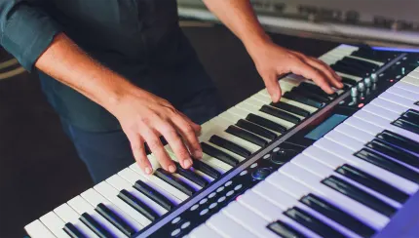
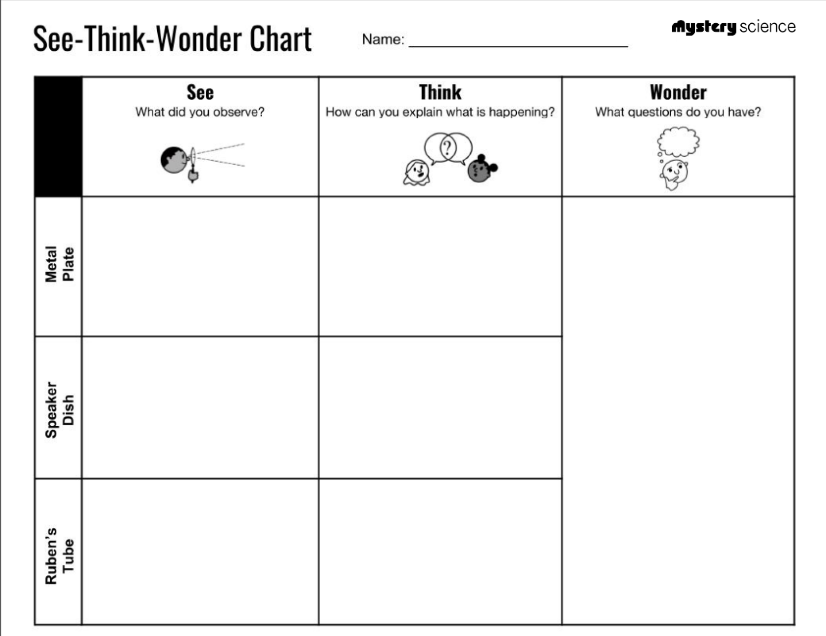
Sound, Waves, & Communication • Grade 4
Anchor Layer Teacher Guide
Anchor Phenomenon: Seeing Sound
Sound Waves & Conceptual Modeling
Anchor Phenomenon Lesson Overview
Note: This lesson is part of this unit’s Anchor Layer. If you have the Anchor Layer turned on, we recommend teaching all lessons in the remainder of this unit in order.
The anchor phenomenon for this unit is a collection of devices that make sound waves visible, in a music video by composer Nigel Stanford. In the activity, they create an initial conceptual model to explain how each device works. Students will re-visit their model after each Mystery to add new information to it.
Anchor Phenomenon 15 mins
Guided Inquiry 30 mins
Hands-On Activity 30 mins
Student Work Samples & Notes
It is important to encourage students to recognize that this activity is about making predictions to explain the phenomenon. They are going to learn a lot throughout the unit and have an opportunity to change or add to their first model.
When the music changes, the pattern of the salt changes
The different sounds make different vibrations in the plate, making the salt move.
What causes the patterns to change?
Is there a relationship between the type of sound and the pattern that is made?
What happens when the volume goes up?
What happens when the tone changes?
When the music changes, the pattern in the water changes.
The music changes and makes different patterns of vibrations. The vibrations travel from the speaker to the water.
When the music changes, the pattern of the flames changes.
The flames go higher and lower depending on the music.
‹#›

Slide 5
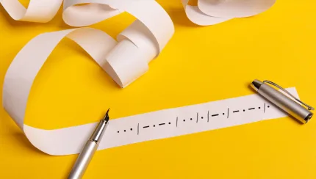
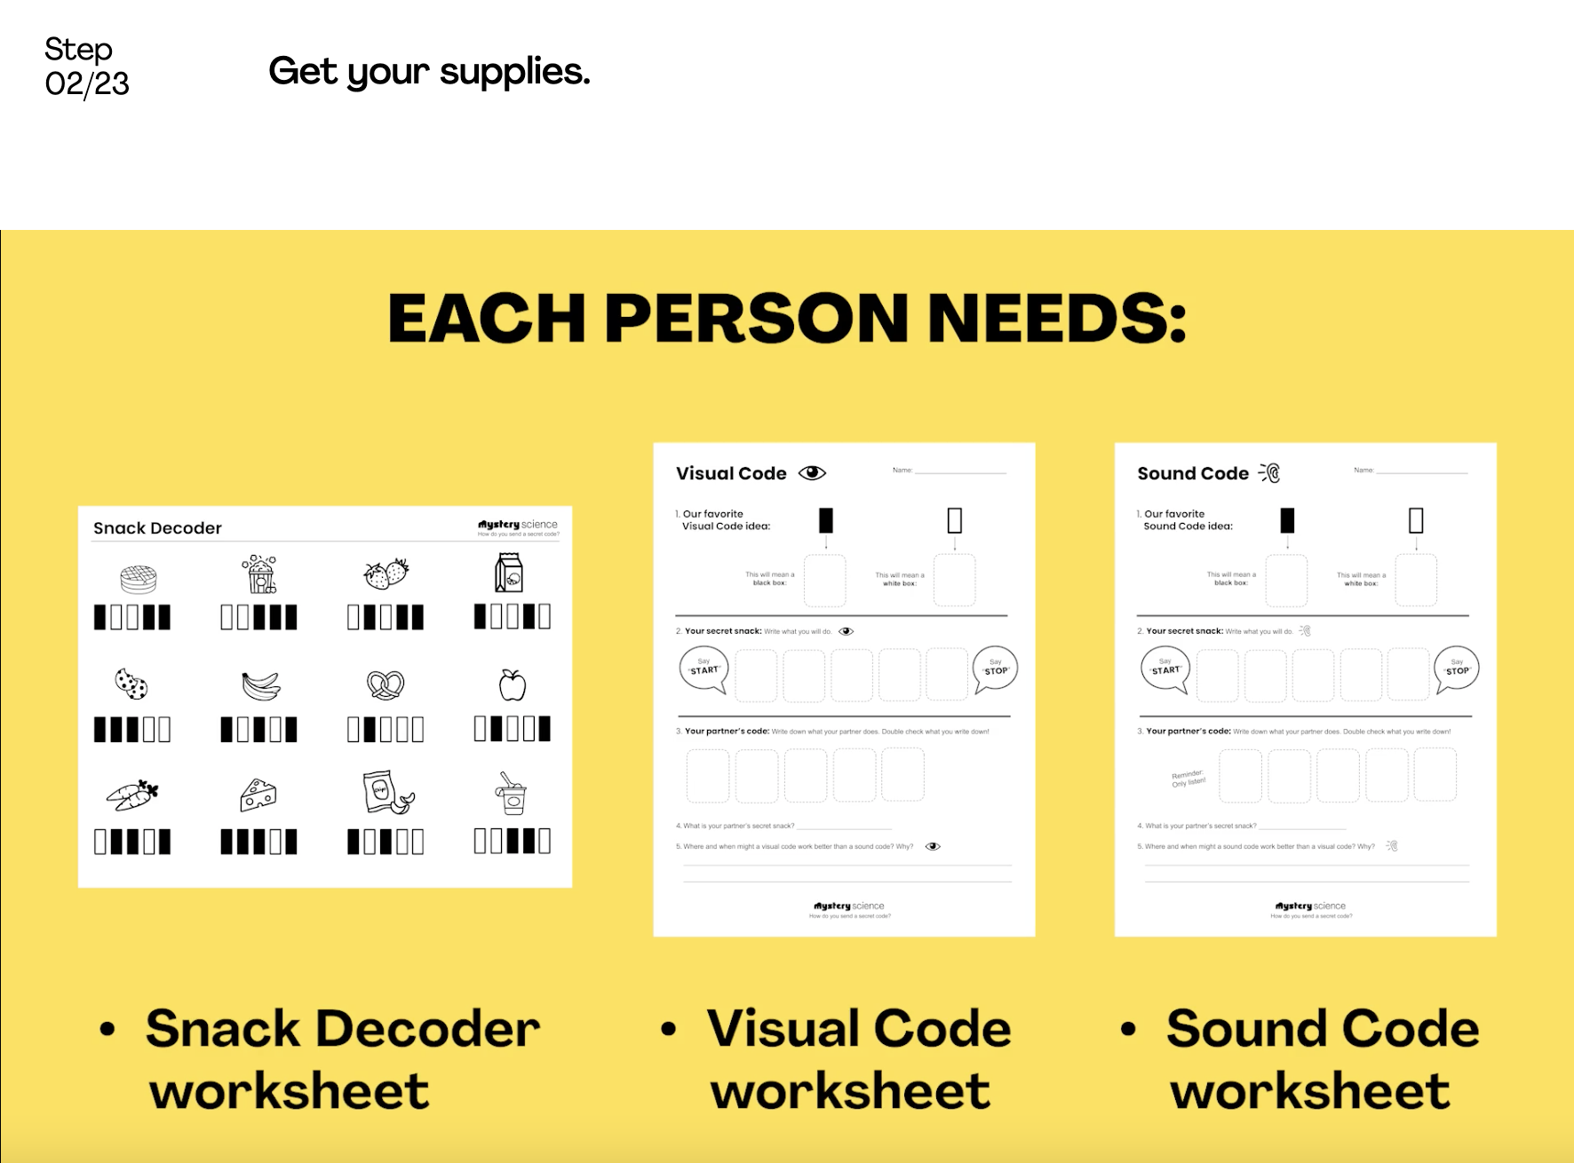
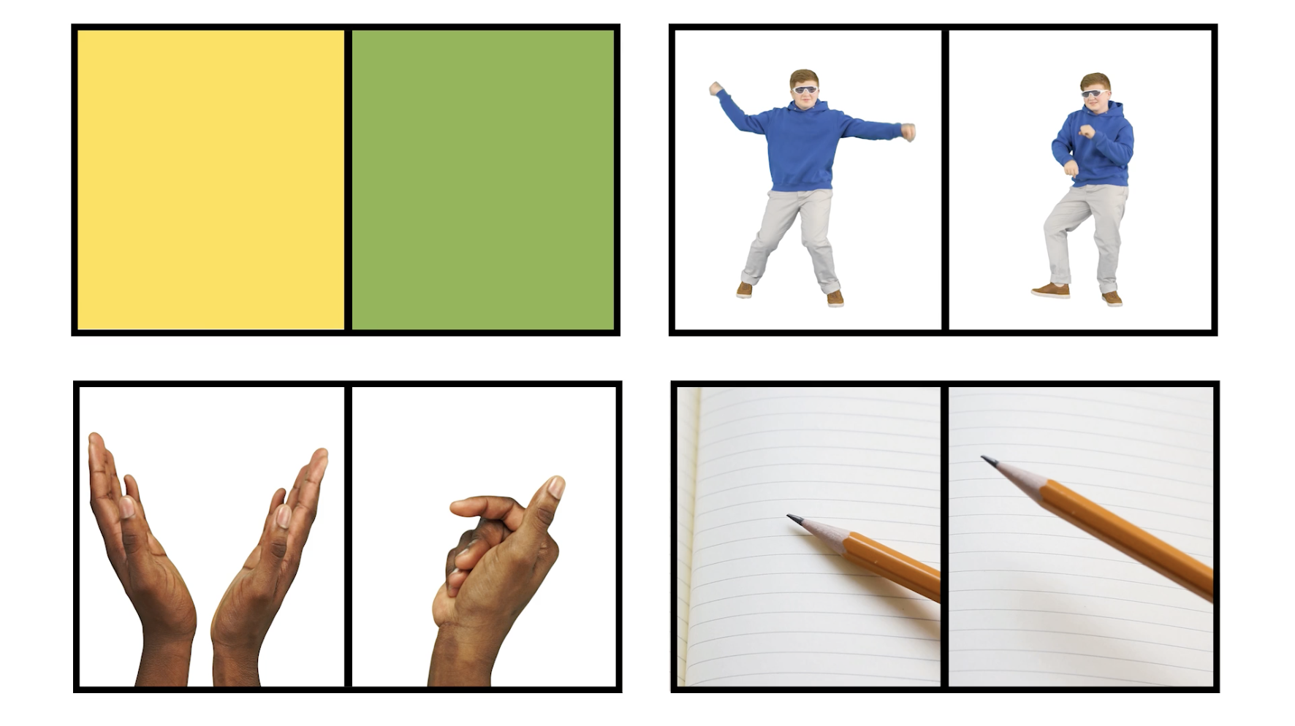
Sound, Waves, & Communication • Grade 4
Anchor Layer Teacher Guide
Lesson 1: How do you send a secret code? (pg 1 of 2)
Pattern Transfer & Technology
Overview
In this lesson, students explore how digital devices encode complex information so that it can be transferred over long distances.
In the activity, Secret Snacks, students generate their own codes in order to transfer information across the classroom. Then, they compare their codes and evaluate which worked best given the criteria and constraints.
If you have students who are sensitive to sensory overload, you may want to adjust the activity or create additional constraints (e.g. only whisper sounds) to create a safe space for all students.
Anchor Connection on Next Page
Exploration 15 mins
Hands-On Activity 35 mins
Wrap-up 15 mins
Anchor Connection 20 mins
Activity Notes
We suggest students work in pairs. Homeschool students will need a partner for this activity.
This activity involves pairs of students working together to create codes and then separating from one another to communicate those codes over a distance. Ideally student pairs will stand across the room from one another, but you may need to modify depending on your classroom.
You can choose to provide whatever materials you’d like for students to use for their codes. We suggest at least some paper and crayons. But you can include flashlights, musical instruments, or anything you’d like to encourage student creativity in their visual and sound code creation.
‹#›

Slide 6
Sound, Waves, & Communication • Grade 4
Anchor Layer Teacher Guide
Lesson 1: How do you send a secret code? (pg 2 of 2)
Pattern Transfer & Technology
Anchor Connection
The speaker and metal plate need electrical signals to make them vibrate. When they vibrate, they make a sound.
The electrical signals carry a code, and that code is what makes the speaker and metal plate generate different sounds. The code used to make sounds is different from the code that is in this lesson, but it is still a code of electrical signals.
Students revisit the explanations and/or drawings that they worked on during the Anchor Phenomenon. They should understand that the speaker and metal plate both vibrate and make sounds when they receive an electrical signal. The electrical signal carries the sound as a code.
Students can update their explanations and/or drawings by adding:
Electrical signals make the speaker and metal plate vibrate.
When the speaker and metal plates vibrate, they make a sound.
Connecting Storyline Question
Why do vibrating objects make sounds?
Exploration 15 mins
Hands-On Activity 35 mins
Wrap-up 15 mins
Anchor Connection 20 mins
‹#›

Slide 7
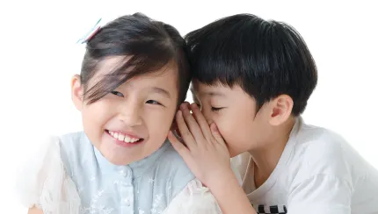
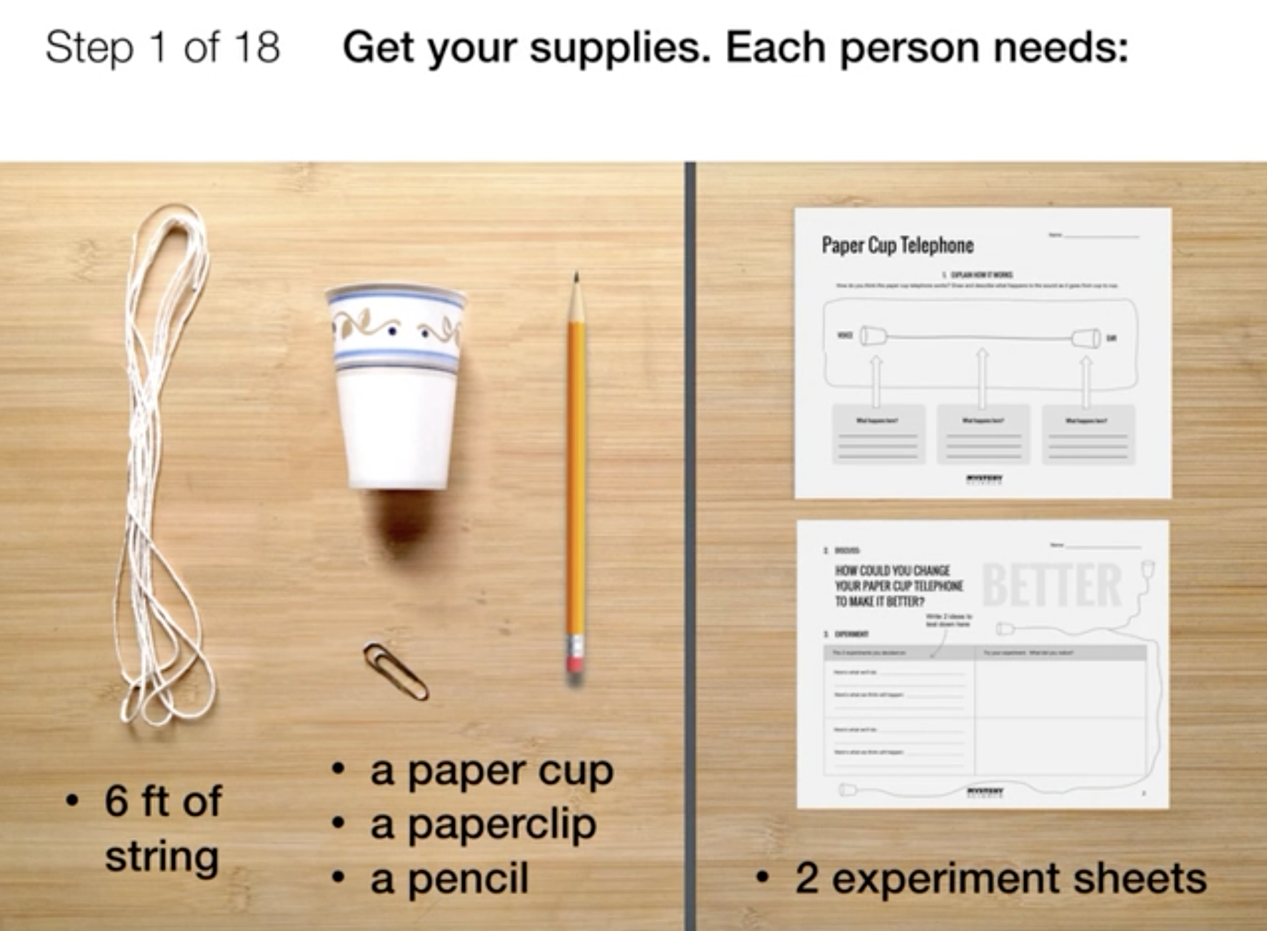
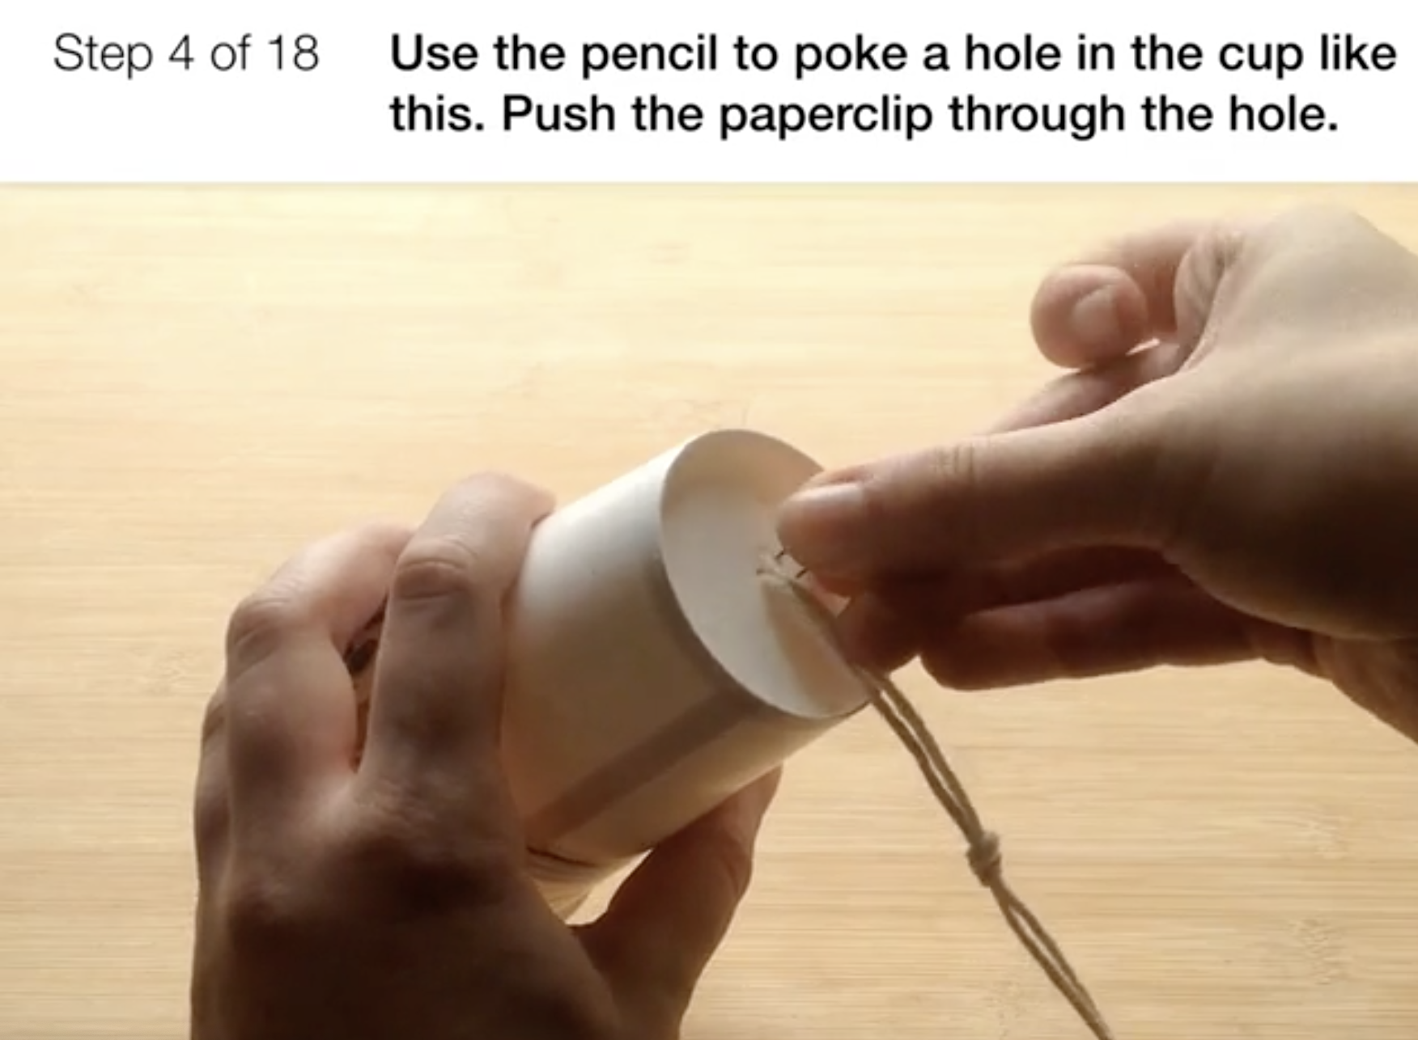
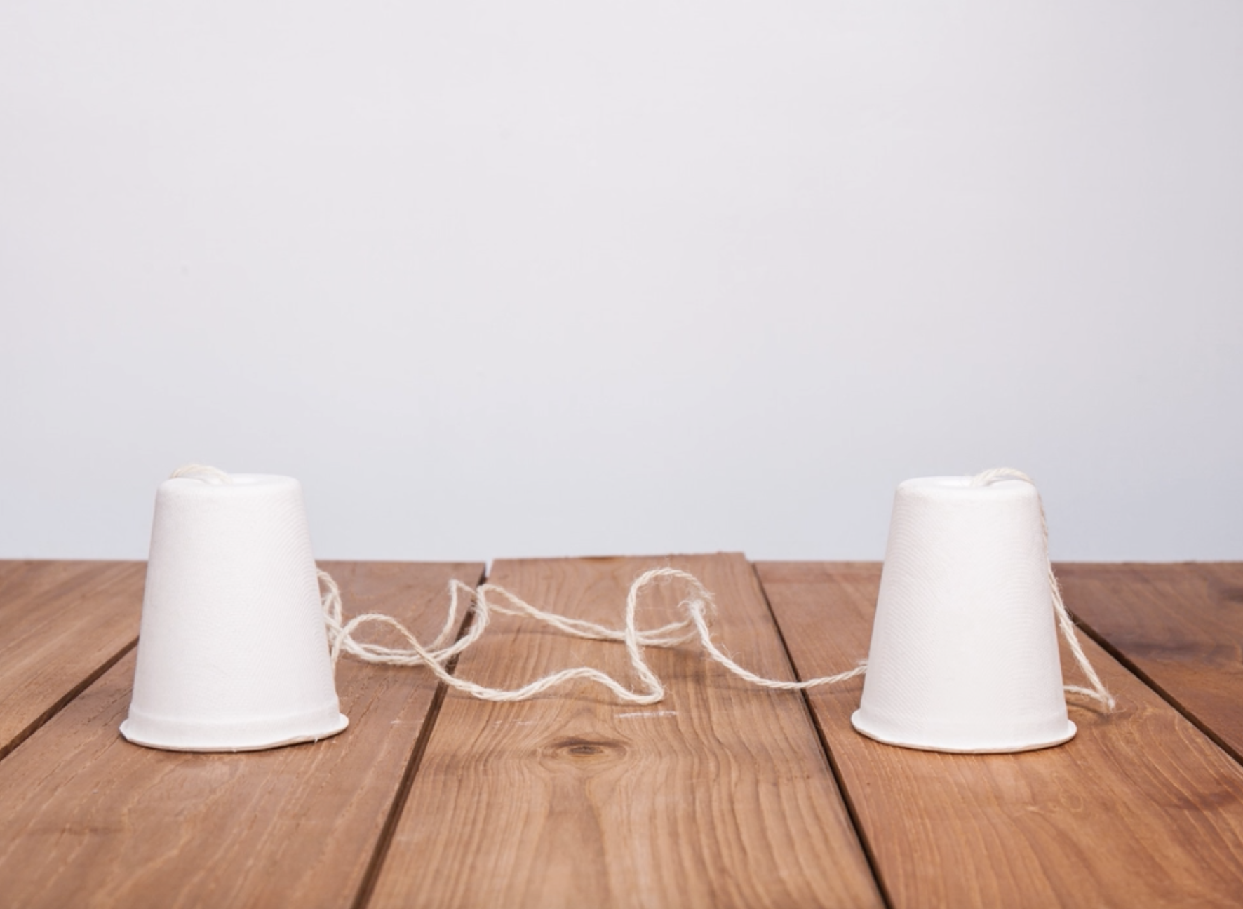
Sound, Waves, & Communication • Grade 4
Anchor Layer Teacher Guide
Lesson 2: How far can a whisper travel? (pg 1 of 2)
Sound, Vibration, & Engineering
Overview
In this lesson, students learn about the connection between sounds and vibration.
In the activity, Paper Cup Telephone, students make telephones using cups and string. Students then modify the design of their telephones using different types of supplies to see if they can improve the sound quality.
Anchor Connection on Next Page
Exploration 10 mins
Hands-On Activity 40 mins
Anchor Connection 30 mins
Assessment 25 mins
Activity Notes
Each student will first make half of a paper cup telephone. Then, students will pair up to complete their telephones. Students will also have the chance to come up with their own experiments with the telephone. The list below shows materials they could use.
more paper cups, including larger and smaller cups
construction paper could be used to make a cup larger
ribbon, yarn, dental floss, or other kinds of string
more of the same string you used before
more paper clips
Each student needs a piece of string that is 6 feet in length. Read our Teacher Tips for a way to prepare several strings using a yardstick.
Your students will have the chance to come up with their own experiments with the phone. But before students attempt to modify and improve the design of their telephones, they need to know which materials are available to them. During Step 15 of the experiment, we suggest you show students which of these will be available.
‹#›

Slide 8
Sound, Waves, & Communication • Grade 4
Anchor Layer Teacher Guide
Lesson 2: How far can a whisper travel? (pg 2 of 2)
Sound, Vibration, & Engineering
Anchor Connection
Sound is a vibration. When there is no sound, there is no vibration.
When there is sound, the vibrations cause patterns to form in the salt on the metal plate, the water in the dish, and the flames above the Ruben’s Tube.
Students revisit the explanations and/or drawings that they worked on during the Anchor Phenomenon. They should understand that the metal plate makes sound when it vibrates, and changes the pattern as the sound changes. The plate is vibrating the most where there is less powder and vibrating the least in places where the powder is collecting.
Students can update their explanations and/or drawings by:
Adding that sound is a vibration
Adding labels, marking areas covered with salt as vibrating less and areas with no salt as vibrating more
Describing how they gathered evidence of vibrations by feeling their throat and the from the string in the cup telephone activity
Note: updates to the Ruben’s Tube and Speaker Dish sheets are optional at this point.
Connecting Storyline Question
Do sound vibrations also travel through liquids?
Exploration 10 mins
Hands-On Activity 40 mins
Anchor Connection 30 mins
Assessment 25 mins
‹#›

Slide 9
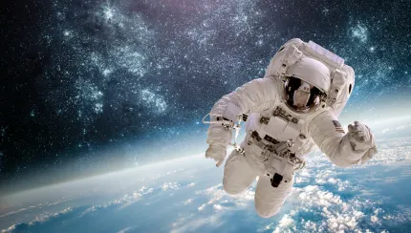
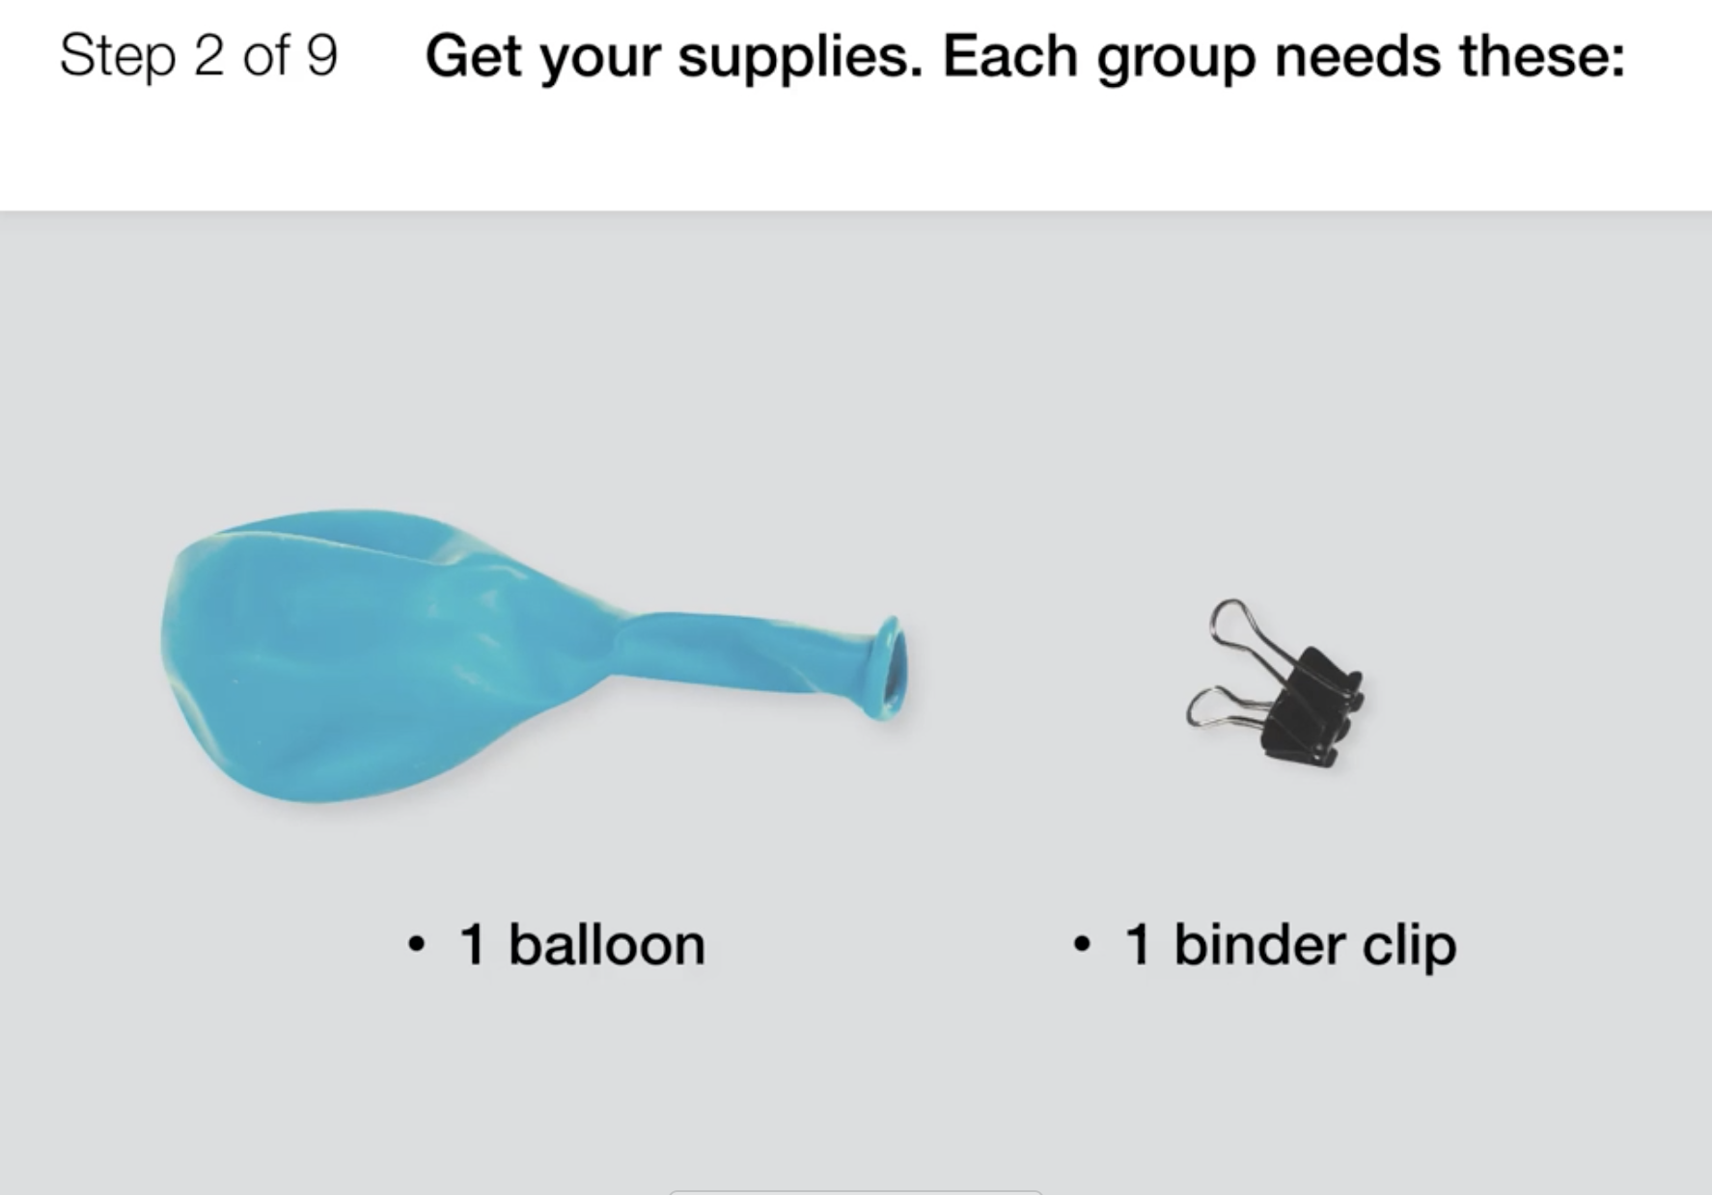
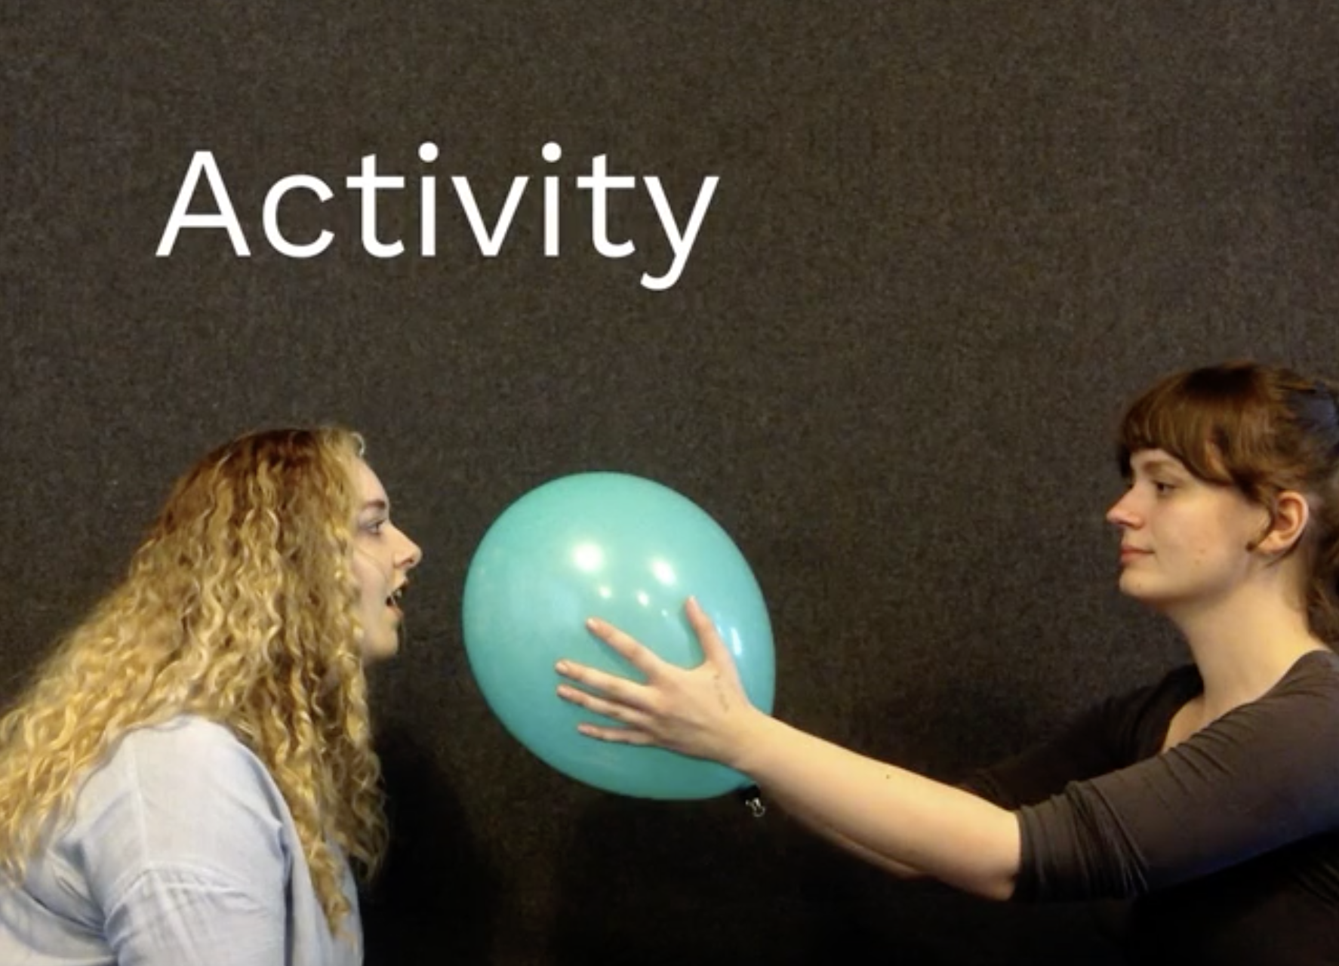
Sound, Waves, & Communication • Grade 4
Anchor Layer Teacher Guide
Lesson 3: What would happen if you screamed into outer space?
Sound & Vibrations (pg 1 of 2)
Overview
In this lesson, students explore the role that air plays in enabling a sound vibration to travel.
In the activity, Act Out a Sound, students do two short activities that explore sound vibrations. Students experiment with sound to understand how it moves through the air and then consider what would happen in an environment like space where there is no air.
Anchor Connection on Next Page
Exploration 6 mins
Hands-On Activity 50 mins
Wrap-up 4 mins
Anchor Connection 30 mins
Assessment 25 mins
Activity Notes
For the first activity, we suggest students work in pairs. For the second activity, you need a minimum of four people (and a maximum of six people) who will sit in a line, side by side. So make sure you have the people and the chairs you need.
The first activity requires balloons and binder clips. The second activity requires the printouts and some tape. You may want to separate these supplies into two piles for easy classroom distribution.
‹#›

Slide 10
Sound, Waves, & Communication • Grade 4
Anchor Layer Teacher Guide
Lesson 3: What would happen if you screamed into outer space?
Sound & Vibrations (pg 2 of 2)
Anchor Connection
Sound needs a medium to travel through. The medium is the material that is vibrated by the sound wave. We can’t see sound vibrations in the air, but we can see them in the water, the salt, and the flames.
The pattern in the water is caused by the vibration from the speaker traveling through the air and then the water. The vibration starts on the edges of the dish and travels to the center and back.
Students revisit the explanations and/or drawings that they worked on during the Anchor Phenomenon. They should understand that the sound vibrations travel through water from the edge of the dish towards the center; in the same way the vibrations travel through air.
Students can update their explanations and/or drawings by:
Adding that sound vibrations travel through a medium
Adding that sound vibrations travel from one blob of air or water to the next blob, just like what they saw in the activity
Describing that they compared the vibrations with air (by feeling the vibrating balloons) to the lack of vibrations without air (by listening to the bell in a vacuum)
Describing how they modeled the air as a medium in the activity
Connecting Storyline Question
Why do some mediums show sound vibrations better than others?
Exploration 6 mins
Hands-On Activity 50 mins
Wrap-up 4 mins
Anchor Connection 30 mins
Assessment 25 mins
‹#›

Slide 11
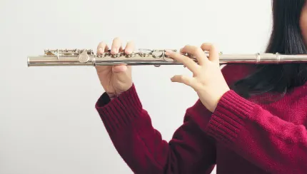
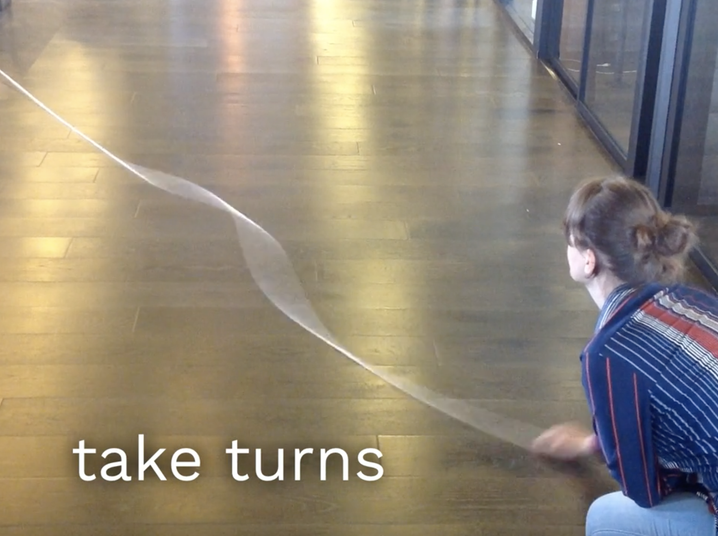
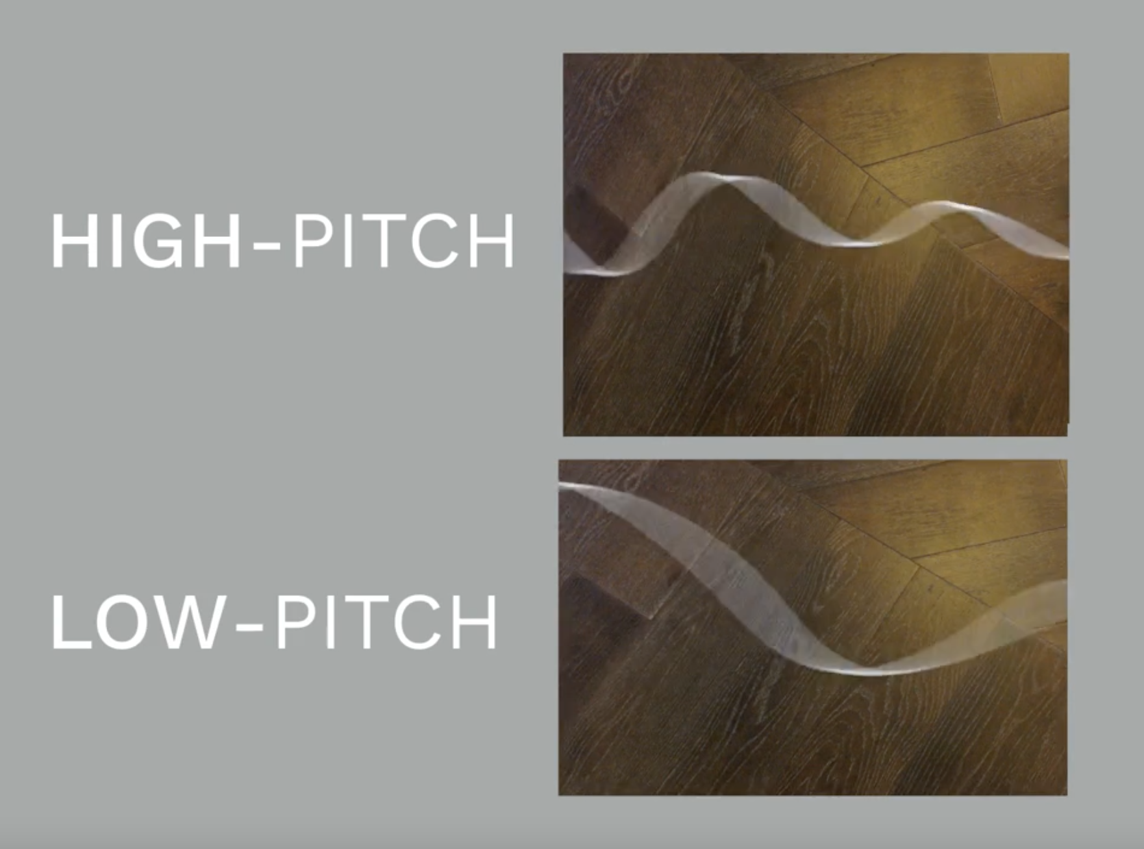
Sound, Waves, & Communication • Grade 4
Anchor Layer Teacher Guide
Lesson 4: Why are some sounds high and some sounds low?
Sound Waves & Wavelength (pg 1 of 2)
Overview
In this lesson, students discover that sound is a wave.
In the activity, Making Waves, students draw the waves that different sounds make using a virtual oscilloscope, a machine that shows images of sound waves. Then they vibrate a rope to make waves that look like the ones made by the oscilloscope.
Anchor Connection on Next Page
Exploration 30 mins
Hands-On Activity 30 mins
Anchor Connection 30 mins
Assessment 25 mins
Activity Notes
For the rope activity, you’ll need a smooth, hard floor where you can stretch out a rope that’s 12 to 15 feet long. Students can take turns making waves. We suggest having at least one rope for each group of 8 students.
For each group of students, you’ll need a flexible rope or clothesline measuring 12 to 15 feet in length.
Virtual Oscilloscope Extension (Optional): In our Extensions section, we include a link to an online oscilloscope that you can use to extend your exploration of the patterns made by sound. Using this tool, students can experiment with different sounds and see the patterns that the waves make.
‹#›

Slide 12
Sound, Waves, & Communication • Grade 4
Anchor Layer Teacher Guide
Lesson 4: Why are some sounds high and some sounds low?
Sound Waves & Wavelength (pg 2 of 2)
Anchor Connection
Sounds have different wavelengths, which result in different pitches. Higher-pitched sounds have a shorter wavelength and lower-pitched sounds have a longer wavelength.
The gas that fills the Ruben’s Tube is the medium that the sound travels through. The speaker at the end of the tube causes more gas to come out of the tube at some places, and less gas to come out at others. Taller flames form where more gas is being pushed out, and shorter flames form where less gas is being pushed out.
Students revisit the explanations and/or drawings that they worked on during the Anchor Phenomenon. They should understand that the pattern of flames on the Ruben’s Tube changes when the pitch of the sound changes. The pattern of flames shows the wavelength of the sounds made.
Students can update their explanations and/or drawings by:
Adding that the pitch of a sound is a result of the wavelength of the vibration in their drawings and/or explanations
Explaining that they interpreted the different wavelengths of the vibrations shown in the oscilloscope
As an optional summarizing step, students could be asked to explain how, in each of these systems, a single cause (vibrations) can lead to a variety of effects (salt being shaken around, water forming waves, and flames being taller or shorter in the tube).
Connecting Storyline Question
Is it easier to ‘see’ high pitch or low pitch sounds?
Exploration 30 mins
Hands-On Activity 30 mins
Anchor Connection 30 mins
Assessment 25 mins
‹#›

Slide 13
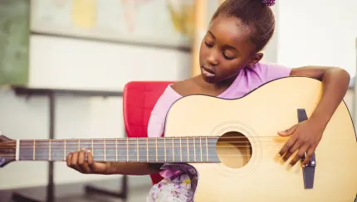
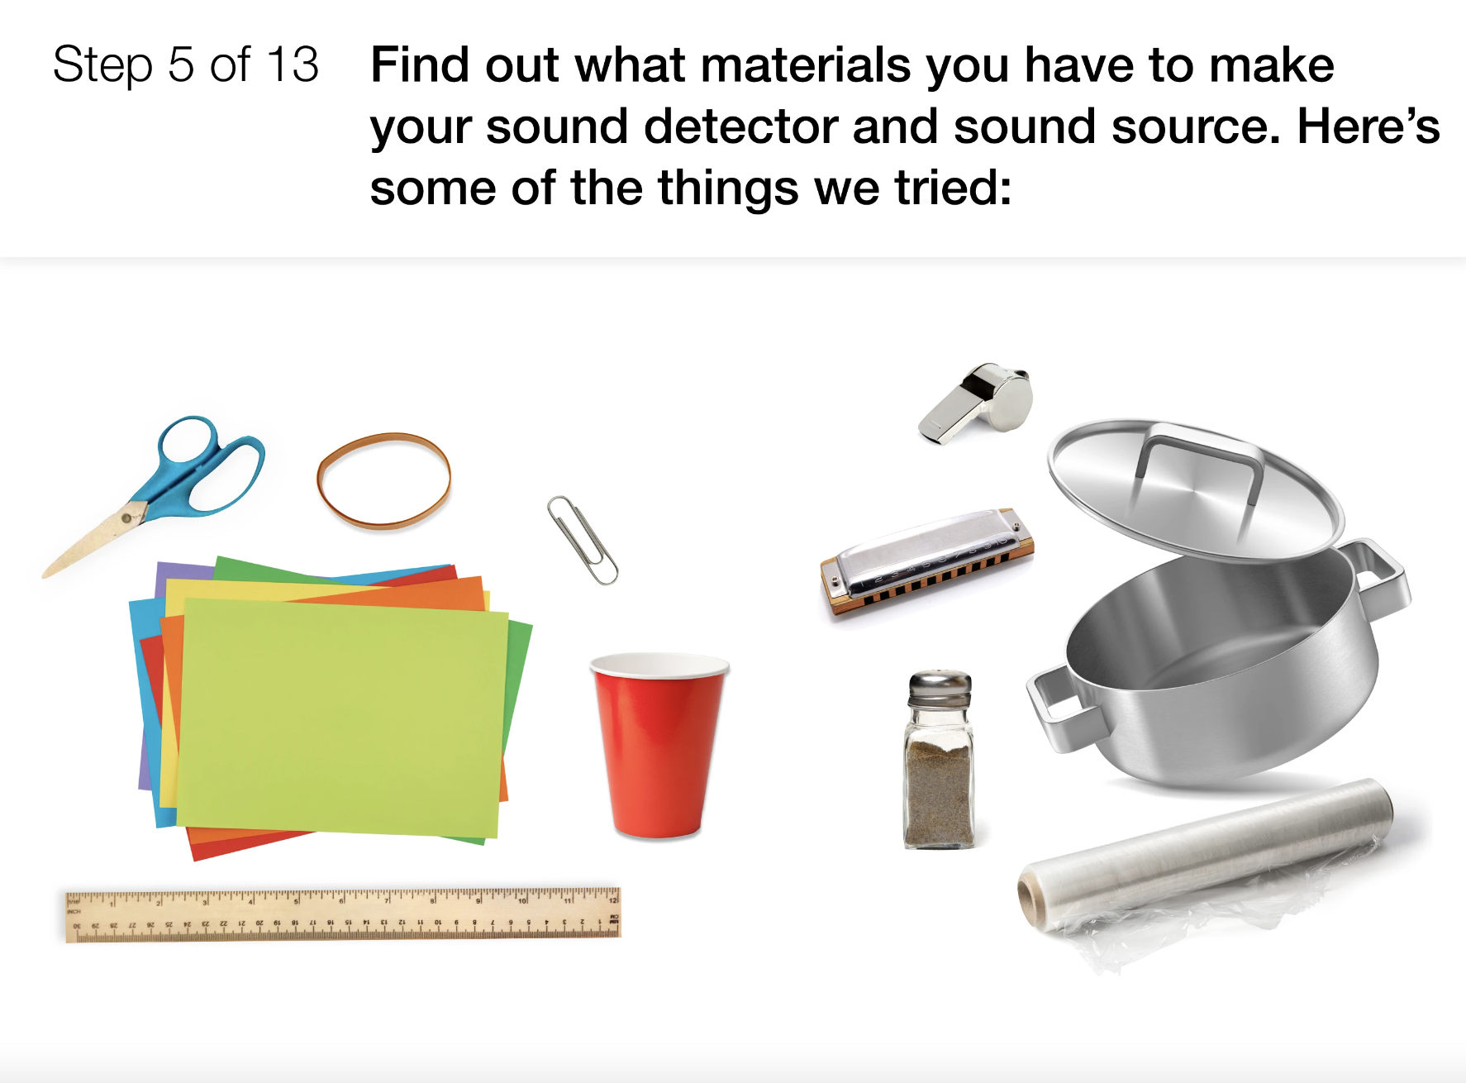
Sound, Waves, & Communication • Grade 4
Anchor Layer Teacher Guide
Performance Task: How can you make sound waves visible?
Sound Waves & Engineering
Overview
In this performance task, students apply what they've learned about sound and sound waves by building their own Sound Wave Watcher that uses the vibrations of sound to make visible patterns.
Unit Review 30 mins
Hands-On Activity 120 mins
Performance Task Notes
Plan ahead! Students may bring in materials and objects from home to use in their machines. Students will work in pairs to share ideas, but each student will build their own Sound Wave Watcher.
See the lesson page for a list of basic supplies that we have used in making Sound Wave Watchers. We encourage you to reuse supplies from the paper cup telephone activity and to raid your recycling bin and craft box for additional supplies. You can use those supplies to substitute or supplement our list.
Crosscutting Concepts
Patterns: Patterns help us to make predictions and form explanations. Students evaluate each pattern and predict how its changes relate to sound.
Cause & Effect: Cause and effect relationships are used to explain change. Understanding a single cause can help
us explain a wide variety of effects.
‹#›

