Slide 1

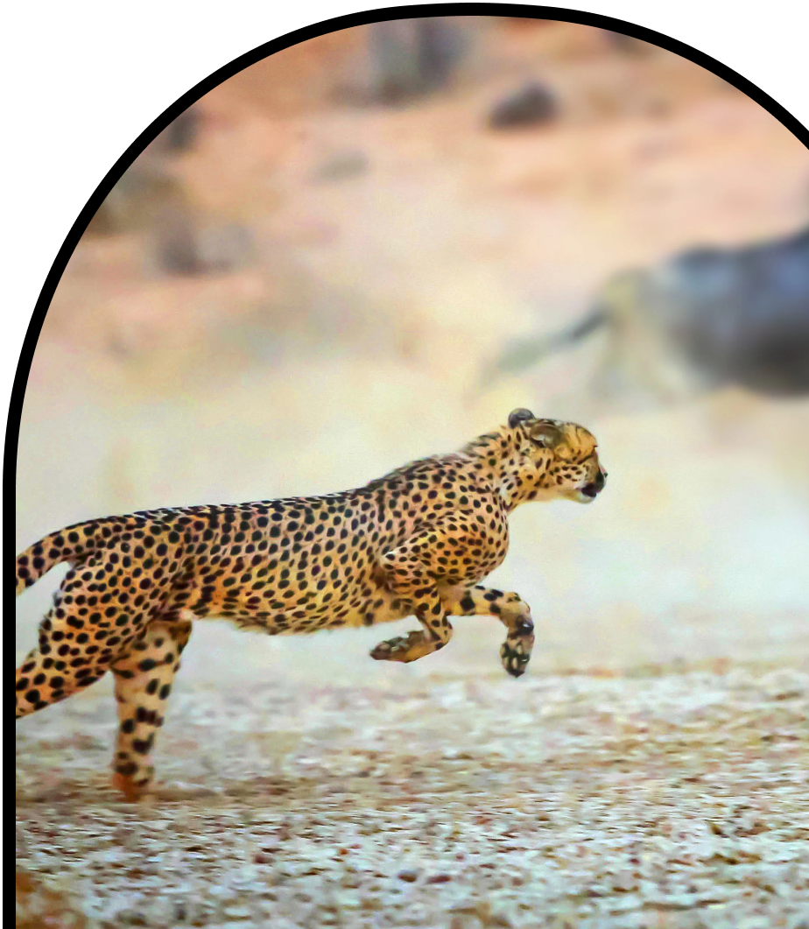
Anchor Layer Teacher Guide
A curriculum companion for Anchor Layer users
Grade 3
Heredity, Survival, & Selection
Unit Web Link • Pacing Guide • Other Units

Slide 2
Heredity, Survival, & Selection • Grade 3
Anchor Layer Teacher Guide
Unit Summary
In this unit, students explore the inherited and acquired traits of plants and animals. Analyzing traits provides evidence for how those traits vary, how they are inherited, and how they have changed over time through both artificial and natural selection. Students also examine how a particular environment can affect traits, including inherited traits that provide animals with an advantage for survival. Assessments
Performance Expectations | Science & Engineering Practices | Disciplinary Core Ideas | Crosscutting Concepts
• 3-LS2-1. Construct an argument that some animals form groups that help members survive. • 3-LS3-1. Analyze and interpret data to provide evidence that plants and animals have traits inherited from parents and that variation of these traits exists in a group of similar organisms • 3-LS3-2. Use evidence to support the explanation that traits can be influenced by the environment. • 3-LS4-3. Construct an argument with evidence that in a particular habitat some organisms can survive well, some survive less well, and some cannot survive at all. • 3-LS4-2. Use evidence to construct an explanation for how the variations in characteristics among individuals of the same species may provide advantages in surviving, finding mates, and reproducing. | • Analyzing and Interpreting Data • Constructing Explanations and Designing Solutions • Planning and Carrying Out Investigations • Engaging in Argument from Evidence • Obtaining, Evaluating, and Communicating Information | • LS3.A: Inheritance of Traits • LS3.B: Variation of Traits • LS4.B: Natural Selection • LS4.C: Adaptation • LS2.D: Social Interactions and Group Behavior | • Systems and System Models • Patterns • Stability and Change • Cause and Effect
Heredity, Survival, & Selection Lesson Flow on Next Page
‹#›

Slide 3
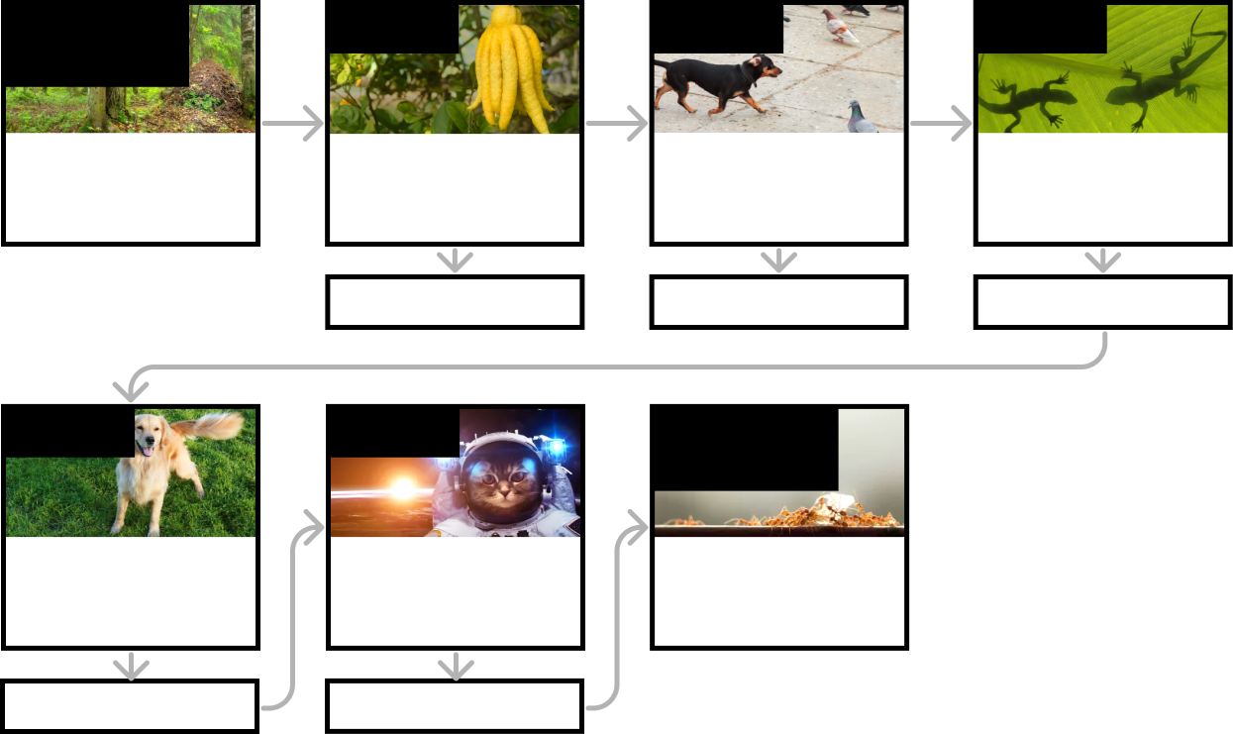
Heredity, Survival, & Selection • Grade 3
Anchor Layer Teacher Guide
Heredity, Survival, & Selection Lesson Flow
Anchor Phenomenon
Lesson 1
Lesson 2
Lesson 3
Animal Groups & Survival
Animals Around Us
Traits & Inheritance
How do you identify a mysterious fruit?
Trait Variation, Inheritance, & Artificial Selection What do dogs and pigeons have in common?
Trait Variation, Survival, & Natural Selection
How could a lizard's toes help it survive?
Anchor Connection
Anchor Connection
Anchor Connection
Lesson 4
Lesson 5
Performance Task
Animal Groups & Survival
Why do dogs wag their tails?
Traits & Environmental Variation How long can people (and animals) survive in outer space?
Animal Groups & Survival
Why do ants live in colonies?
Anchor Connection
Anchor Connection
‹#›

Slide 4

Heredity, Survival, & Selection • Grade 3
Anchor Layer Teacher Guide
Anchor Phenomenon Background
What makes ants one of the most successful kinds of animals on the Earth?
It is easy to see why some animals are successful. For example, leopards have large teeth and claws, and are very fast and powerful. Eagles have keen eyesight, the ability to fly, and sharp beaks and talons. And yet very few animals even come close to the level of success that ants have achieved. Estimates suggest that there are between ten and one hundred quadrillion ants on Earth—this amounts to millions of ants for every single person in existence. They can also be found on almost every landmass on Earth. What makes ants so successful?
Ants do have physical characteristics that help them be successful, such as antennae that help them feel their surroundings, a high level of strength for their size, powerful jaws and sharp stingers, and an ability to eat a very wide variety of foods. However, their behaviors play a huge role in their success.
Many animals live primarily solitary lives, but ants spend their lives together in groups. Some groups may only have a few hundred members, but some can number in the hundreds of millions. Ants also build and defend nests. Some ants build nests underground, while others build in trees, while others build nests out of their own bodies! Within their nests, ants take on different roles. By doing different jobs and working together, they can help support one another.
By better understanding how ants work so well together, scientists and engineers hope to improve our lives, too. For example, understanding how ants move efficiently in their nests can help us do everything from improving rush-hour traffic to designing robots that can explore new places.
‹#›

Slide 5
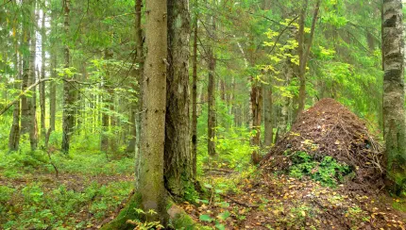
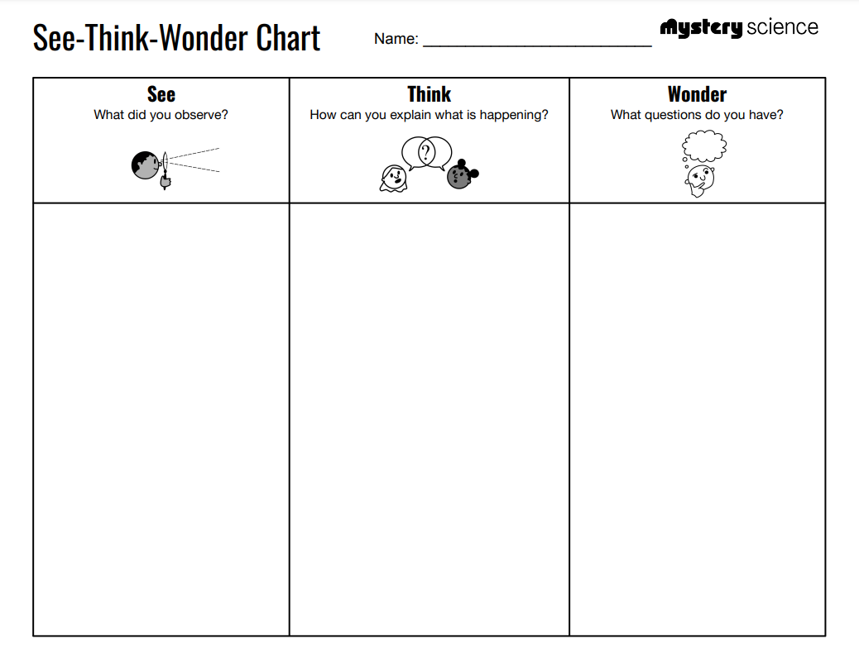
Heredity, Survival, & Selection • Grade 3
Anchor Layer Teacher Guide
Anchor Phenomenon: Animals Around Us
Animal Groups & Survival
Anchor Phenomenon Lesson Overview
Note: This lesson is part of this unit’s Anchor Layer. If you have the Anchor Layer turned on, we recommend teaching all of the lessons in this unit in order.
The anchor phenomenon for this unit is one of the most successful kinds of animals on Earth: ants! How can such small creatures survive in so many places with such a huge population of individuals?
During the introduction, students generate observations and questions about the phenomenon and create a list of possible explanations for the phenomenon.. Students will use these initial ideas to track how their understanding grows throughout the unit.
Anchor Phenomenon 15 mins
Guided Inquiry 15 mins
Hands-On Activity 15 mins
Student Work Samples & Notes
Students will gather clues during and after each lesson in this unit to help them improve their understanding and explanations. It is important to encourage students to recognize that even if they don't know the perfect answer yet, they are going to learn a lot throughout the unit and will have an opportunity to revisit the phenomenon over time.
The ants have jaws
The ants have antennae
The ants have six legs
I think they bite things
I think they live underground
I think they have big nests
I wonder what they eat
I wonder how they survive if they’re so little
I wonder how they build their nests
‹#›

Slide 6
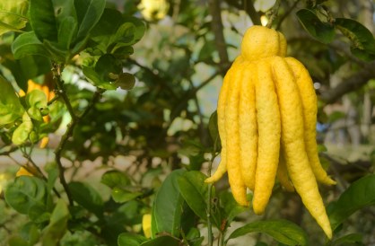

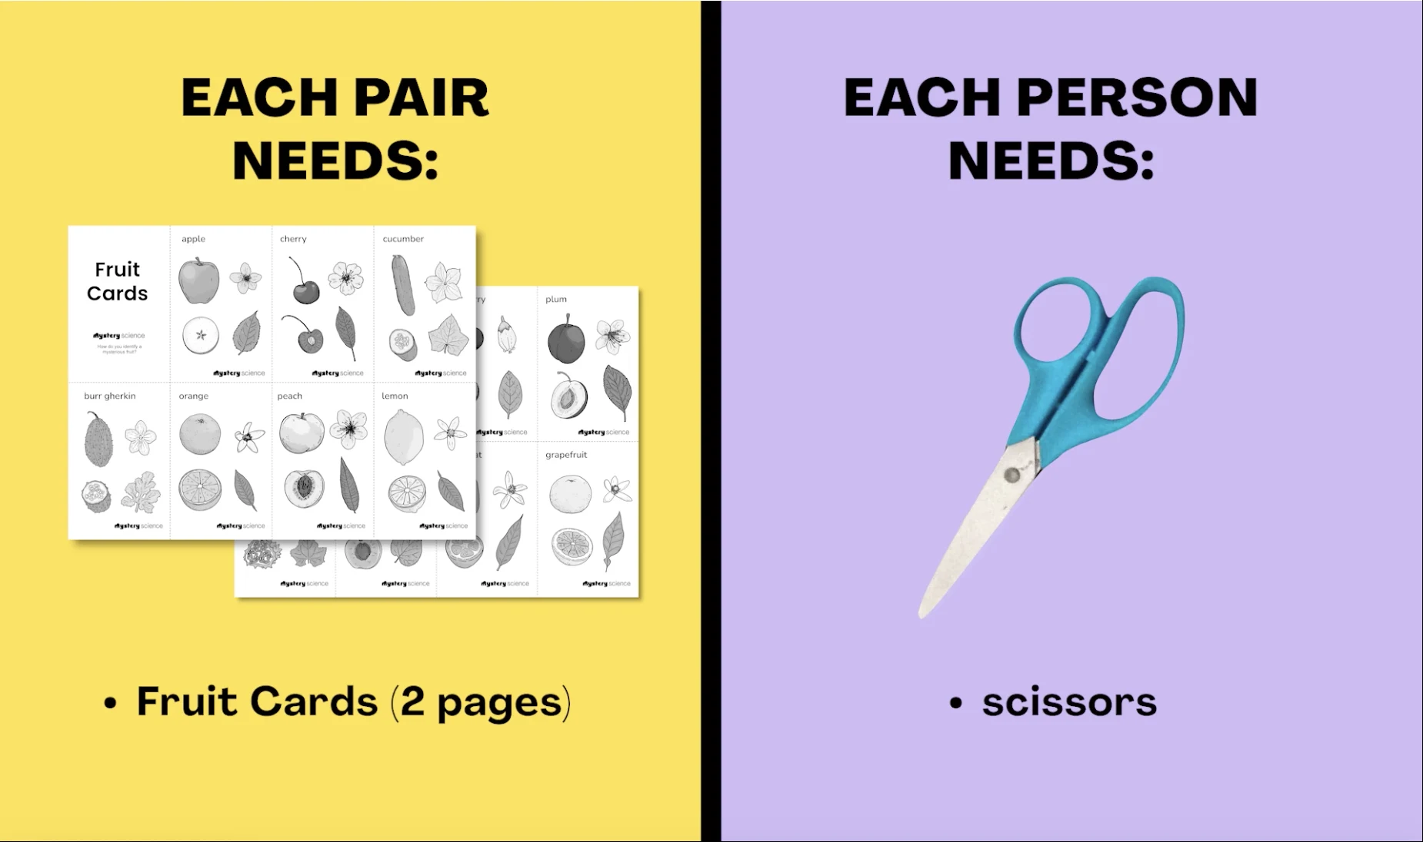
Heredity, Survival, & Selection • Grade 3
Anchor Layer Teacher Guide
Lesson 1: How do you identify a mysterious fruit?
Trait Variation, Inheritance, & Artificial Selection (pg 1 of 2)
Overview
In this lesson, students examine plant traits and use that information as evidence to help them identify an unknown fruit.
In the activity, Fruit Market Mysteries, students look for similarities and differences in the leaves, flowers, and fruits of plants found at the grocery store to sort them into groups and identify patterns of inheritance.
Anchor Connection on Next Page
Exploration 10 mins
Hands-On Activity 35 mins
Wrap-Up 10 mins
Anchor Connection 15 mins
Assessment 20 mins
Activity Notes
We suggest students work in pairs.
Materials for this activity are needed at two different steps, so we suggest organizing them beforehand for easier distribution.
The Fruit Market Mysteries worksheet is needed in Step 1. The Fruit Cards and scissors are then needed in Step 12.
‹#›

Slide 7
Heredity, Survival, & Selection • Grade 3
Anchor Layer Teacher Guide
Lesson 1: How do you identify a mysterious fruit?
Trait Variation, Inheritance, & Artificial Selection (pg 2 of 2)
Anchor Connection
There are many different types of plants that produce fruit, and the characteristics of those plants are widely varied. One thing that they have in common, though, is that they are eaten by ants! Different specific types of ants may have specific diets, but as a group, ants have an extremely broad diet. This is one of the things that has helped ants be successful: no matter where they are, there is a good chance they will find something they can eat.
Students revise the explanation and/or drawing that they worked on during the Anchor Phenomenon. They should understand that different kinds of ants use different kinds of plants around the world as sources of food. This helps them to survive.
Connecting Storyline Question
How are ants different from one another?
Exploration 10 mins
Hands-On Activity 35 mins
Wrap-Up 10 mins
Anchor Connection 15 mins
Assessment 20 mins
‹#›

Slide 8
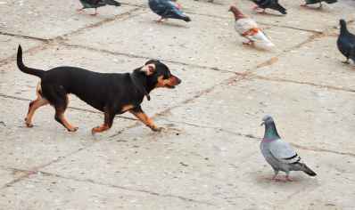

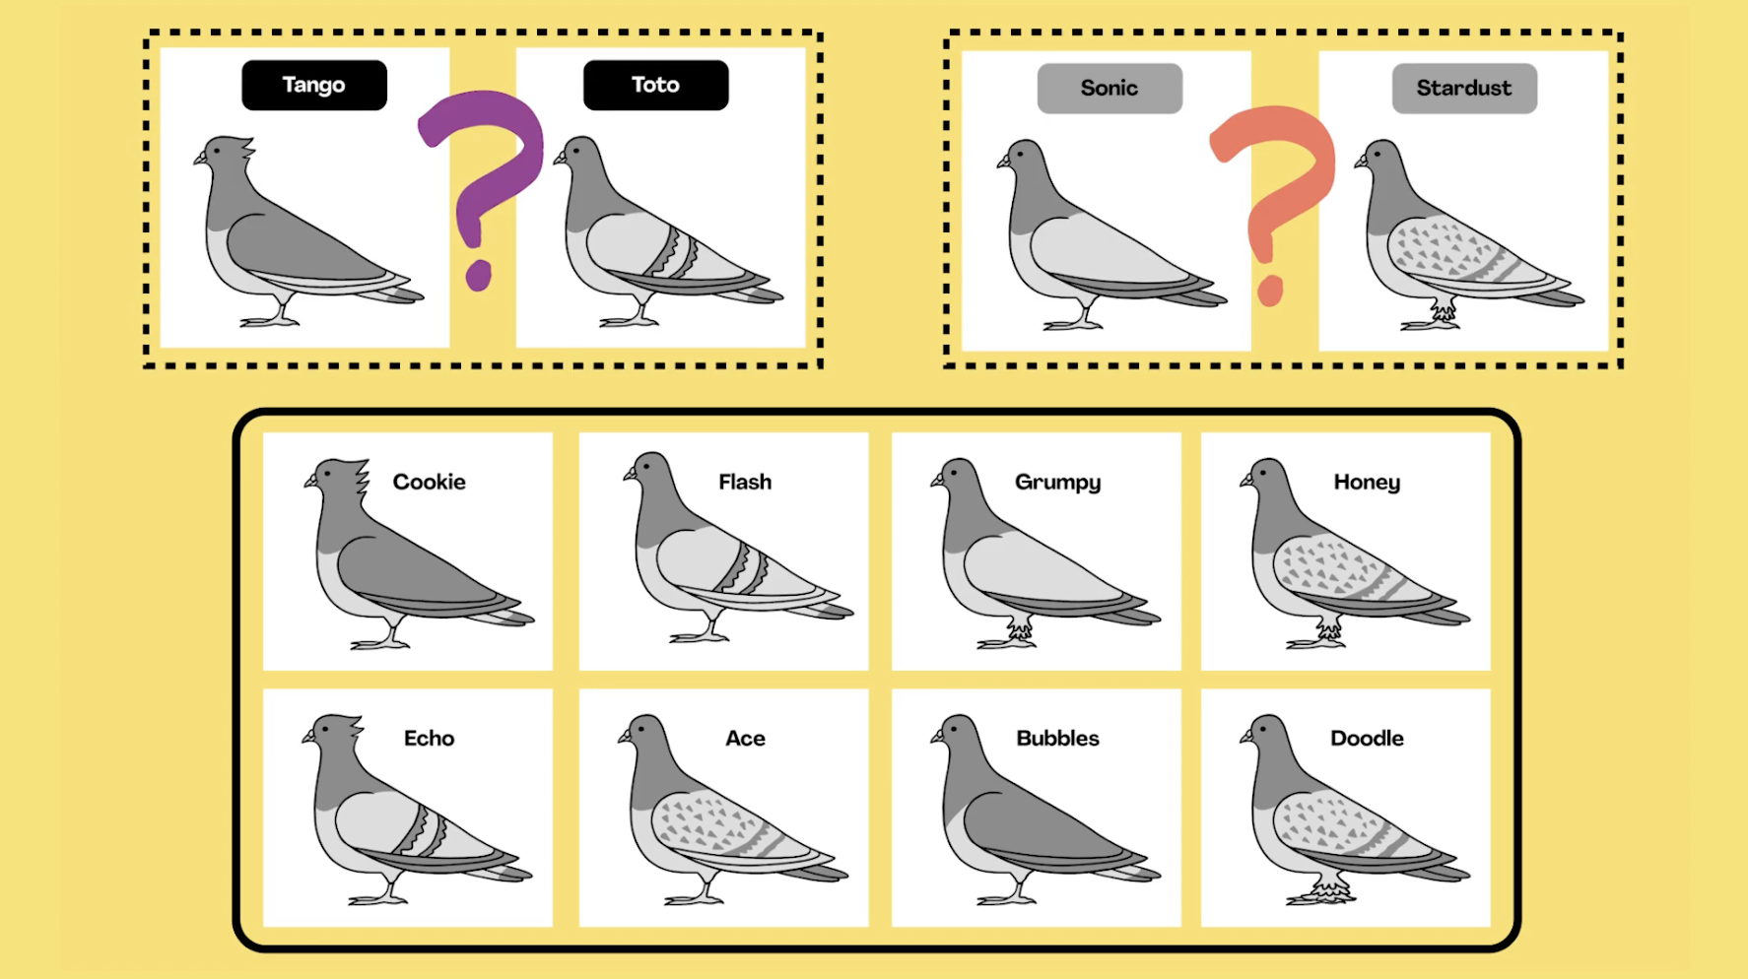
Heredity, Survival, & Selection • Grade 3
Anchor Layer Teacher Guide
Lesson 2: What do dogs and pigeons have in common?
Trait Variation, Inheritance, & Artificial Selection (pg 1 of 2)
Overview
In this lesson, students explore the extreme trait variation of different dog breeds -- and pet pigeon breeds!
In the activity, Pigeon Pairings, students analyze trait similarities and differences among parent, offspring, and sibling pigeons. They interpret this data to discover that the variation and inheritance of traits creates a pattern that explains why we see such extreme traits in artificially selected animal breeds.
Exploration 12 mins
Hands-On Activity 35 mins
Wrap-Up 12 mins
Anchor Connection 15 mins
Assessment 20 mins
Activity Notes
We suggest students work in pairs for this activity.
Anchor Connection on Next Page
‹#›

Slide 9
Heredity, Survival, & Selection • Grade 3
Anchor Layer Teacher Guide
Lesson 2: What do dogs and pigeons have in common?
Trait Variation, Inheritance, & Artificial Selection (pg 2 of 2)
Anchor Connection
There can be a great deal of variation between the individuals of a single type of animal. This is true in terms of physical characteristics, such as height or color, as well as in terms of behavior. Within a single ant colony, different ants can exhibit different specific behaviors. This helps them survive, because it allows them to do different jobs and work together to support one another.
Students revise the explanation and/or drawing that they worked on during the Anchor Phenomenon. They should understand that different ants within a colony have different traits that make them better at doing different jobs. This helps them to survive.
Connecting Storyline Question
How can ants survive if they are all so small?
Exploration 12 mins
Hands-On Activity 35 mins
Wrap-Up 12 mins
Anchor Connection 15 mins
Assessment 20 mins
‹#›

Slide 10
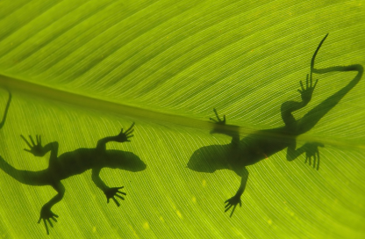
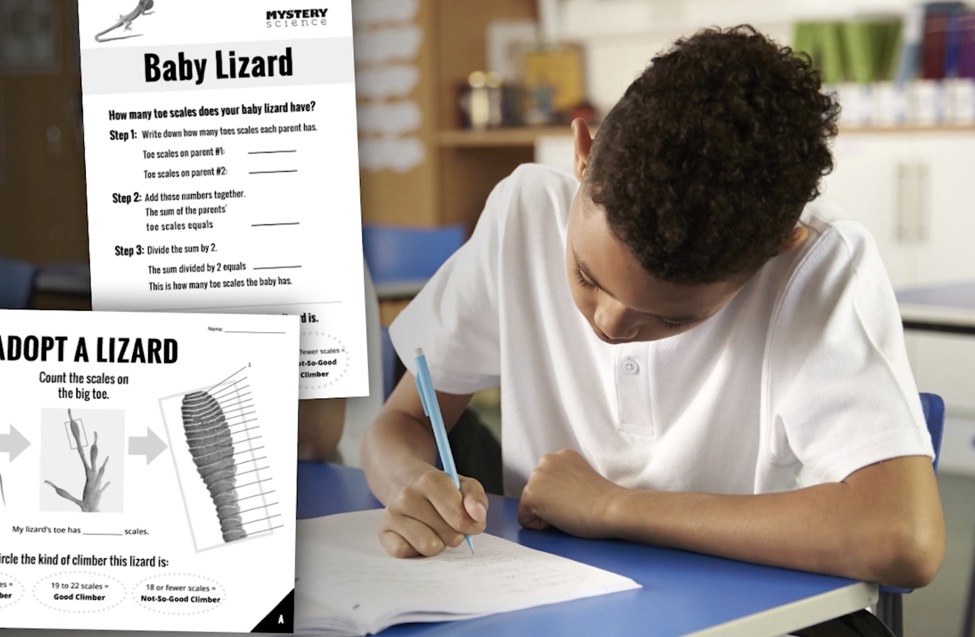
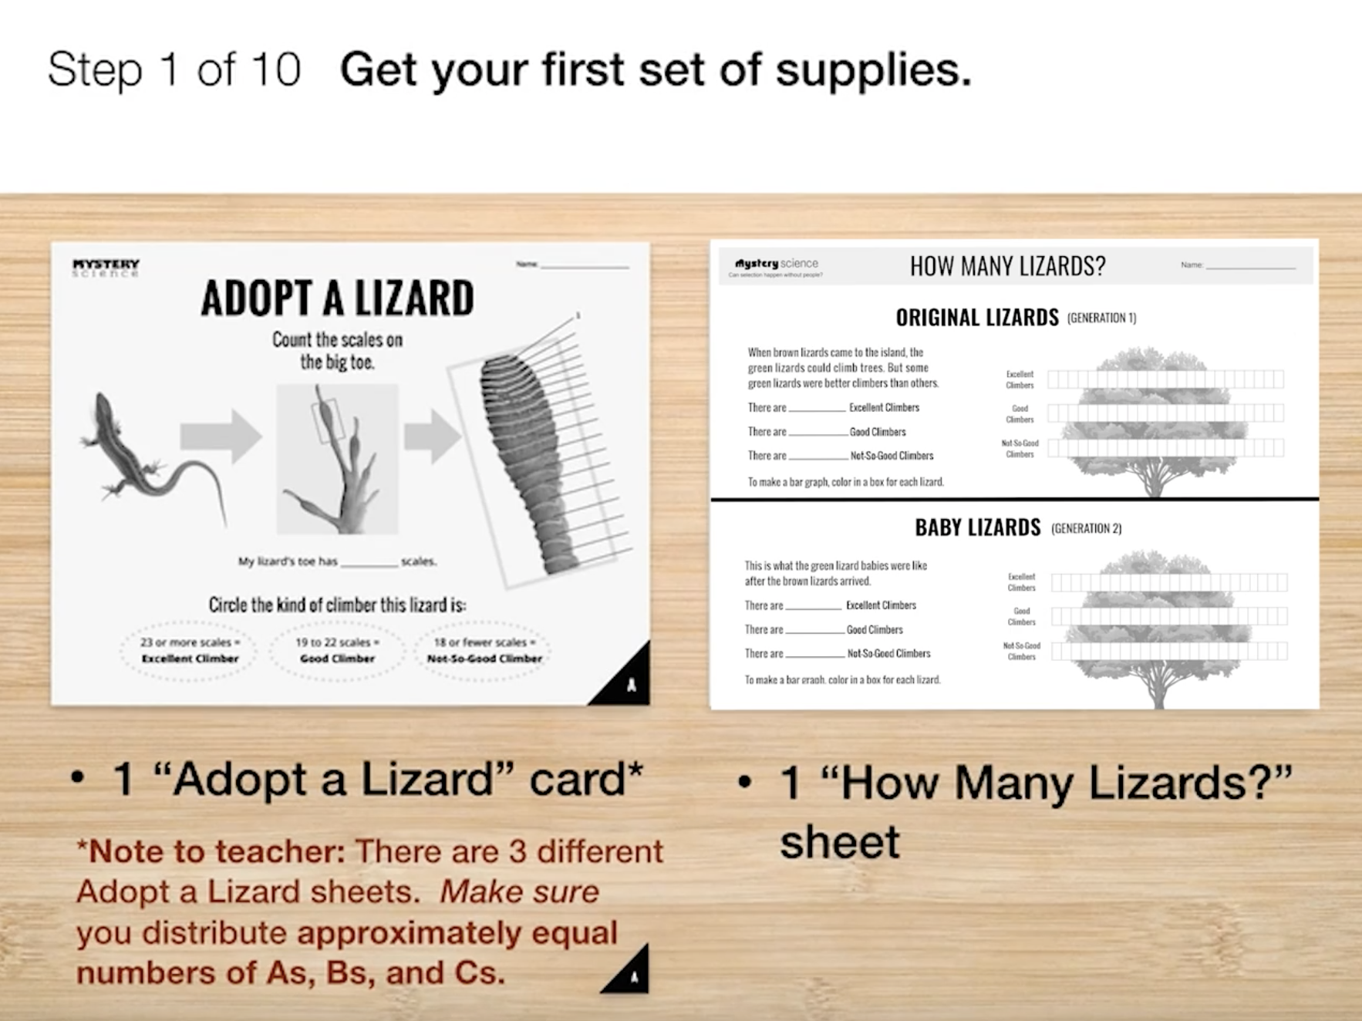
Heredity, Survival, & Selection • Grade 3
Anchor Layer Teacher Guide
Lesson 3: How could a lizard's toes help it survive? (pg 1 of 2)
Trait Variation, Survival, & Natural Selection
Overview
In this lesson, students explore how variation in the toe scales of green lizards provides some individuals with an advantage when it comes to climbing and surviving.
In the activity, Lizard Island, students participate in a simulation to explore what happens to these green lizards when a new species of brown lizards is introduced to their environment. Students gather evidence to explain how a change to the environment can cause a certain trait to become more common in a population over time through the process of natural selection.
Exploration 10 mins
Hands-On Activity 35 mins
Wrap-Up 15 mins
Anchor Connection 15 mins
Assessment 20 mins
Activity Notes
If you have a smaller group (between 1 to 15 students), you need to use the Small Group Version of this activity. This version has step-by-step activity instructions on the printout.
Don’t throw away extra adopt a lizard cards. There are three types of lizards in the activity simulation -- Not-So-Good Climbers, Good Climbers, and Excellent Climbers. It’s important that the simulation begins with an equal number of these lizard types. So, if the number of students in your classroom isn’t divisible by 3 (e.g. 28 students), then you will have a few extra Adopt A Lizard Cards printed out. Have students who finish quickly fill out these extra Adopt A Lizard cards.
Prep baby lizard cards. Each student needs a half sheet of the Baby Lizard Cards. Cut each Baby Lizard page in half before class.
‹#›

Slide 11
Heredity, Survival, & Selection • Grade 3
Anchor Layer Teacher Guide
Lesson 3: How could a lizard's toes help it survive? (pg 2 of 2)
Trait Variation, Survival, & Natural Selection
Anchor Connection
There can be a great deal of variation between the individuals of a single type of animal. This is true in terms of physical characteristics, such as height or color, as well as in terms of behavior. Within a single ant colony, different ants can exhibit different specific behaviors. This helps them survive, because it allows them to do different jobs and work together to support one another.
Students revise the explanation and/or drawing that they worked on during the Anchor Phenomenon. They should understand that different ants within a colony have different traits that make them better at doing different jobs. This helps them to survive.
Connecting Storyline Question
How can ants survive if they are all so small?
Exploration 10 mins
Hands-On Activity 35 mins
Wrap-Up 15 mins
Anchor Connection 15 mins
Assessment 20 mins
‹#›

Slide 12
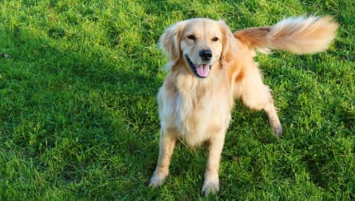
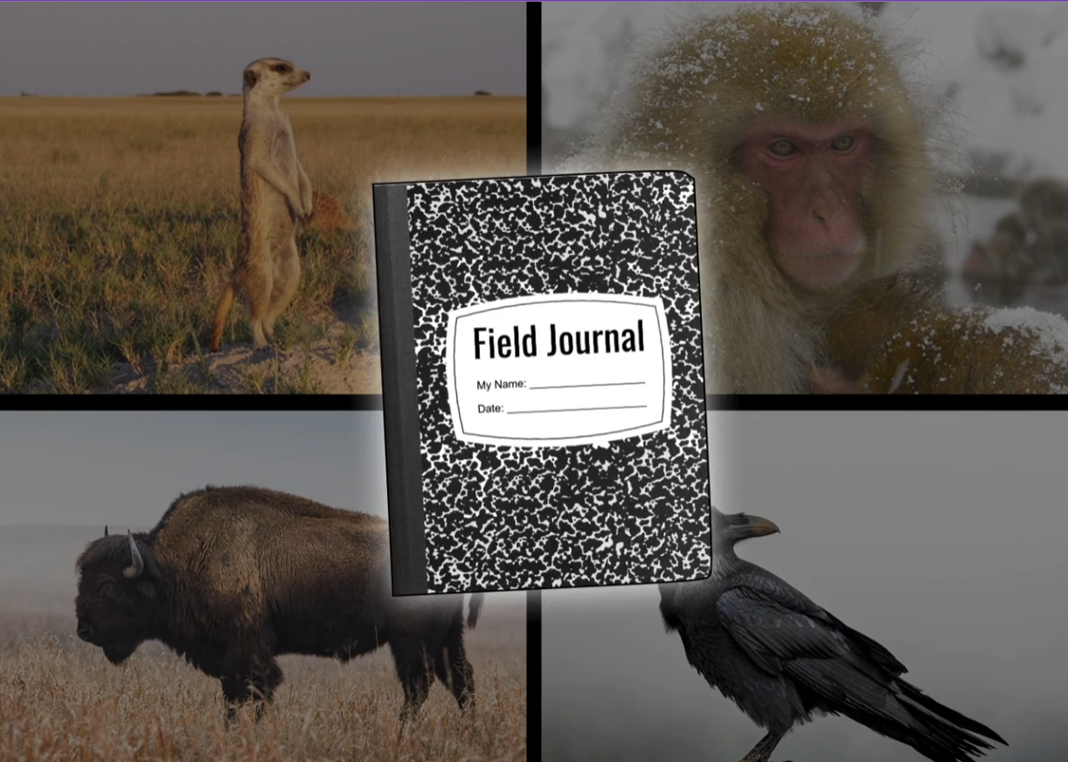

Heredity, Survival, & Selection • Grade 3
Anchor Layer Teacher Guide
Lesson 4: Why do dogs wag their tails? (pg 1 of 2)
Animal Groups & Survival
Overview
In this lesson, students discover why dogs’ expressions, like tail wagging, are so useful when living in a pack.
In the activity, Field Journal, students watch videos of different animals that live in groups to simulate observing them in their natural habitats. They discuss and record their observations, and construct an explanation of how living in groups helps these animals survive.
Anchor Connection on Next Page
Exploration 15 mins
Hands-On Activity 35 mins
Wrap-Up 5 mins
Anchor Connection 15 mins
Assessment 20 mins
Activity Notes
We suggest students work in table groups of four and share a stapler to construct their Field Journals.
The page numbers of the Field Journal will look scrambled on the printout, but when students fold them and make their booklets, the pages will be in order.
‹#›

Slide 13
Heredity, Survival, & Selection • Grade 3
Anchor Layer Teacher Guide
Lesson 4: Why do dogs wag their tails? (pg 2 of 2)
Animal Groups & Survival
Anchor Connection
Ants do many unique things to work together: they link together to stay afloat during floods, they build bridges with their bodies, and they swarm together to defend their homes. These are all examples of one of the key behaviors of all ants: they work together!
Students revise the explanation and/or drawing that they worked on during the Anchor Phenomenon. They should understand that ants work together in their colonies to do many different things to help them survive in the different places that they live. Students may explain the various examples of ant behavior that were shown within the lesson.
Connecting Storyline Question
Are scientists still studying ants?
Exploration 15 mins
Hands-On Activity 35 mins
Wrap-Up 5 mins
Anchor Connection 15 mins
Assessment 20 mins
‹#›

Slide 14
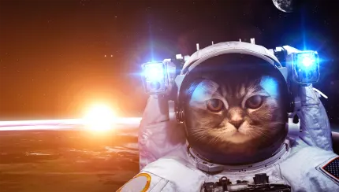
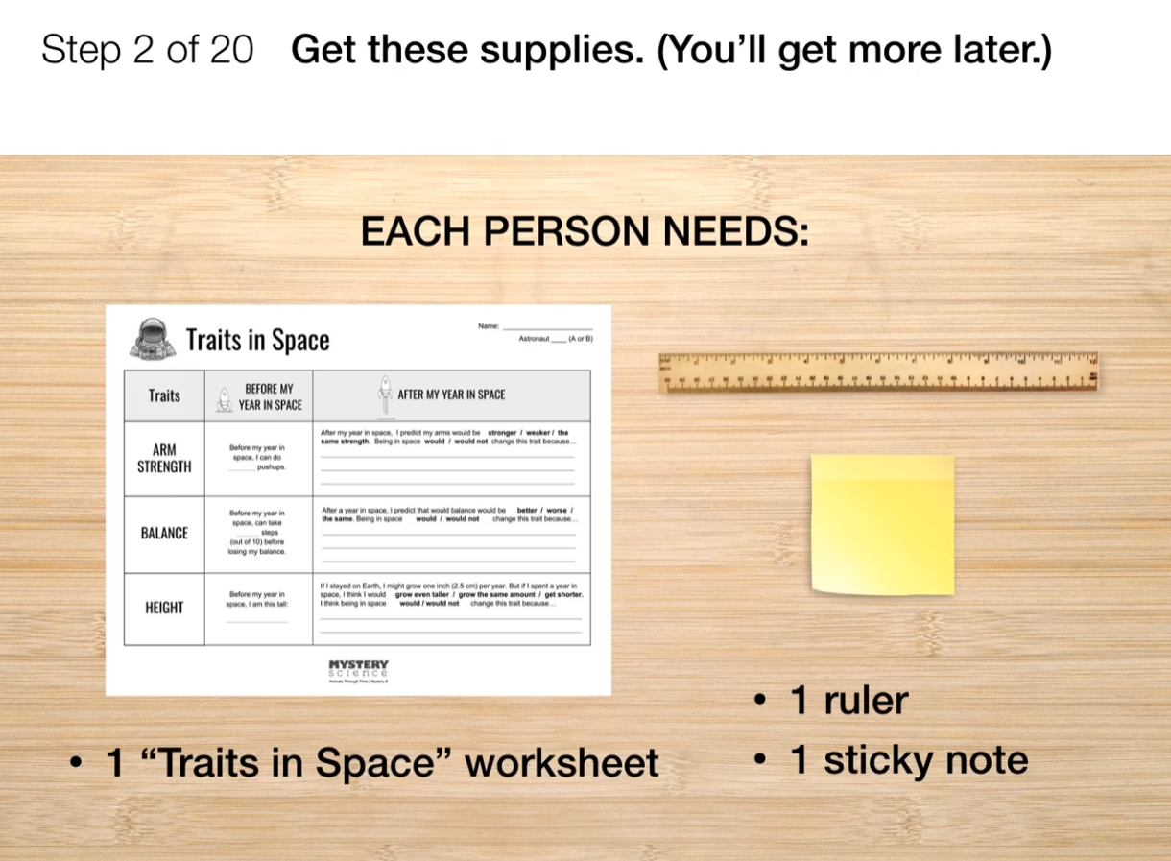
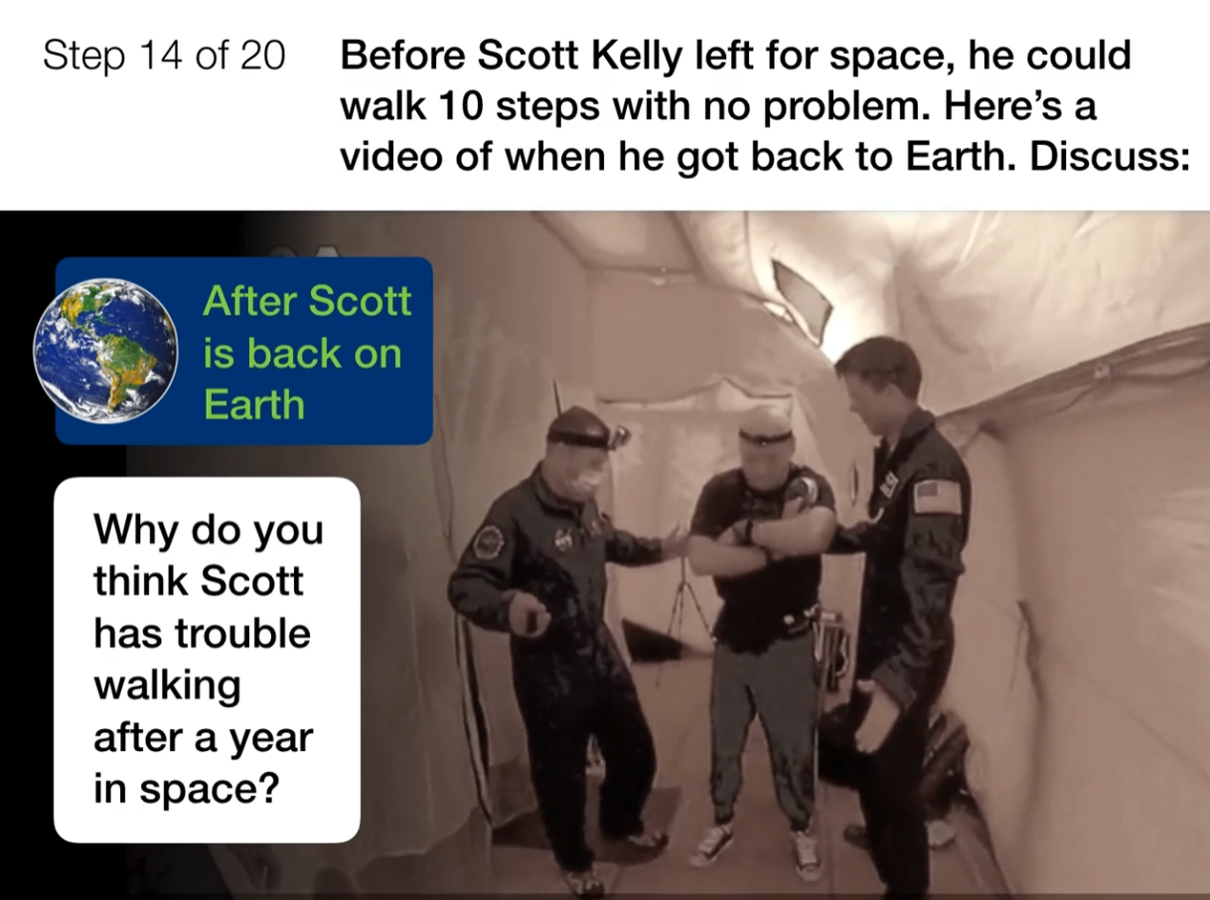
Heredity, Survival, & Selection • Grade 3
Anchor Layer Teacher Guide
Lesson 5: How long can people (and animals) survive in outer space?
Traits & Environmental Variation (pg 1 of 2)
Overview
In this lesson, students examine how physical traits can be influenced by the environment.
In the activity, Astronaut-in-Training, students analyze how a NASA astronaut’s traits changed during his “year in space.” Then they measure some of their physical traits (arm strength, height, and balance) and predict how their own traits might change after living in space.
Anchor Connection on Next Page
Exploration 16 mins
Hands-On Activity 35 mins
Wrap-Up 4 mins
Anchor Connection 15 mins
Assessment 20 mins
Activity Notes
We suggest students work in pairs.
Each pair of students will need floor space where they can do push-ups and walk 15 heel-to-toe steps in a straight line. They will also need wall space where they can do push-ups against the wall.
‹#›

Slide 15
Heredity, Survival, & Selection • Grade 3
Anchor Layer Teacher Guide
Lesson 5: How long can people (and animals) survive in outer space?
Traits & Environmental Variation (pg 2 of 2)
Anchor Connection
Human bodies have long been known to change after long periods of time in space. Scientists were curious about whether or not ant behaviors would change in space, too! Ant behavior is an active area of research that students may find engaging and interesting.
Students revise the explanation and/or drawing that they worked on during the Anchor Phenomenon. They should understand that ants are such incredible survivors that scientists are still trying to understand all of the different things that they do. This includes conducting experiments in space!
Students will be writing out ideas for things they would still like to learn about ants
Connecting Storyline Question
What happens when ants compete with other ants?
Exploration 16 mins
Hands-On Activity 35 mins
Wrap-Up 4 mins
Anchor Connection 15 mins
Assessment 20 mins
‹#›

Slide 16
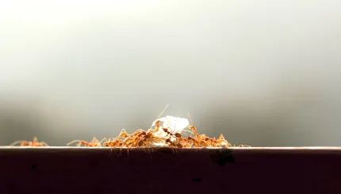
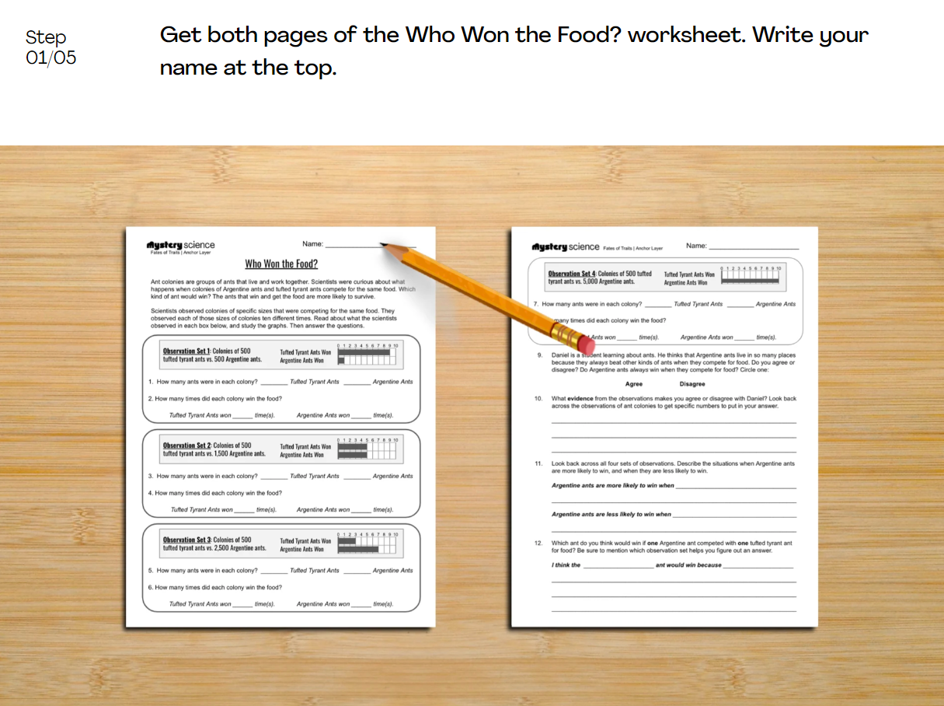
Heredity, Survival, & Selection • Grade 3
Anchor Layer Teacher Guide
Performance Task: Why do ants live in colonies?
Animal Groups & Survival
Overview
In this performance task, students will analyze data from competing ant colonies in order to construct an argument about how living in groups helps animals to survive.
After a review of the unit, students are introduced to one of the most successful kinds of ants: Argentine ants. Students will analyze data that was gathered from observations of Argentine ant colonies competing with tufted tyrant ant colonies. Based on that analysis, students will construct an argument about how living in groups helps animals to survive.
Unit Review 10 mins
Hands-On Activity 40 mins
Performance Task Notes
Students can work individually, in pairs, or you may choose to work with small groups. One copy of the Who Won the Food? worksheet will be needed for each individual, each pair, or each small group.
Crosscutting Concepts
Cause and effect: Different kinds of animals do many different things to survive. Ants in particular have a unique set of physical and behavioral characteristics. These characteristics are the cause that has the effect of ants being able to live in a wide range of habitats.
‹#›

