Slide 1
GRADE 2
Distance Learning Guide
Our recommendations for adapting Mystery Science lessons for socially distant classrooms and online distance learning.
We’ve assigned each lesson one of these labels:
Ready to Teach
These lessons have activities that only need minor modifications to eliminate partner work or shared supplies. For these activities, you can have students work solo without preparing extra supplies.
Adjust Supplies
Jump to a section:
Animal Adventures
4 lessons
Plant Adventures
5 lessons
Work of Water
5 lessons
Material Magic
6 lessons
Guide FAQs
Using Your Mystery Pack
These lessons also have activities that need small changes so students can work solo, but you’ll need to adjust the supply quantities. We suggest how to adjust the supplies.
Demo Activity
These lessons have activities that require coordinated partner work or messy materials, so we recommend demonstrating the activity for students. Students can make detailed observations.
Substitute Activity
These lessons have activities that require specialized materials or adult help. We suggest an alternative activity to do instead.
1

Slide 2
GRADE 2
UNIT Animal Adventures
View this unit here. | Teaching in the classroom | Teaching online
Lesson 1 How many different kinds of animals are there? | Have students do the activity solo. Print additional copies of the Animal Cards so that each student has a set. | Students can do the activity at home. Send each student home with a printed set of the Animal Cards.
Lesson 2 Why would a wild animal visit a playground? | Have students do the activity solo. No supply adjustments. | Students can do the activity at home. Send each student home with a copy of the Habitat Journal printout or assign the digital version.
Lesson 3 Why do frogs say “ribbit”? | Have students do the activity solo. No supply adjustments. | Students can do the activity at home. Send each student home with a copy of the Who’s Calling and Types of Frogs printout or assign the digital version.
Lesson 4 How could you get more birds to visit a birdfeeder? | Have students do the activity solo. No supply adjustments. | Students can do the activity at home. Send students home with a copy of the My Birdfeeder printout (or assign a digital copy). Send students home with supplies, or have them look in the recycling bin at home for materials to build a bird feeder.
Adjust Supplies
Ready to Teach
Ready to Teach
Ready to Teach
2

Slide 3
GRADE 2
UNIT Plant Adventures
View this unit here. | Teaching in the classroom | Teaching online
Lesson 1 How could a tree travel halfway around the world? | Have students do the activity solo. No supply adjustments. | Send supplies and printed templates home. Have students create a “Zone of Darkness” using construction or printer paper. Ask students to drop seed models from as high as possible, without standing on furniture.
Lesson 2 Could a plant survive without light? | We suggest you set-up the radish seed experiment as a classroom demo. Provide students with the Draw the Radishes printout so that they can record their observations. | Set up the activity and demonstrate over video conference. Send each student home with a copy of the Draw the Radishes printout so that they can record their observations.
Lesson 3 Why do trees grow so tall? | Show this time-lapse video of grass seeds growing. [5 seconds = 1 day in real time] Ask: “What happens in the dirt on Day 3 and Day 4? What happens on Day 5 and Day 6?” Have students draw what they notice. | Show this time-lapse video of grass seeds growing. [5 seconds = 1 day in real time] Ask: “What happens in the dirt on Day 3 and Day 4? What happens on Day 5 and Day 6?” Have students draw what they notice.
Lesson 4 Should you water a cactus? | Assign pages 4-14 in Prickly Plants, an Epic! digital book. Ask students: “Why do cacti have spines?” Ask them to draw their favorite cactus. | Assign pages 4-14 in Prickly Plants, an Epic! digital book. Ask students: “Why do cacti have spines?” Ask them to draw their favorite cactus.
Lesson 5 Where do plants grow best? | Have students do the activity solo. No supply adjustments. | Have students do the activity at home. Send each student home with a set of the printed Plant Cards.
Ready to Teach
Demo Activity
Substitute Activity
Substitute Activity
Ready to Teach
3

Slide 4
GRADE 2
UNIT Work of Water
View this unit here. | Teaching in the classroom | Teaching online
Lesson 1 If you floated down a river, where would you end up? | Have students do the activity solo. You will need 2x as many supplies as the lesson supply list suggests. | Send each student home with printed templates, paper, marker and 4 stickers. Note: Students need a spray bottle (or a way to spray water) on their mountain models.
Lesson 2 Why is there sand at the beach? | Have students do the activity solo. Each student will need three sheets of construction paper and a printed copy of the Rocking the River template. | Send each student home with 3 sheets of construction paper and a printed copy of the Rocking the River template (a digital version will not work).
Lesson 3 Where do flash floods happen? | Have students do the activity solo. Provide students with the Texas Explorer and Flash Flood Finder printout to record their observations. | Have students do the activity solo. Provide students with the Texas Explorer and Flash Flood Finder printout to record their observations.
Lesson 4 What’s strong enough to make a canyon? | We suggest setting up a few cornmeal mountains and demoing the activity. Provide students with the How Did Water Change Your Land? printout to record their observations. | Set up the activity and demonstrate over video conference or record and share. Provide a copy of the How Did Water Change Your Land? printout for students to record their observations.
Lesson 5 How can you stop a landslide? | Set up a few cornmeal mountains as a model. Demo a few student ideas. Provide a copy of the Save the Hills worksheet for students and have them draw their engineering solutions instead of building their own. | Set up the activity and demonstrate over video conference or share a recording. Provide a copy of the Save the Hills worksheet for students and have them draw their engineering solutions instead of building their own.
Adjust Supplies
Adjust Supplies
Ready to Teach
Demo Activity
Demo Activity
4

Slide 5
GRADE 2
UNIT Material Magic
View this unit here. | Teaching in the classroom | Teaching online
Lesson 1 Why do we wear clothes? | Have students do the activity solo. You’ll need enough cups and spoons so that every student has one of each. | Send students home with supplies or ask them to find materials at home to construct their hat. Provide a copy of the Mad Hatter printout.
Lesson 2 Can you really fry an egg on a hot sidewalk? | Read or assign the Epic! book Do You Really Want to Burn Your Toast?. Review the vocabulary words insulate and conduct. Ask students to draw an invention that will insulate ice cream on a hot day. | Read or assign the Epic! book Do You Really Want to Burn Your Toast?. Review the vocabulary words insulate and conduct. Ask students to draw an invention that will insulate ice cream on a hot day.
Lesson 3 Why are so many toys made out of plastic? | Set up the containers of warm water and demonstrate each step of the activity. Students can record observations on the Testing Candy for Camp-Way-Too-Hot printout. | Set up the activity and demonstrate over video conference or share a recording. Give students the Testing Candy for Camp-Way-Too-Hot printout to record their observations.
Adjust Supplies
Substitute Activity
Demo Activity
5

Slide 6
GRADE 2
UNIT Material Magic
View this unit here. | Teaching in the classroom | Teaching online
Lesson 5 Could you build a house out of paper? | Have students do the activity solo. No supply adjustments. | Send each student home with 20 index cards and 16 paper clips. Send home the Paper Towers printout (or assign the digital version).
Lesson 6 How do you build a city out of mud? | Set up the three soil models and demonstrate each step of the activity. Students can record observations on the Mystery Mud Tester printout. | Set up the three soil models and demonstrate over video conference or share a recording. Give students the Mystery Mud Tester printout to record their observations.
Ready to Teach
Demo Activity
6

Slide 7
GRADE 2
Guide FAQs
Additional recommendations for using this guide to adapt Mystery Science for socially distant classrooms and online distance learning.
Where should I start?
Animal Adventures is the easiest Grade 2 unit to adapt for distance learning, so we recommend starting with that unit.
What does it mean when the guide says students can work “solo”?
Our lessons are designed to get students talking and working together, but group work and sharing supplies is not advised at present. So, when we mention students working “solo,” we mean that students can work independently at home or in the classroom, without partners or sharing supplies.
Where can I find all of the printouts for the Grade 2 units?
To easily make packets of printouts for students, you can find all the printouts for each grade level here.
What if I skip some of the lessons in a unit?
If you omit lessons, we recommend reviewing the Grade 2 Planning Guide to see the concepts and standards covered in those lessons.
Will students need any additional supplies for the activities?
This guide lists the specialized supplies students need for each activity, but general classroom supplies (such as pencils, scissors, crayons, markers, and rulers) are not listed. We suggest checking the lesson supply lists to know which general supplies students will need.
7

Slide 8
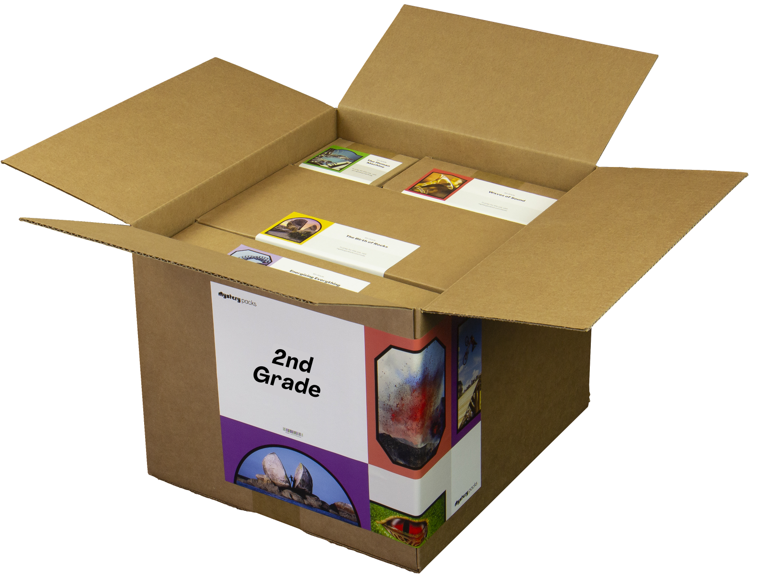
GRADE 2
Using Your Mystery Pack
Mystery Packs are supply kits that contain all the materials needed to teach Mystery Science for the entire year. Each box contains supplies for a class of 30 students.
Does my Mystery Pack contain enough supplies to send home?
For activities labeled Ready to Teach, there are enough supplies in your box for each student to have their own materials. For activities labeled Adjust Supplies, you’ll need some extra materials so that students can work on their own without sharing supplies.
What if I can’t send supplies home to students?
If students don’t have access to supplies, you can turn some activities into demonstrations and share via video conference. Students can participate by recording their observations.
What if I don’t use all of my supplies this year?
Don’t worry! You can still use your Mystery Pack next school year. You’ll just need to refill any supplies that you do use this year.
I don’t have a Mystery Pack. Can I still order one?
Yes! Packs are still available for purchase. You can learn more about Mystery Packs and how to get them here.
8

